Slide 1
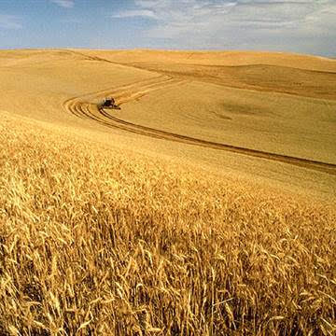
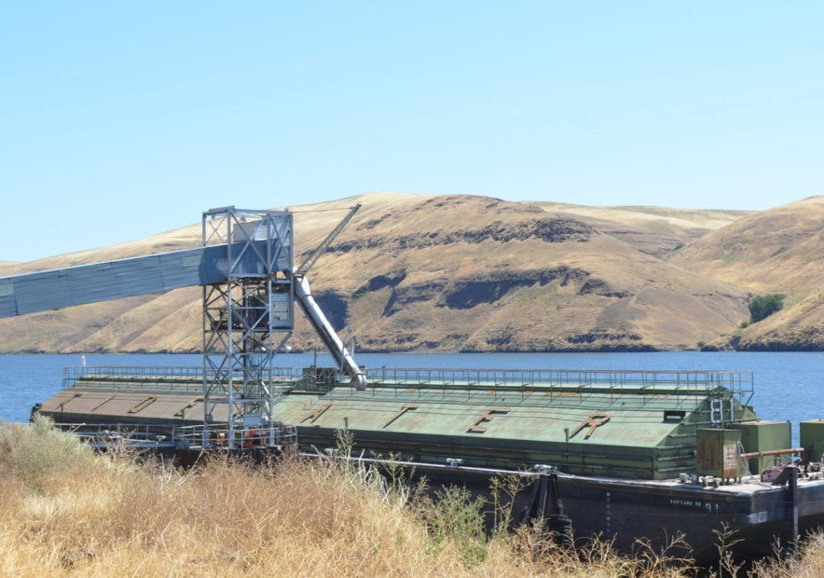
New Perspectives
Freight Transportation on the Lower Snake River
By Linwood Laughy January 2020

Slide 2
50+ Years of Contention
Pacific Northwesterners have contentiously debated the benefits, costs and damaging effects of the four lower Snake River dams since before their construction in the 1960s and 70s.

Slide 3
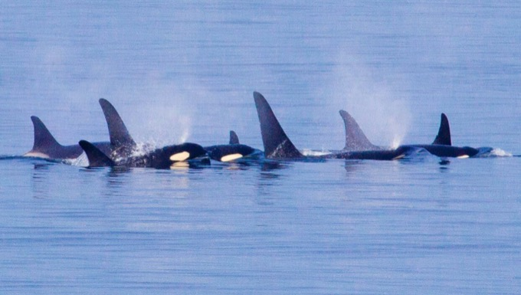
The looming extinction of Southern Resident Killer Whales and collapsing Snake River salmon and steelhead runs have recently brought this simmering debate to a boil.

Slide 4
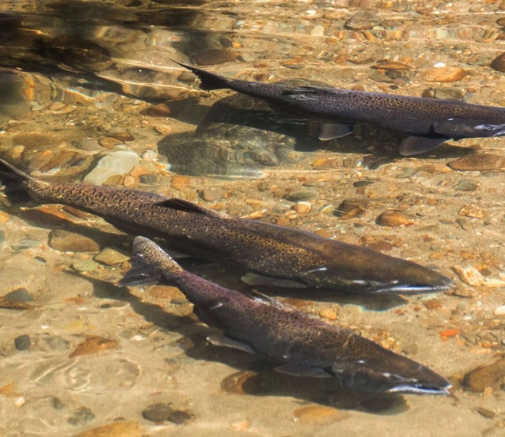
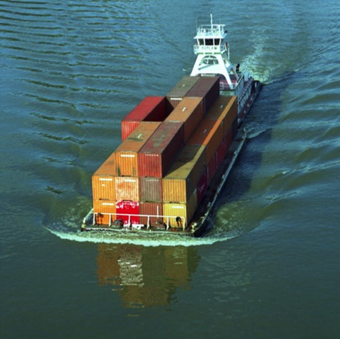
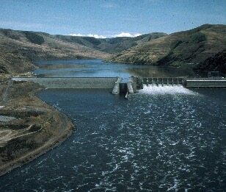
Three major elements define the debate:
Freight transportation
Hydropower
Snake River ESA-listed threatened and endangered salmon and steelhead.
This presentation focuses on freight transportation.

Slide 5
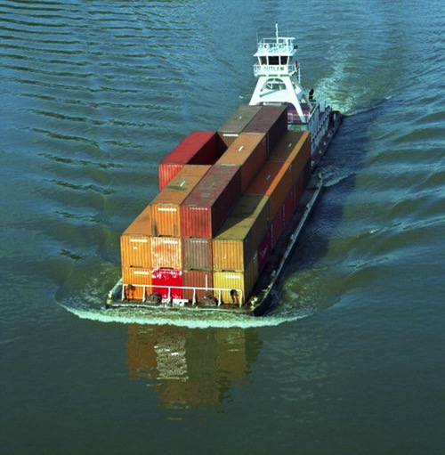
Beginning in 2000, freight volume transported on the lower Snake River declined dramatically as demonstrated in the following graphs.

Slide 6
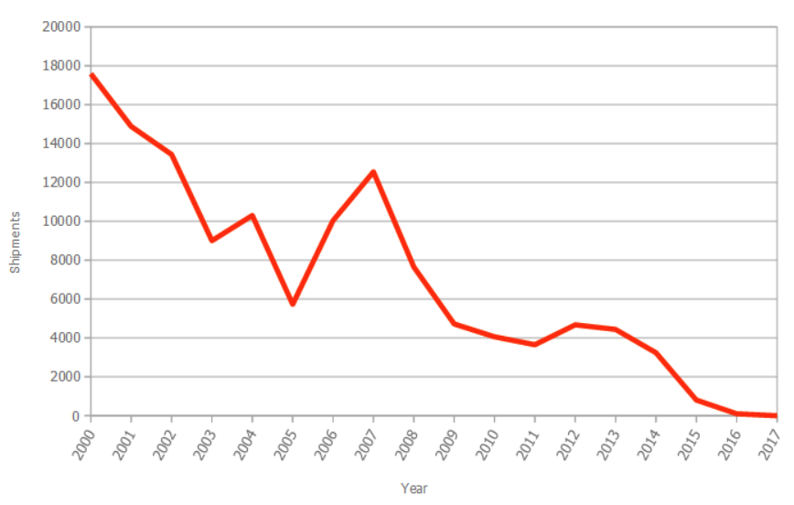
Snake River Container Shipments by TEU*
In 2000, the Port of Lewiston barged 17,590 TEUs of containerized freight.
In 2017, container-on-barge shipping hit zero.
This decline began long before the Port of Portland closed its container operations in 2015.
The probability of container shipping returning to the Lower Snake River is near zero.
2000-2017
*TEU refers to a twenty-foot equivalent unit. Most containers are 40 ft. long, or 2 TEUs. The Port of Lewiston was the only container shipper on the lower Snake River.

Slide 7
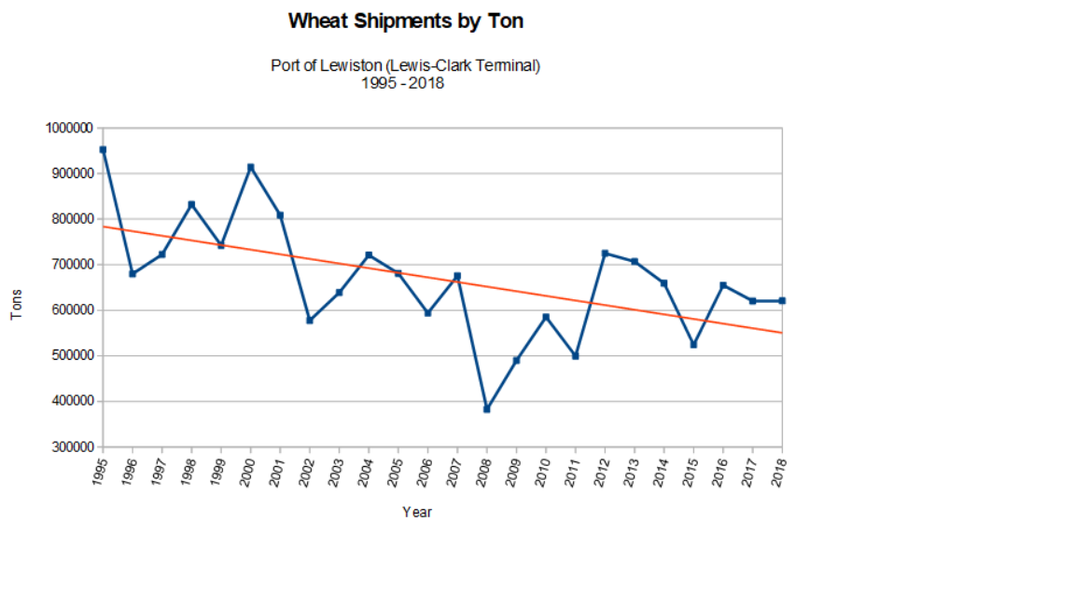
1995-2018 Port of Lewiston wheat shipments by barge have been declining for 20+ years.
In 1995 the Port of Lewiston shipped 952,599 tons of wheat on the lower Snake River. By 2018 wheat volume from Lewiston had decreased by 332,013 tons, a drop of 35%.
Today all wheat at the Port of Lewiston is shipped by a private corporation from its own property over its own docks.
A gradual shift from barge to rail continues with the construction of unit-train loaders such as the one near the Idaho/Washington border at Oaksdale, WA and the new loading facility at Endicott, WA.

Slide 8
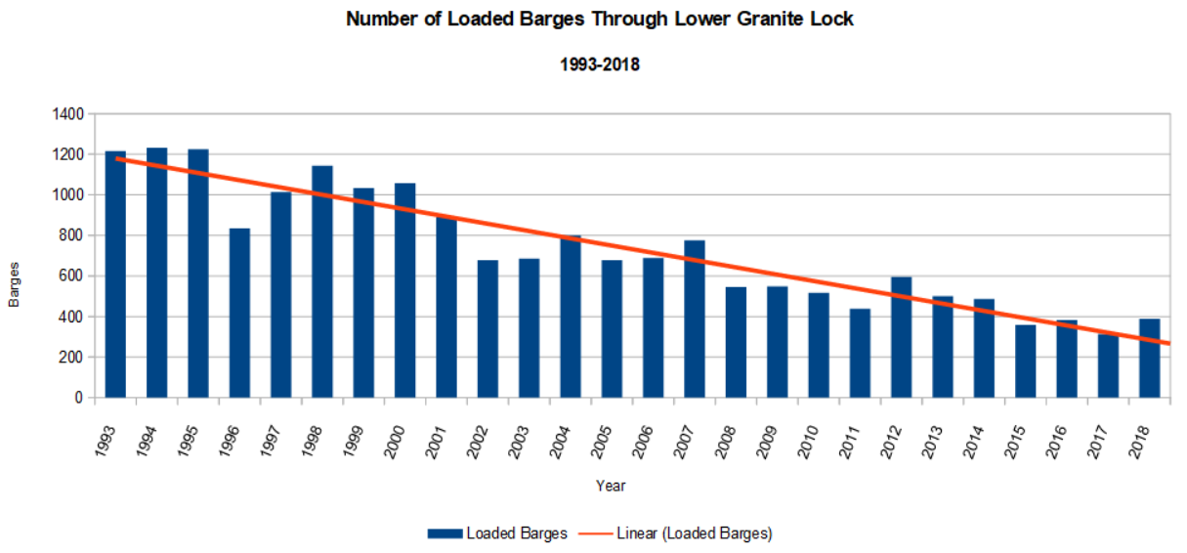
Barge numbers through Lower Granite Lock continue a 25-year slide.
Number of Loaded Barges through Lower Granite Lock
(1993-2018)
All waterborne freight to and from the Ports of Lewiston ID, Clarkston WA, and the Port of Wilma (Whitman County, WA) passes through the lock at Lower Granite Dam.
In 1994, 1,233 loaded barges were locked through Lower Granite.
The number of loaded barges in 2017 was 314, a decline of 75%!
The number of loaded barges through Lower Granite has declined from an average of 3.4 barges per day to only 1 barge per day.

Slide 9
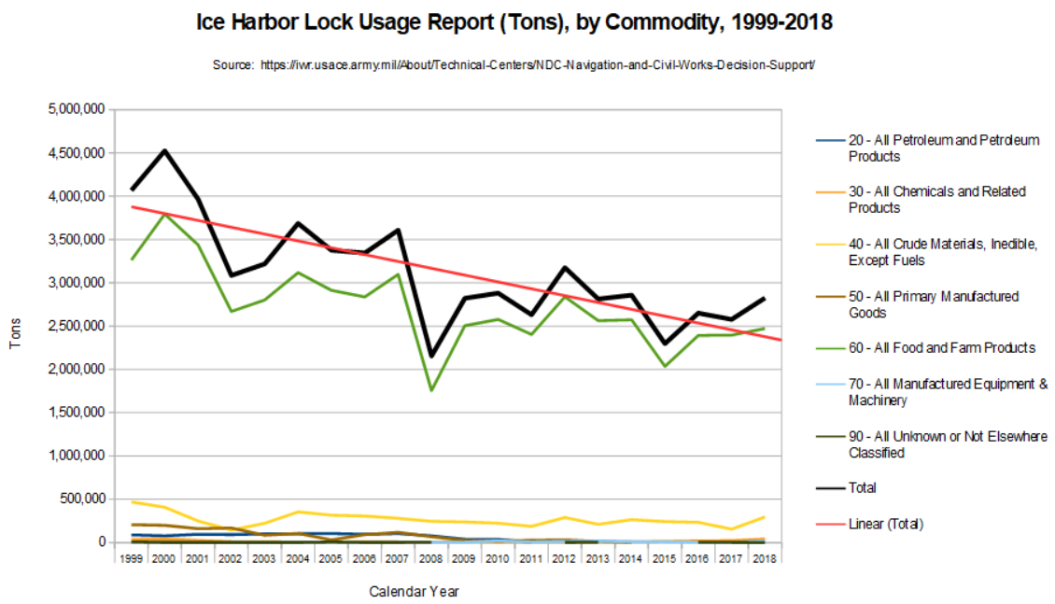
Total freight volume over the past four years averages 2.64 million tons, a decline of over 40% since the year 2000.
The lower Snake River no longer transports paper, pulp, petroleum, pulse (lentils, peas and soy beans), logs or lumber.
Grain accounts for over 90% of all freight shipped on the lower Snake River (green line).
Grain shipping has experienced a similar rate of decline as more grain growers shift to rail.
Lower Snake River Freight Decline*
*Freight locked through Ice Harbor Dam provides the most accurate measure of freight volume on the Lower Snake River Project (the 4 dams and their respective reservoirs). Freight shipped to the Port of Pasco, notably petroleum, travels a short distance on the Snake River but does not cross any LSR dam.

Slide 10
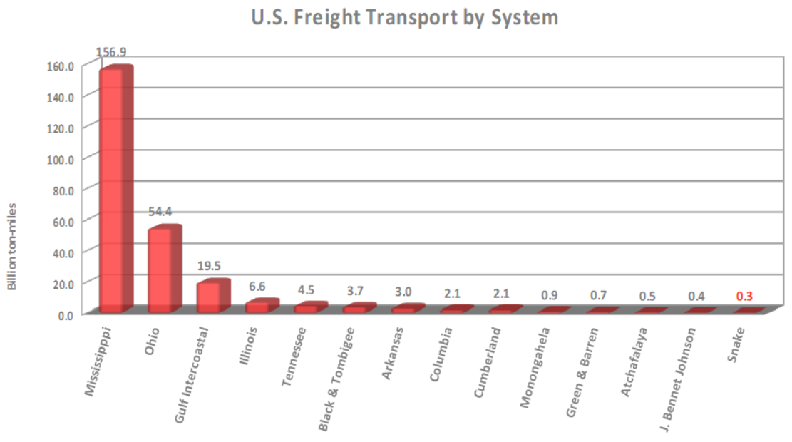
Relative Importance of Rivers on U.S. Inland Waterways
U.S. Freight Transport by System
The Corps of Engineers classifies rivers by the number of ton-miles of freight a river carries each year. A ton-mile is defined as one ton of freight traveling one mile.
High use rivers transport 3+ billion ton-miles annually.
Moderate use rivers transport 1-3 billion ton-miles.
Low use rivers transport less than one billion ton-miles.
The lower Snake River dams and reservoirs transport the next to the lowest freight volume among 17 rivers in the Inland Waterways System.
In the years 2014-2016, the annual average freight volume on the Lower Snake River totaled 0.28 billion ton-miles.
If this volume of freight tripled, the river would still be classified as a low use river.
Billion Ton-Miles

Slide 11
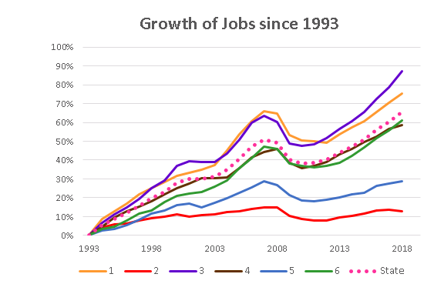
Waterborne Freight Transportation: A Failed Promise
From 1993-2018, Idaho statewide job growth was 66%. Job growth in Region 2 over the same period was 13%.
The next lowest region’s job growth was more than twice that of Region 2. Job growth in the other 4 regions ranged from 59% to 87%.
In 2008, Region 2 averaged 42,645 employed workers. For 2018 the region averaged 41,858 employed workers, a net loss of 787 jobs.
Region 2 is the only region in Idaho that has not recovered from the 2008 great recession.
Lewiston is the principal city in Region 2, north-central Idaho, represented by the bottom dark orange line.
Lewiston has Idaho’s only port.

Slide 12
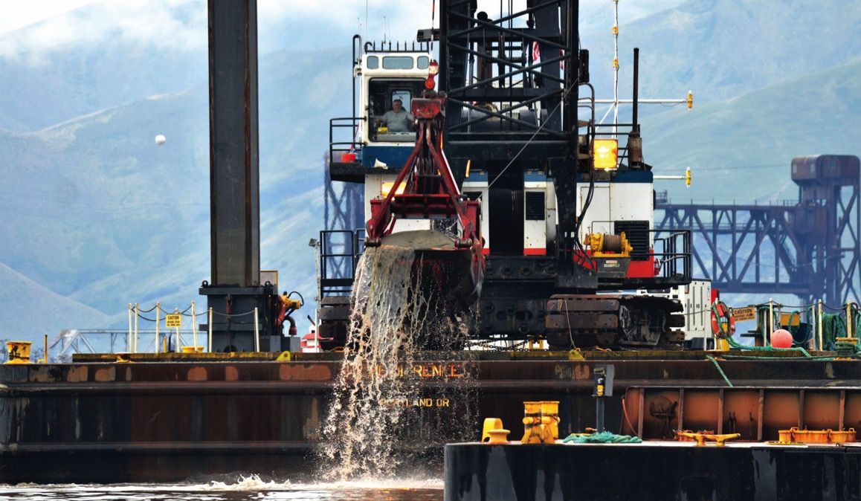
Freight volume continues to decline. Taxpayer costs continue to rise.
Estimated Tax Payer Costs:
$15 Million annually for lock operations and maintenance.
$2 Million annually for Clearwater and Snake sediment management ($30+ million since 2004).
$5+ Million annually for navigation’s share of Lower Snake River fish and wildlife costs.
$3+ Million annual average for costs of major lock and dam rehabilitation work.

Slide 13
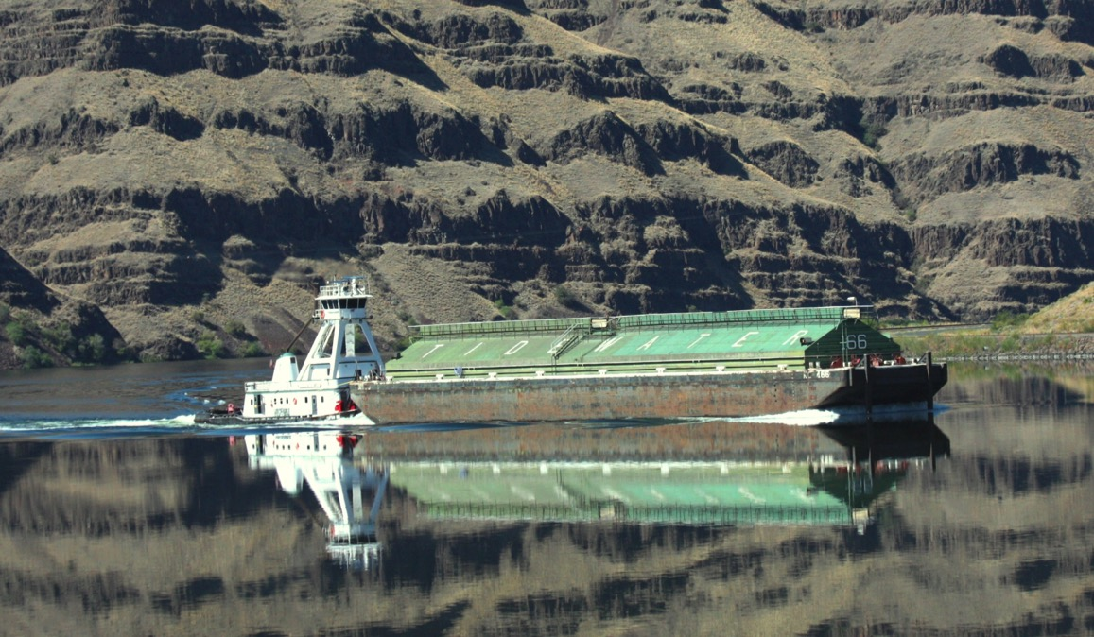
The lower Snake River navigation channel is paved with taxpayer subsidies .
A conservative estimate of total annual taxpayer cost for freight transportation on the lower Snake River is $25 Million.
Total freight volume on the LSR project over the last few years averages 2.73 million tons.
A barge carries 3,500 tons.
Thus on top of each barge of grain transported on the Lower Snake River sits a taxpayer subsidy of at least $30,000.

