Slide 1
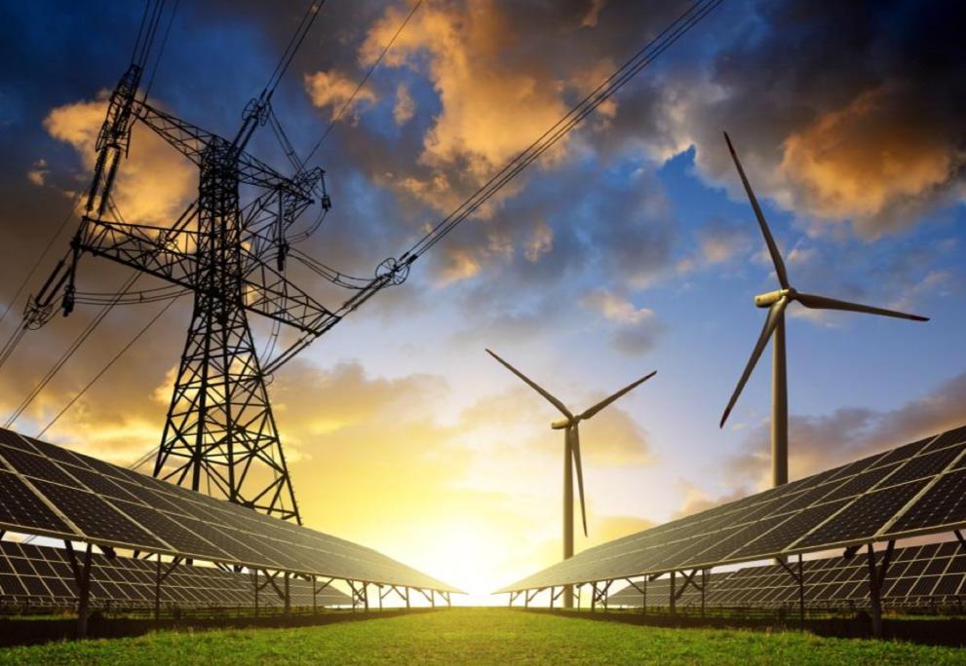
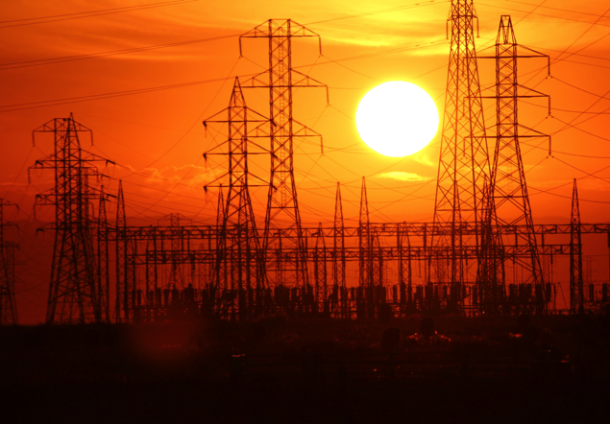
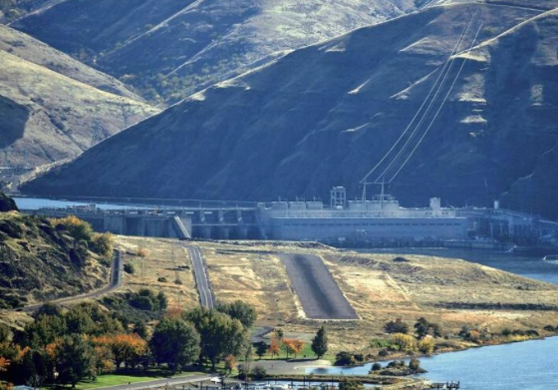
New Perspectives
Lower Snake River Hydropower
By Linwood Laughy
May 2019

Slide 2
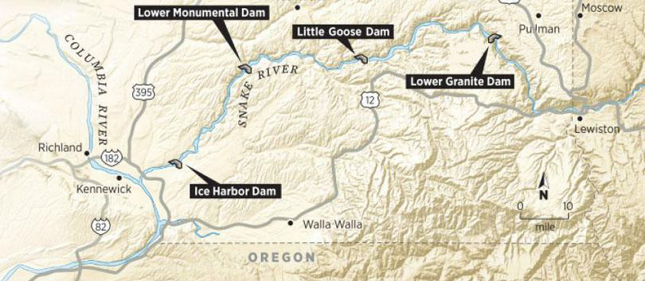
50+ Years of Contention
Pacific Northwesterners have contentiously debated the benefits and damaging effects of the four lower Snake River dams since before their construction in the 1960s and 70s.

Slide 3
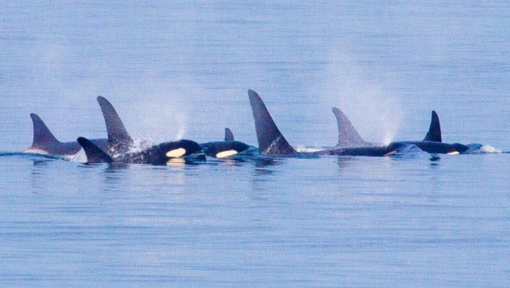

The looming extinction of
Southern Resident Killer Whales and collapsing Snake River salmon and steelhead runs have recently brought this simmering debate to a boil.
This presentation focuses on hydropower.

Slide 4
The four LSR dams combined produce less than 4% of the Pacific Northwest’s power supply.
Projected regional load for operating year 2020 is 23,906 average Megawatts (aMW).
Projected generation in OY 2020 under critical water conditions is 28,820 aMW, leaving a surplus of 3,950 aMW, four times the average production of the LSR dams combined.
If all four LSR dams were breached, the region would still have an energy surplus.

Slide 5
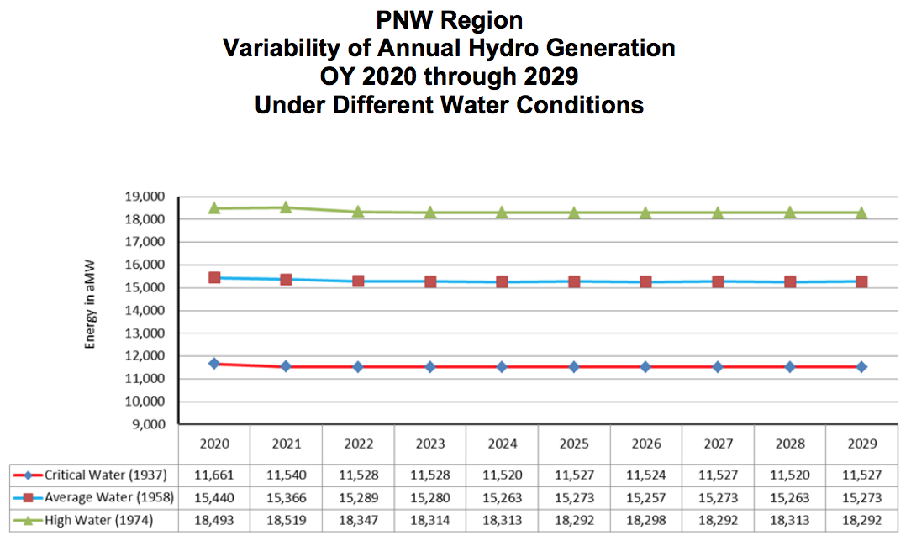
Critical water 1937 represents the lowest recorded river flow; 1958 flows represent an average water year; 1974 provides an example of a high water year.
BPA uses 1937 water levels in its energy forecast, understating the volume of surplus power that will likely be available much of the year.
The amount of hydropower generated in a given operating year depends on the volume of water available in the rivers.

Slide 6
Pacific Northwest Surplus Energy Relative to the LSR Dams
1958 Water Year
Compared to an average water year, a high water year would produce another 3,127 aMW, more than 3 times the average output of all four LSR dams.
The use of critical water year 1937 for power projections consistently underestimates the amount of surplus energy in the PNW.
During an average water year PNW surplus energy increases by an estimated 3,779 aMW, four times the average output of all four lower Snake River dams.

Slide 7
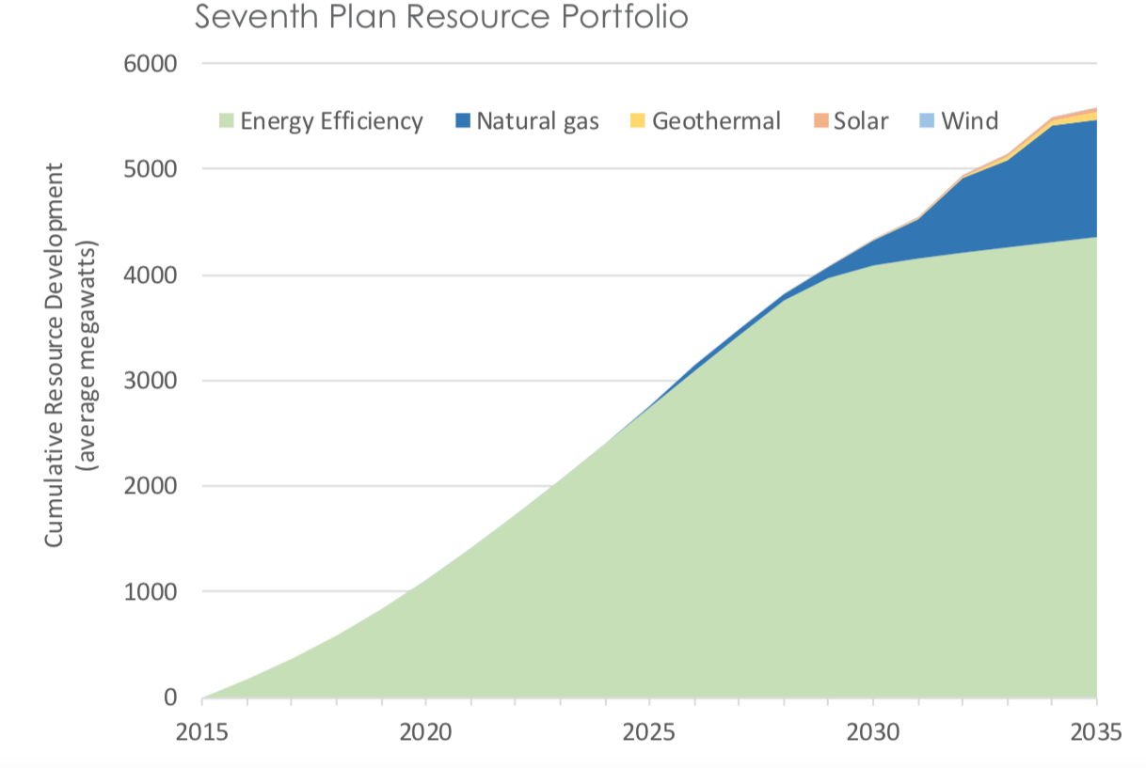
By 2020 the NWPCC projects additional power resulting from efficiency gains will be 1000 aMW, equal to the annual output of 4 LSR dams.
By 2030 NWPCC projects energy efficiency alone will have saved 4,000 aMW, the equivalent output from 16 LSRDs.
The Northwest Power & Conservation Council projects increased efficiency will meet future growth in Northwest load demand.

Slide 8
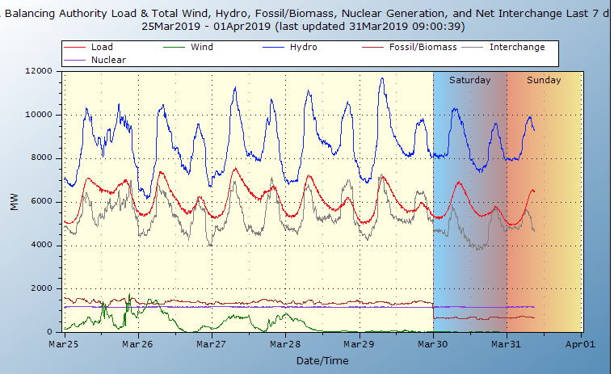
BPA Seven Day Load and Resource Balance
In the March dates depicted in this graph, BPA’s combined power generation is approximately twice as great as its contracted power demand.
During spring run-off, surplus power will increase significantly, causing BPA to shut down or reduce wind and other power sources through its Oversupply Management Protocol. BPA sometimes is forced to sell surplus power at negative prices.
March 2019 seven day BPA power generation : from top, hydropower in blue, load demand in red, surplus in gray; wind in green, nuclear in cobalt; fossil/biomass in brown.
BPA historically relied on the sale of surplus energy for an important part of its revenue stream.

Slide 9
Prior to 2009 the price of surplus power averaged around $60 per Megawatt hour (MWh).
Since 2009 the average price for surplus power has been about $22 per MWh.
When surplus power sold for $60 MWh, power from the LSRDs had an annual market value of $506 Million. That amount of energy in today’s surplus market would earn $186 Million, representing a projected drop in revenue of $320 Million.
C0B stands for the California-Oregon Border energy market, which is available to the public at no cost. COB prices closely mirror the prices on the Mid-Columbia C energy market which are available only through subscription.
Dramatic change is underway in the Pacific Northwest and West Coast energy markets.
“We’ve taken huge hits in the secondary revenues market, with cheap gas, low load growth, and the oversupply conditions. It’s been a bloodbath for folks in the wholesale market” – Elliot Mainzer, Administrator BPA

Slide 10
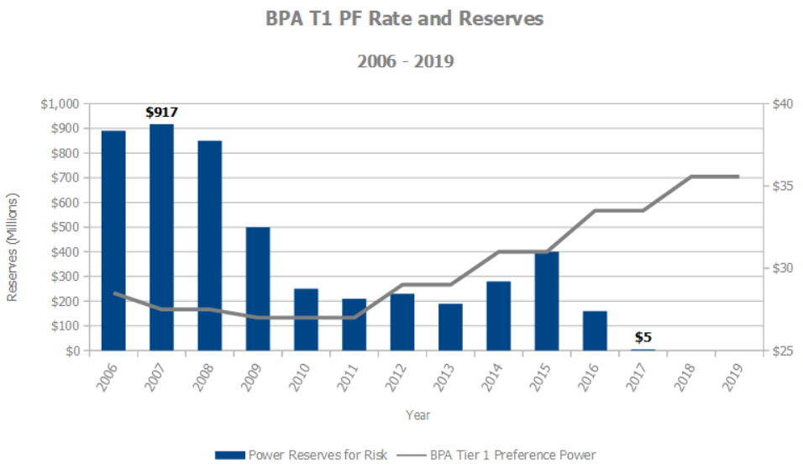
Beginning in 2008, BPA responded to its loss of revenue by drawing down its fiscal reserves, from $917 million in 2007 to just $5 million in 2017.
Beginning in 2011, BPA began raising the price of power for its contracted Tier 1 customers. Price increases totaled 30% over a period of eight years.
Declining prices for surplus energy have created a fiscal crisis for BPA

Slide 11
Public Utility Districts (PUDs) that purchase BPA power are under contract until 2028.
BPA currently charges $35.57 per MWh for firm (guaranteed) power.
If BPA is unable to offer power at a competitive price, PUDs will reduce their power purchases from BPA or not renew their contracts at all.
BPA’s loss of revenues from the sale of surplus energy force the federal agency to raise its price. The agency’s 2018-2023 strategic plan calls for BPA to sell more surplus power at higher prices into a falling market.
.

Slide 12
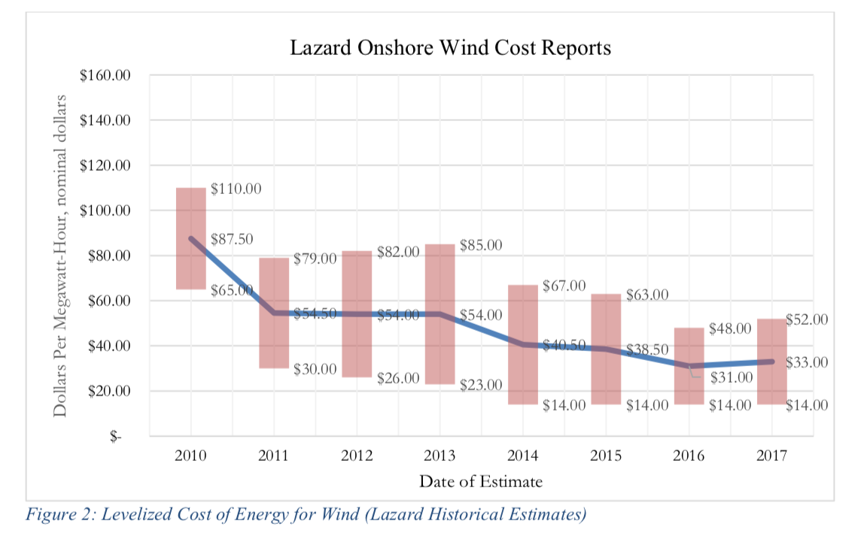
Pacific Northwest wind power produces nearly 3 times the output of all four LSRDs combined.
New wind power projects in Montana are predicted to reach 5,000 aMW by 2030.
The Wheatridge project near Pendleton, Oregon will include 292 turbines with a peak capacity of 500 aMW. This project combines wind, solar and battery backup to offer firm power at competitive pricing.
Declining 62% in price since 2010, wind power is now cost competitive with BPA’s rate for firm contracted power.

Slide 13
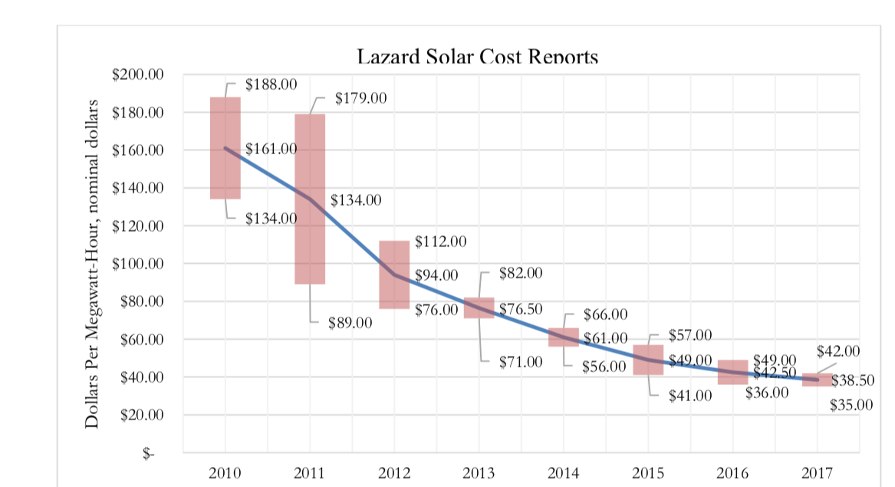
Between 2018 and 2023 California, once a major market for BPA’s surplus power, intends to add 14,037 aMW of new solar energy. Beginning in 2020, all new homes in California must include solar energy.
BPA’s Connection Queue for its transmission grid now includes 16,054 aMW of solar energy. Gaining access to the grid is the first step in many potential projects.
Idaho Power Company recently signed a long-term contract to purchase 120 aMW at a price of $21.75 per megawatt hour.
From 2010-2017 the average price of solar energy declined by 76% to $38.50 per MWh.
Notes:
Present 16

Slide 14
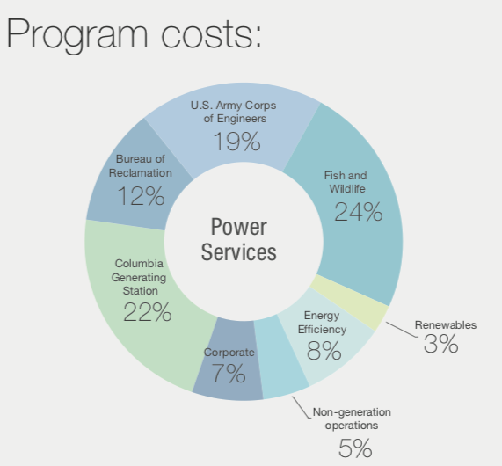
Since 2001 the Army Corps of Engineers has spent at least $1.8 Billion on “structural improvements” to lower Snake and Columbia River dams in an attempt to increase juvenile fish survival. Overall survival rates have shown little change.
After 20 plus years and a cost of over $15 Billion, no Columbia or Snake River threatened or endangered salmon or steelhead species is on a path to recovery.
From 2008 to 2017 BPA’s cost for Fish and Wildlife mitigation in the Columbia Basin averaged $727 Million per year, or about 24% of BPA’ annual budget.

Slide 15
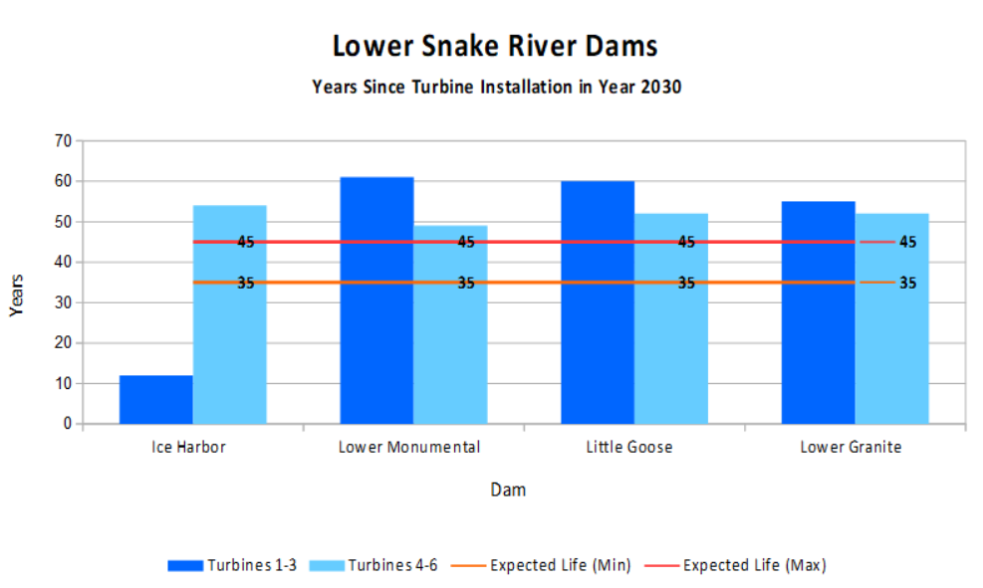
In its FY2016-2030 Hydro Asset Strategy for Large Capital Forecast, BPA budgeted approximately $42 Million per turbine for rehabbing 14 turbines at the McNary Dam on the Columbia River.
This same Capital forecast includes only $2.8M-$3.0M per year for turbine reliability at Little Goose, Lower Granite, Lower Monumental and Ice Harbor dams.
The estimated cost after 2030 to rehab 21 turbines in the LSRDs exceeds $1 Billion.
Current and projected market conditions make highly improbable that these turbines will ever be rehabbed.
The Corps of Engineers projects the design life of LSRD turbines at 35-45 years.
By 2030, 9 LSRD turbines will be over 60 years of age, and 12 more turbines will be between 50-60 years old.
Notes:
Present 17

Slide 16
In Conclusion
Bonneville Power Administration is $15 Billion in debt and in the last 10 years has burned through over $900 Million of financial reserves.
BPA faces major recurring costs for fish mitigation as Snake River threatened and endangered salmon and steelhead species slide toward extinction.
BPA’s aging hydropower assets will require ever greater amounts of costly repairs and thus major capital investments.
On May 1, 2019 Moody’s Investment Service downgraded BPA’s investment rating from stable to negative.
In 2028, BPA’s long-term contracts with most or all of 135 Public Utility Districts come to an end. If BPA is unable to offer competitive pricing —by 2023, according to the agency’s top administrator—BPA’s captive customers will find other sources for part or all of their energy needs.
Idaho Congressman Mike Simpson recently told a reporter with Boise’s KIVITV “The Bonneville Power Administration is going broke. I don’t know what other word to use.”
Notes:
Present 18

Slide 17
Sources
Slide 1: | Mike Mislos, BitPinas, LA Solar Group
Slide 2: | Four Lower Snake River Dams, Molly Quinn, The Spokesman Review
Slide 3: | Betsey Thoennes (Salmon and Orca)
Slide 4: | PNW Region Firm Regional Loads by Customer Class, BPA White Book, Bonneville Power Administration PNW Region Generation by Resource Type, BPA White Book, Bonneville Power Administration Dataquery 2.0, U.S. Army Corps of Engineers
Slide 5: | PNW Region Variability of Annual Hydro Generation, BPA White Book, Bonneville Power Administration 2018 Pacific Northwest Loads and Resources Study, BPA White Book, Bonneville Power Administration
Slide 6: | PNW Region Firm Regional Loads by Customer Class, BPA White Book, Bonneville Power Administration PNW Region Variability of Annual Hydro Generation, BPA White Book, Bonneville Power Administration PNW Region Generation by Resource Type, BPA White Book, Bonneville Power Administration Dataquery 2.0, U.S. Army Corps of Engineers
Slide 7: | Seventh Northwest Conservation and Electric Power Plan, Northwest Power and Conservation Council
Slide 8: | BPA Balancing Authority Load and Total Wind, Hydro, Fossil/Biomass, Nuclear Generation, and Net Interchange, Near-Real-Time, Bonneville Power Administration Oversupply, Bonneville Power Administration
Slide 9: | The Bonneville Power Administration 2018: Threatened, Endangered, or on the Brink of Extinction?, Rocky Mountain Econometrics John Harrison, New Era, New Challenges, Northwest Power and Conservation Council

Slide 18
Sources
Slide 10: | BPA Rates Have Climbed Substantially Power Business Line Cash Reserves are Depleted, BPA T1 PF Rate and Reserves 2006-2019, Northwest Power and Conservation Council
Slide 11: | BPA Strategic Plan 2018-2023, Bonneville Power Administration John Harrison, New Era, New Challenges, Northwest Power and Conservation Council
Slide 12: | Robert McCullough, Figure 2: Levelized Cost of Energy for Wind (Lazard Historical Estimates) Wind, Montana State University Wheatridge Wind Energy Facility Request for Amendment 2: Draft Proposed Order, Oregon Energy Facility Siting Council Historical Energy Production, Northwest Power and Conservation Council
Slide 13: | Robert McCullough, Figure 1: Levelized Cost of Energy for Solar (Lazard Historical Estimates) Paul Horn, Chart: Which States are Adding the Most Solar Capacity?, Inside Climate News (Oct. 30, 2018) Bonneville Power Administration Interconnection Request Queue, Interconnection, Bonneville Power Administration Rocky Barker, Idaho Power aims to end use of coal and natural gas – a ‘big deal,’ conservationist says, Idaho Statesman
Slide 14: | BPA Strategic Plan 2018-2023, Bonneville Power Administration Letter from Elliot E. Mainzer, Administrator and Chief Executive Officer of Bonneville Power Administration Juvenile salmon and steelhead pass the dams through many different routes, Federal Caucus Salmon Species Listed Under the Federal Endangered Species Act, Washington State Recreation and Conservation Office
Slide 15: | Lower Snake River Juvenile Salmon Migration Feasibility Report/Environmental Impact Statement, US Army Corps of Engineers
Slide 16: | Bonneville Power Administration, Moody’s Investors Service BPA Financial Reserves, Bonneville Power Administration BPA Rates Have Climbed Substantially Power Business Line Cash Reserves are...., Northwest Power and Conservation Council IPR/CIR Details, Bonneville Power Administration Alex Bruell, Bonneville proposes rate increase for 2020-2021, TDN

