Slide 1
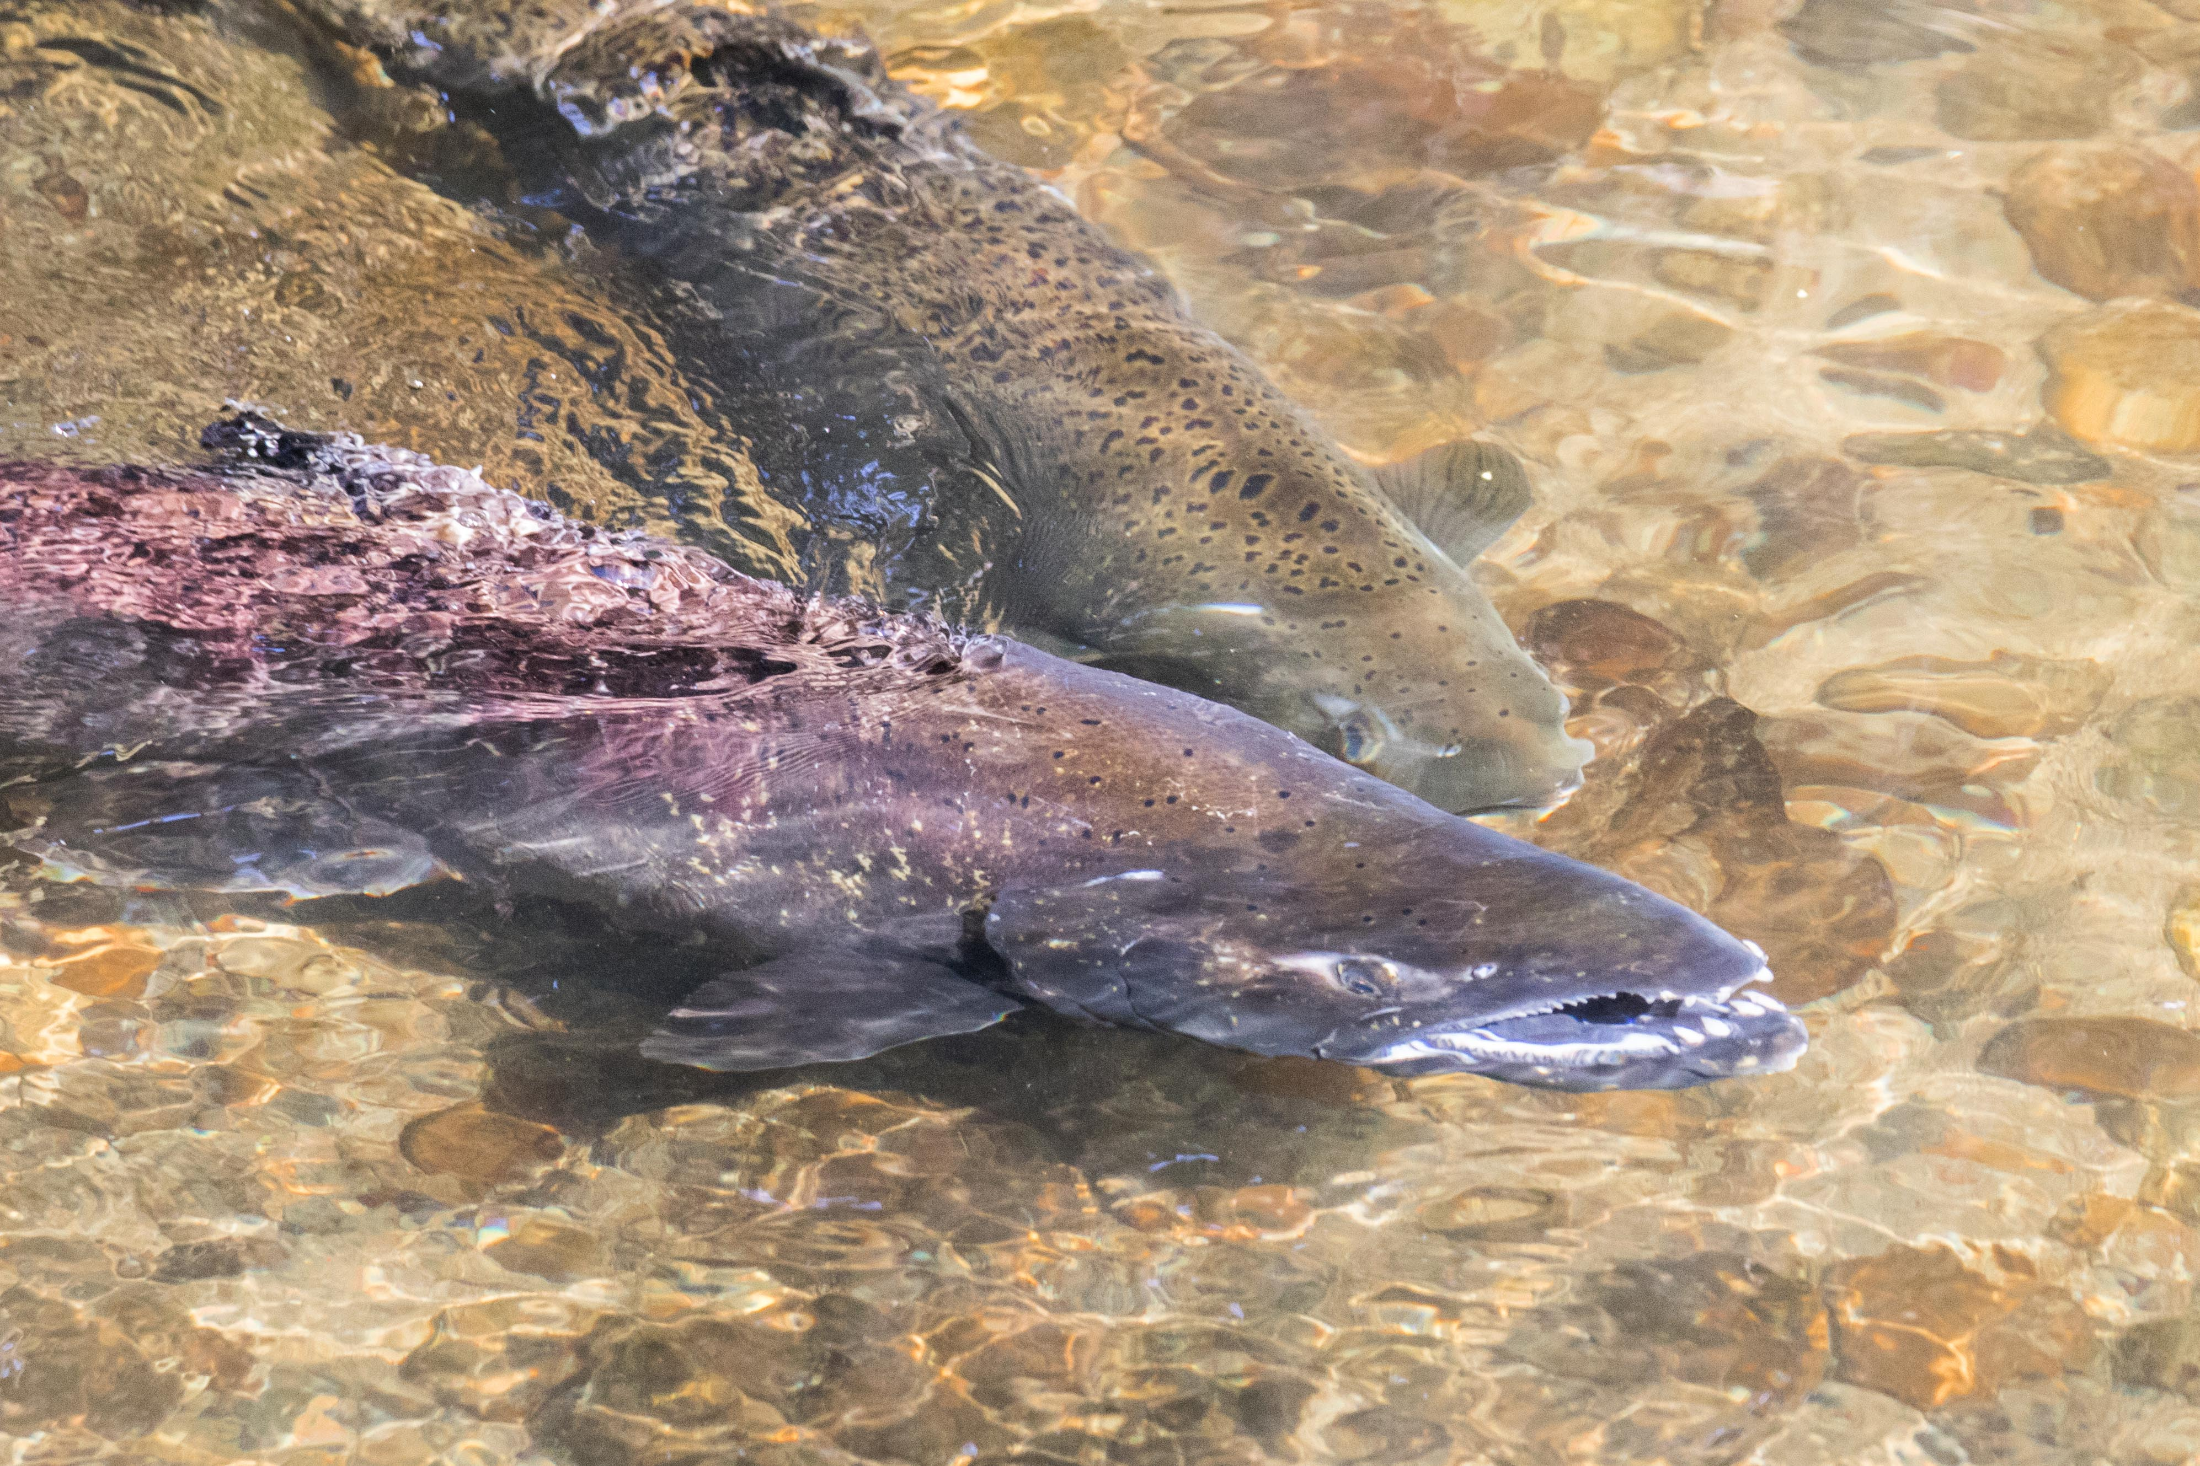
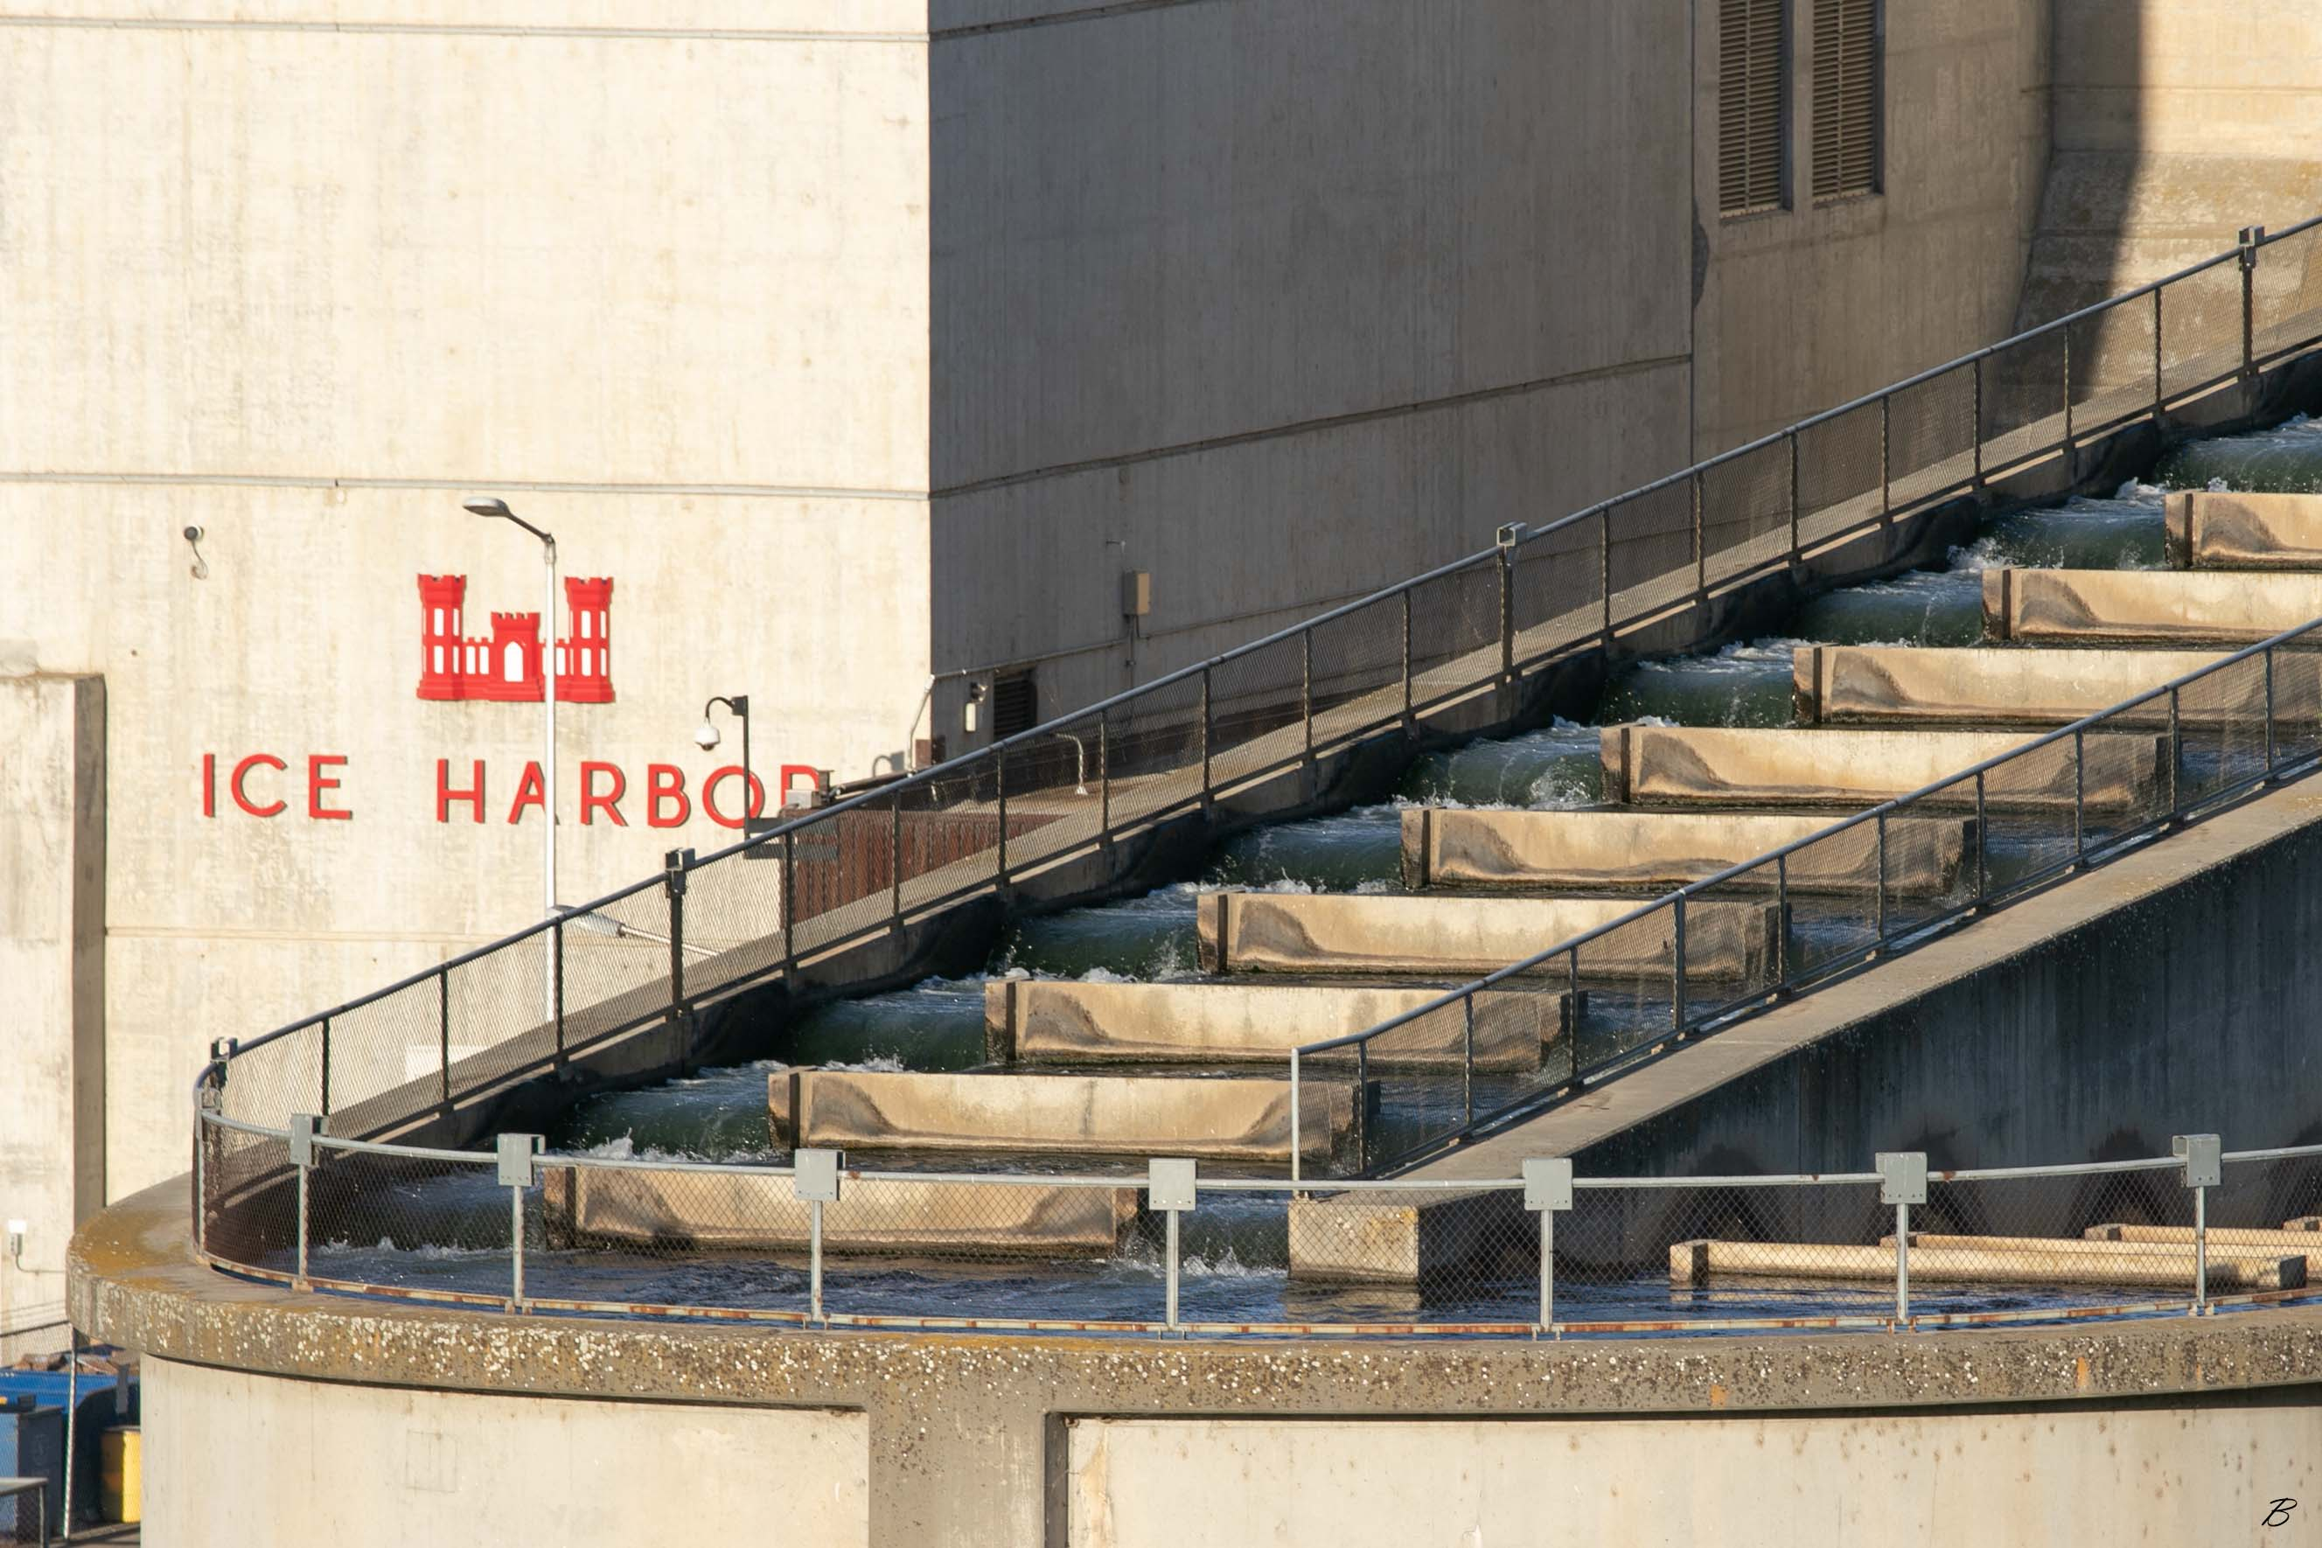
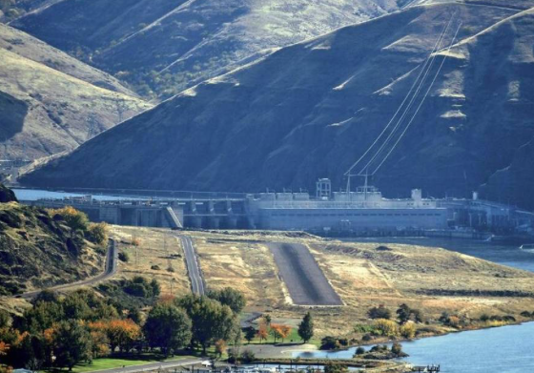
New Perspectives
NEW PIC
NEW PIC
Snake River Salmon and Steelhead
Linwood Laughy
January, 2020

Slide 2
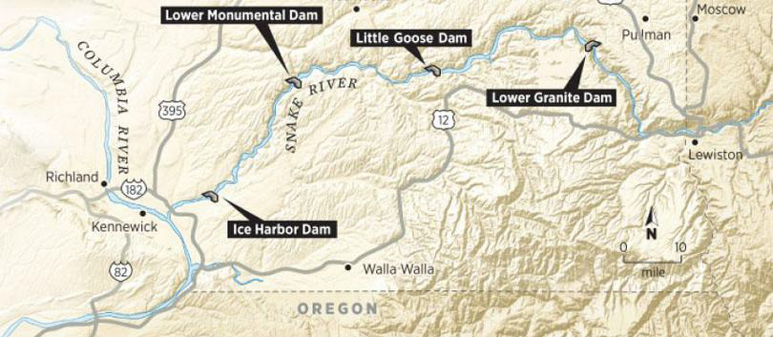
50+ Years of Contention
Pacific Northwesterners have contentiously debated the issue of the four lower Snake River dams since before their construction in the 1960s and 70s.
Notes:
from Spokesman Review http://www.spokesman.com/blogs/outdoors/2017/mar/02/lower-snake-river-dams-conflict-depicted-1971-wsu-documentary/

Slide 3
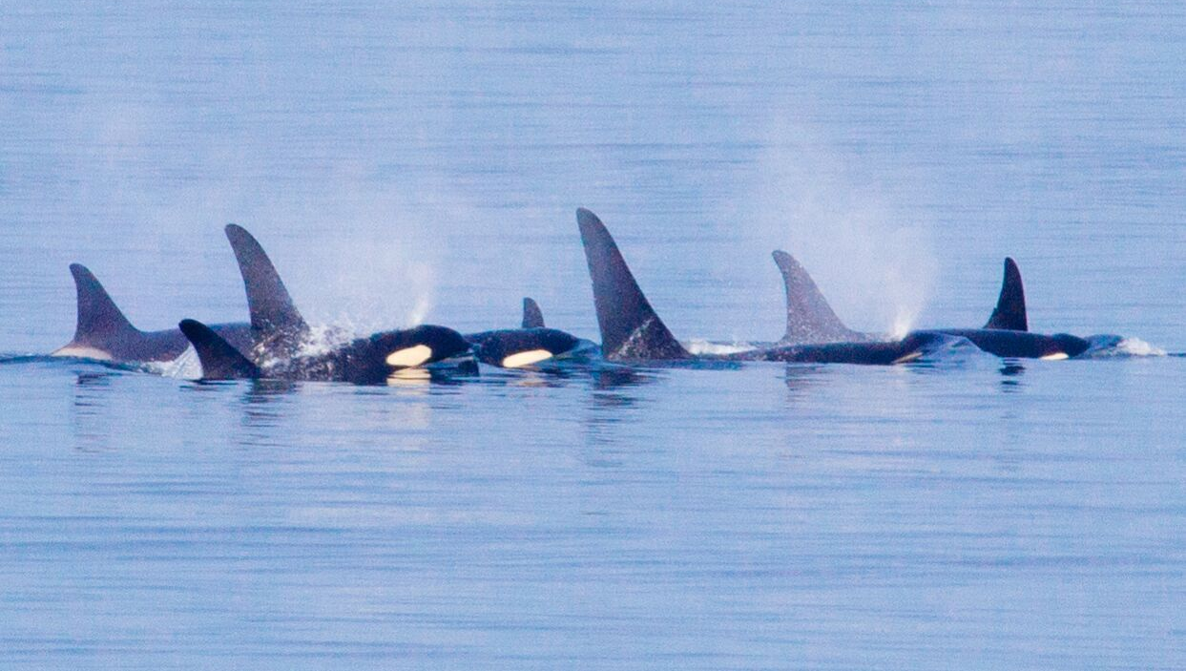
The looming extinction of
Southern Resident Killer Whales and collapsing Snake River salmon and steelhead runs have recently brought this simmering issue to a boil.

Slide 4
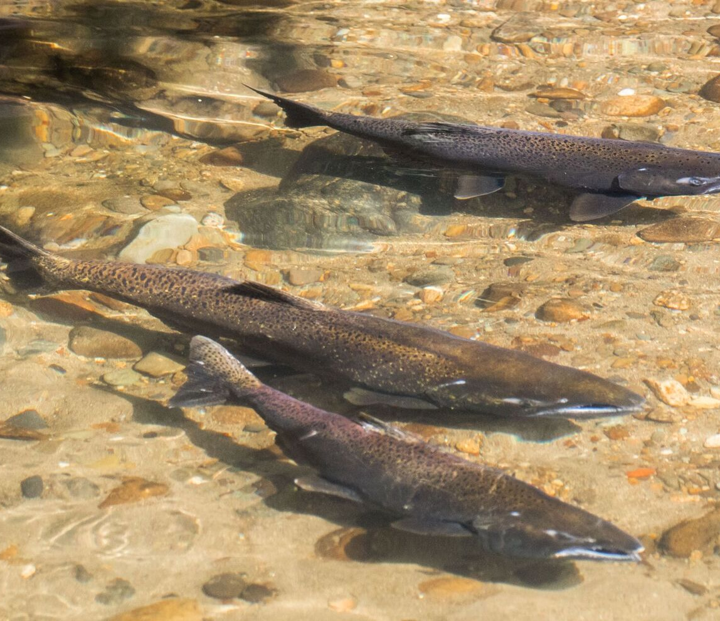
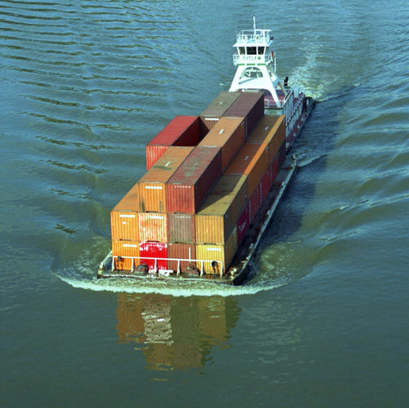
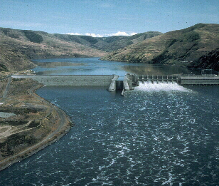
Three major elements define the debate:
Freight transportation
Hydropower
Snake River threatened and endangered salmon and steelhead.
This presentation focuses on
Snake River salmon and steelhead.

Slide 5
The problem of passing migratory fish over dams on lower Snake River was discussed with representatives of the U.S. Fish and Wildlife Service, State of Washington Department of Fisheries, Fish Commission of Oregon, Oregon State Game Commission, and the State of Idaho Department of Fish and Game.
The consensus of opinion of these agencies was that any series of dams on lower Snake River would be hazardous and might entirely eliminate the runs of migratory fish in that stream. In view of the experience at Bonneville Dam, this office does not concur with this unfounded opinion.
Special Report on Selection of Sites, Lower Snake River Oregon, Washington and Idaho
-Corps of Engineers March 14, 1947

Slide 6
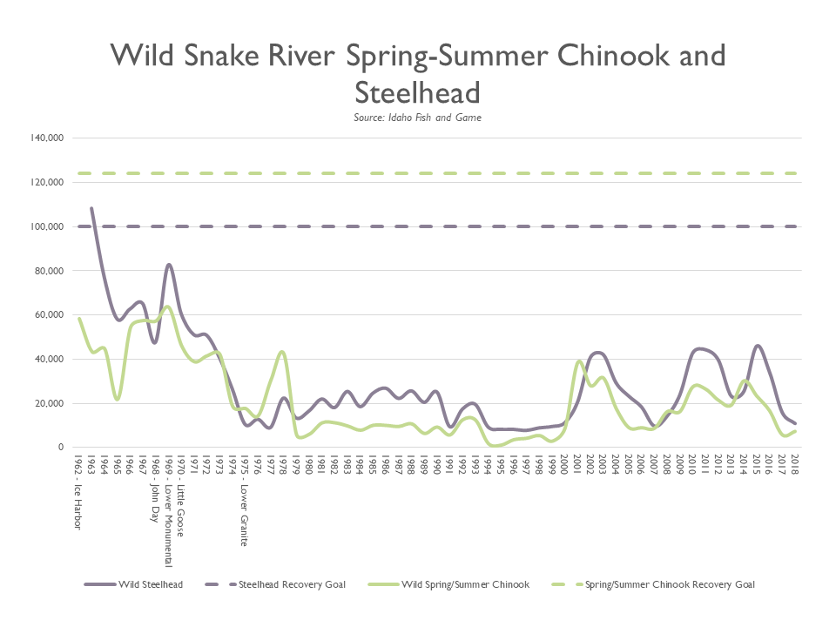
Snake River Spring/Summer Chinook and SR steelhead numbers plummeted in 1962-1975, the same years the LSR dams were constructed .
After 30+ years and the expenditure of billions of dollars, neither species is on a path to recovery.
(Years in graph 1962-2018)
Historically, an estimated 1.5 million wild spring/summer Chinook returned to the Snake River
and its tributaries.
Notes:
In 1963, 43,176 wild steelhead crossed the Lewiston dam on the Clearwater River. 2607 over Lower Granite in the 2018-2019 season (includes B run headed to Salmon River plus Orego streams

Slide 7
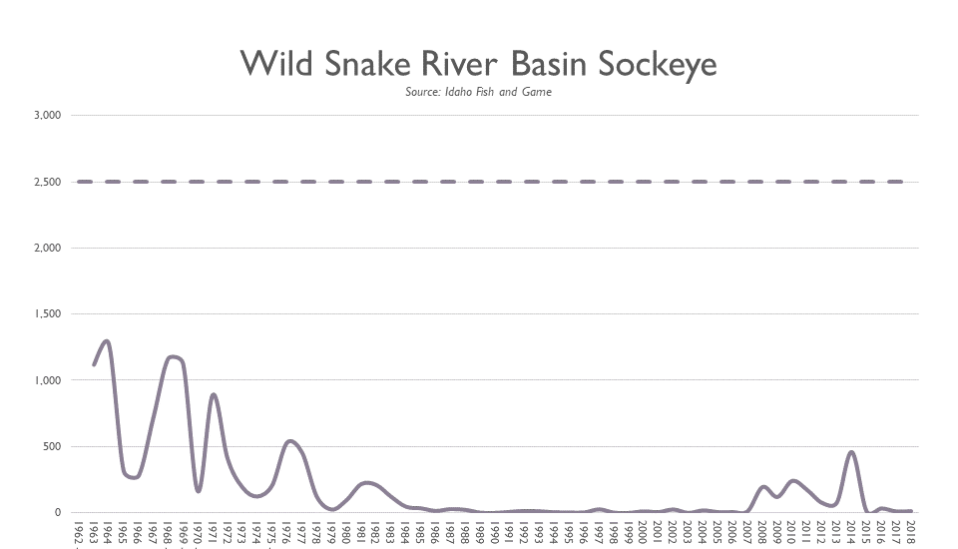
Snake River sockeye numbers plunged between 1963 and 1990 during and following construction of the LSR dams.
The recovery goal for Snake River endangered wild sockeye salmon is 2,500 fish at Lower Granite Dam.
The four-year total reaching the Stanley basin in 2015-2018 is 69 fish, an average of 17 per year.
(Years in graph 1962-2018)
Historically, an estimated 150,000 sockeye salmon returned each year to the Snake River basin.
-LITTLE GOOSE
-LOWER GRANITE
-ICE HARBOR
-JOHN DAY
-LOWER MONUMENTAL

Slide 8
Pike minnows, bass and walleye thrive in warm water reservoirs, where they eat millions of salmon and steelhead smolts.
Delayed travel time through reservoirs upsets the juvenile salmons’ biological clock for transitioning from fresh to salt water.
Cormorants, terns and gulls dine on salmon smolts throughout their migratory journey.
Passage over, through or around 8 dams (tailrace to tailrace) takes a heavy cumulative toll.
Delayed mortality — the physical damage and stress that result from passing 8 dams and reservoirs— wipes out an estimated 50% of remaining smolts below Bonneville Dam.
For every 1,000,000 Snake River juvenile spring/summer Chinook that begin their migratory journey to the sea, during an average water year over 800,000 perish en route.

Slide 9
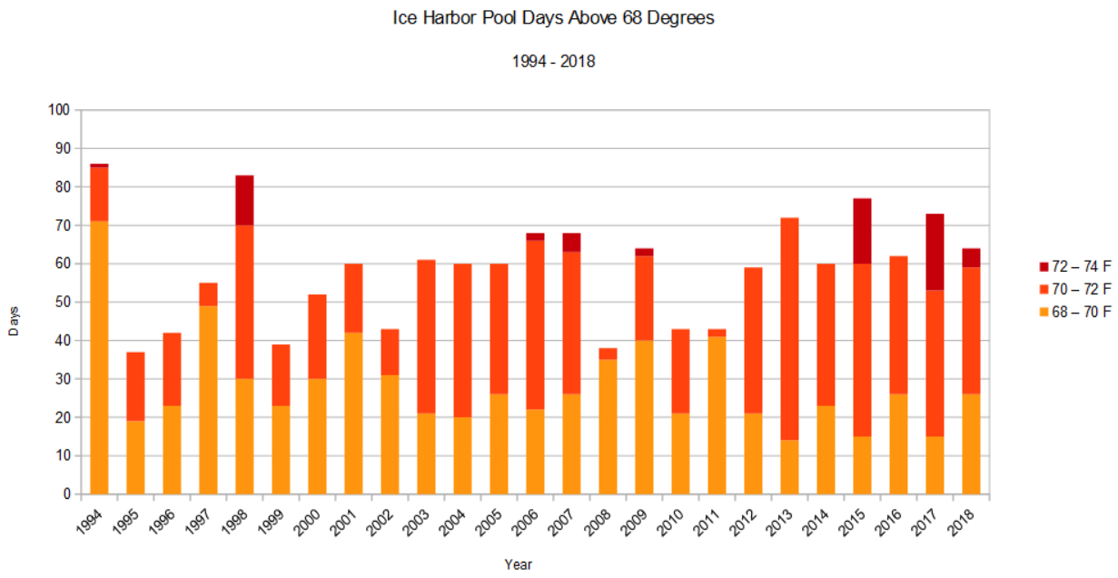
Climate change poses a new challenge for salmon and steelhead, which need water temperatures at or below 68 degrees F.
Temperatures of 69-70°F increase stress on adult fish and make them susceptible to disease.
At 70-72°F, migration can slow or stop.
Temperatures of 72-74°F can be lethal.
In 2015, temperatures in the Snake and Columbia Rivers exceeded 72°F for a total of 18 days, and more than 250,000 adult salmon died.

Slide 10
The Environmental Protection Agency has estimated water temperatures in the Columbia and Snake Rivers with and without dams.
Six Columbia-Snake River dams have the greatest impact on increasing water temperatures. Four of the six are dams on the lower Snake River.
Each of the four LSR dams can raise water temperatures more than 1° Celsius.
An increase of one degree Celsius raises water temperature from 68°F to 69.8°F; an additional 1° Celsius results in an increase to 71.6°F.
Temperature increases are typically cumulative.
20° C = 68°F 22° C = 71.6°F 23° C = 73.4°F

Slide 11
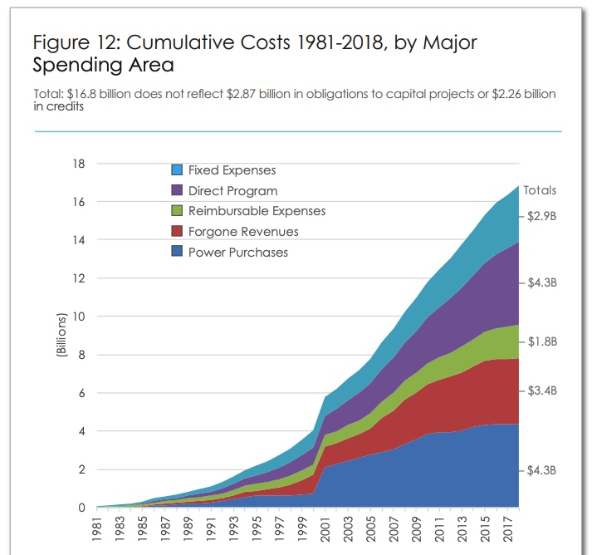
Over the past 20 years, taxpayers and electricity rate payers have incurred costs of $16.8 Billion implementing a fish and wildlife program declared inadequate and illegal by three U.S. District judges.
Between 2008-2017, Columbia Basin F & W costs for Bonneville Power Administration averaged $727 million per year, about 24% of BPA’s nearly $3 Billion annual budget.
After 25+ years, no Columbia or Snake River threatened or endangered salmon or steelhead species is on a path to recovery.
Government agencies and special interest groups continue to support the status quo on the lower Snake River.

Slide 12
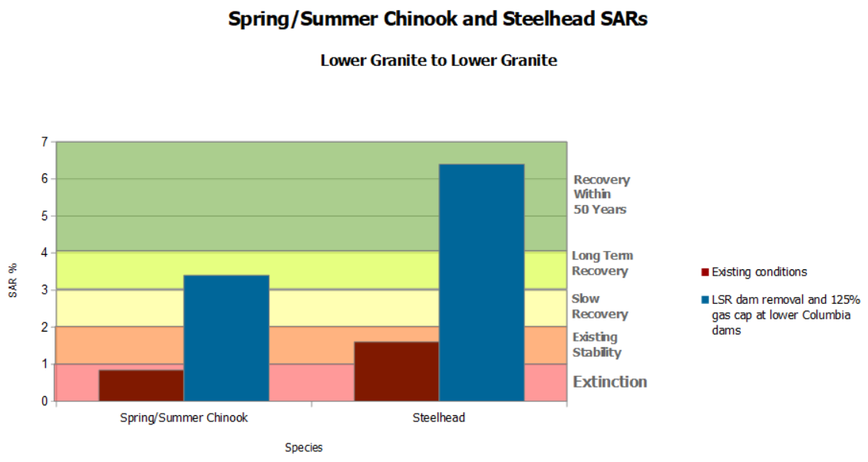
In 2017 the Fish Passage Center reported removal of the four dams on the lower Snake River and increased spill to the 125% gas cap at four dams in the lower Columbia could lead to a four-fold increase in Snake River salmon and steelhead SARs.
A four-fold increase in Snake River spring/summer Chinook SARs would remove these fish from a path to extinction and approach the 4% average SAR needed for recovery.
A four-fold increase in Snake River steelhead SARs would result in a solid recovery and potential delisting of this species from the Threatened and Endangered Species List.
Notes:
2017 CSS only reference needed

Slide 13
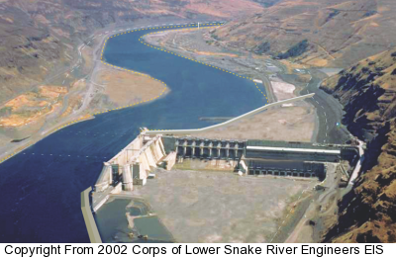
Returning the lower Snake River to a more normal flow will yield positive economic, cultural and environmental outcomes.
A free-flowing river would reduce juvenile salmon and steelhead migration travel times, reduce the number of piscine and avian predators en route, reduce water temperatures, and eliminate delayed mortality due to dam passage.
A free-flowing lower Snake River would provide over 200 miles of riparian habitat and the return of some or most of the 120,000 game birds and 90 thousand song birds lost when the dams were constructed.
An estimated 18,000 acres of land would become available for agricultural and other uses.
Taxpayers would save many millions of dollars each year with sustainable Snake River fish runs, which would boost local economies from the west coast to Stanley, Idaho.

