Slide 1
RIVERS AND CLIMATE CHANGE
Climate Education & Stewardship Program

Slide 2

Great Old Broads for Wilderness is a national grassroots organization, led by women, that engages and inspires activism to preserve and protect wilderness and wild lands.

Slide 3
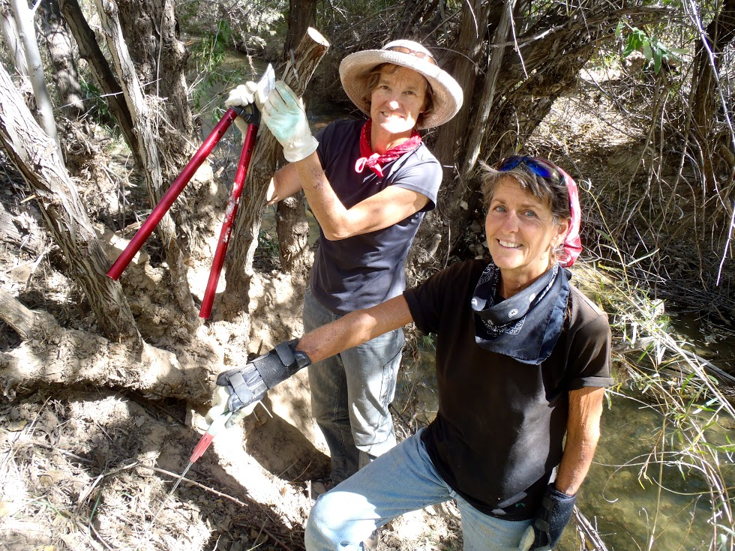
Great Old Broads for Wilderness Mission
Education
Stewardship
Advocacy

Slide 4
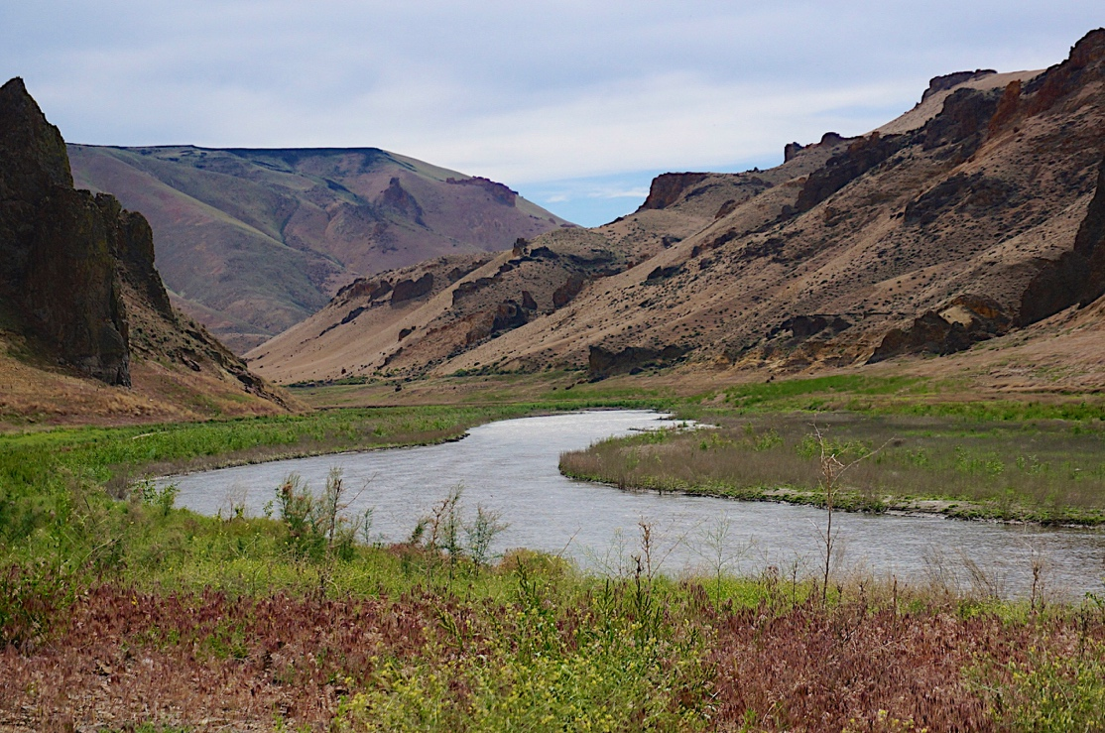
Today We’ll Learn About:
Public lands and their role in climate change
Impacts of climate change on water, landscapes, and communities
Ways to build climate resilience on public lands

Slide 5
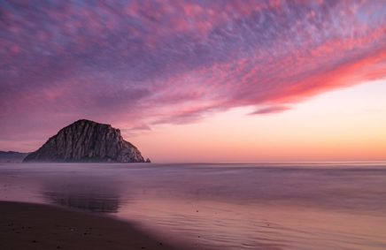
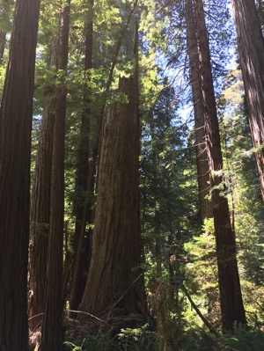
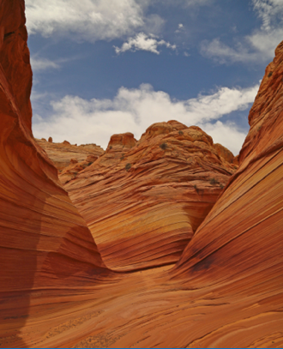
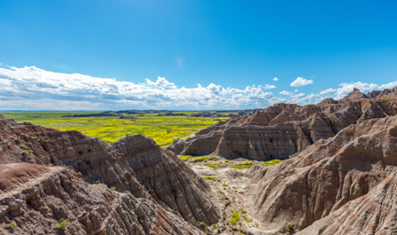
What are Public Lands?

Slide 6
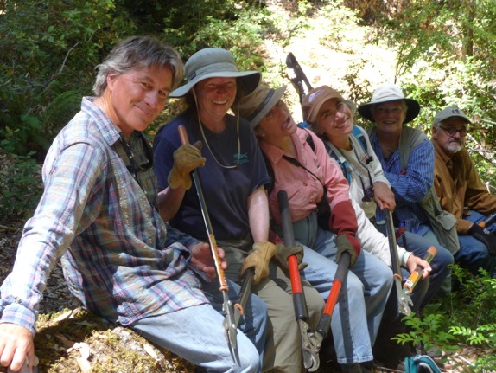
Federal, State, and Local Public Lands
National Parks
National Forests
National Conservation Lands
State Parks
City Parks
Wild and Scenic Rivers
National Monuments
National Recreation Areas
Wilderness Areas
Wilderness Study Areas

Slide 7
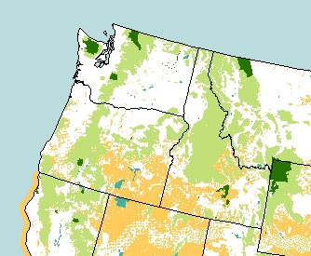
Federal Public Lands in the Northwest
Bureau of Land Management
Fish & Wildlife Service
Forest Service
National Park Service
The federal government manages almost half of the land base in the Pacific Northwest (60% of the land in Idaho, 48% in Oregon, and nearly 30% in Washington).
Map of U.S. public lands by Kara Clauser, Center for Biological Diversity.

Slide 8
How Do Public Lands Contribute to Climate Change?

Slide 9

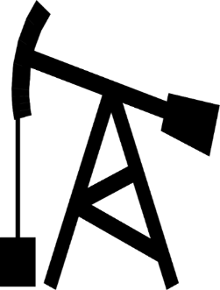

Public Lands Use and Climate Change
Public lands emit 4.5 times
the amount carbon they absorb
Center for American Progress, 2013; in Millions of Metric Tons of Carbon-Equivalent (mmCO₂e); in 2012, the U.S. gross emissions were 6545 mmCO₂e with gross offset of 881 mmCO₂e

Slide 10
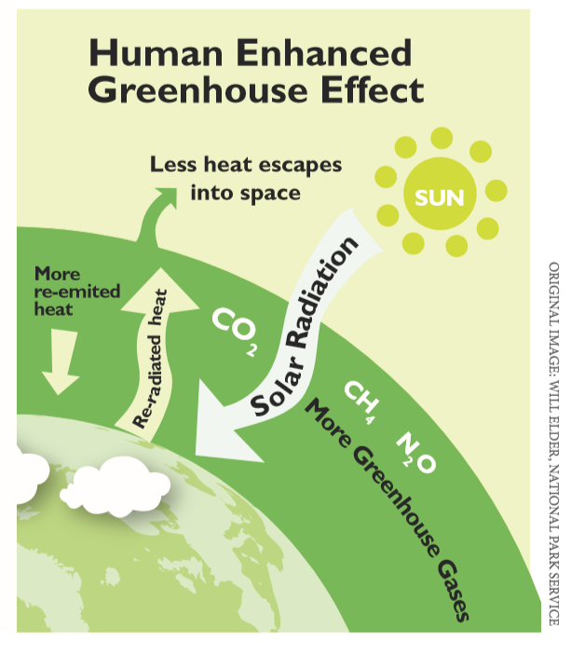
Public Lands Use and Climate Change

Slide 11
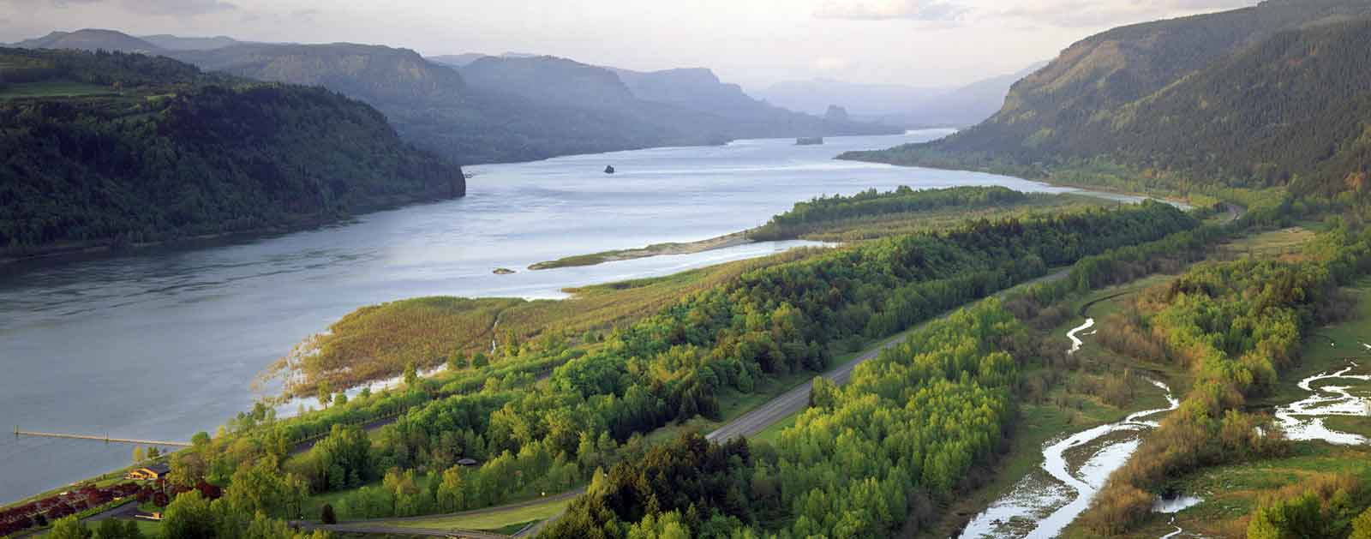
Rivers of the Northwest
Columbia River (Photo: American Rivers)

Slide 12
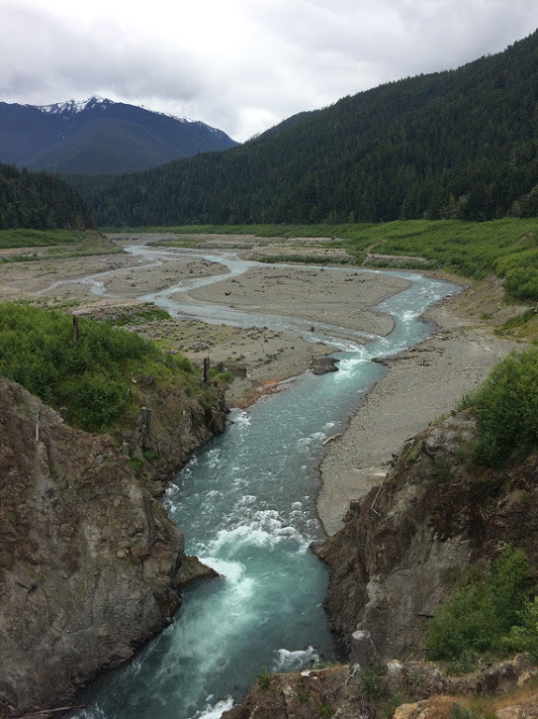
Who Manages Our Rivers?
Water is a public resource managed for multiple uses to benefit all people
U.S. Fish and Wildlife Service, U.S. Army Corp of Engineers, and U.S. Bureau of Reclamation all play major roles in river management
National Wild and Scenic Rivers managed by federal land-management agencies (USFS, BLM, USFWS, NPS)

Slide 13
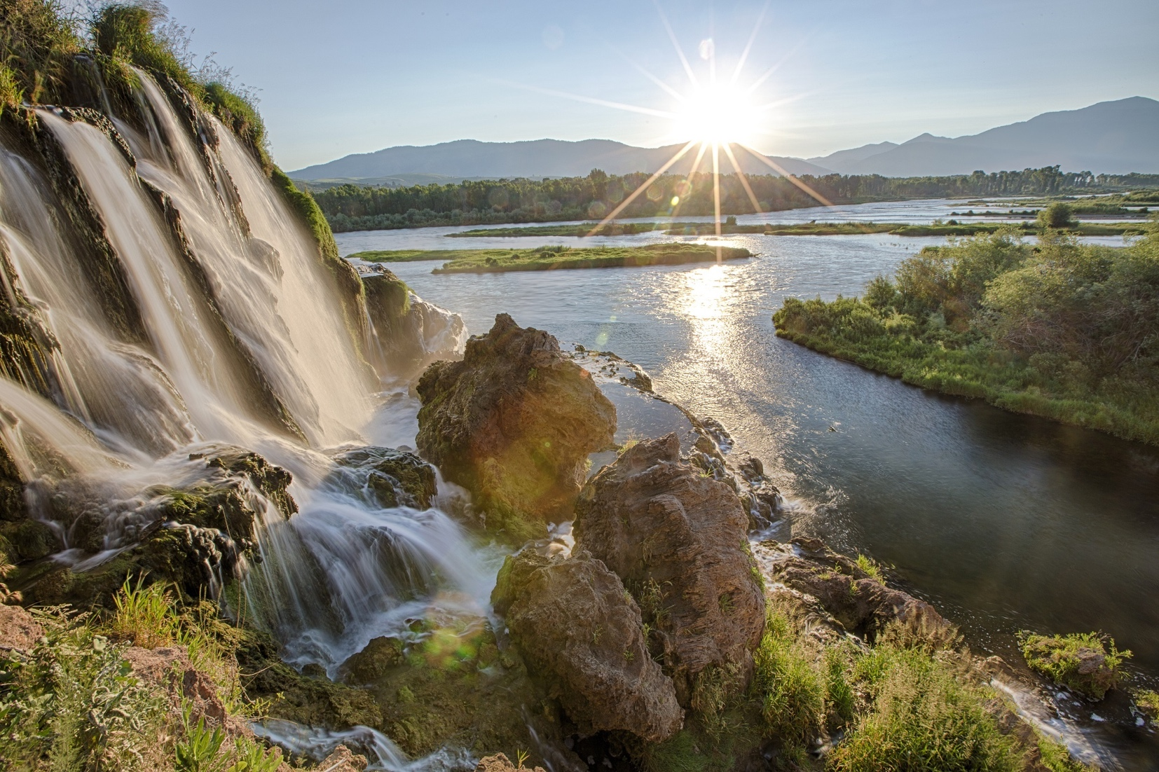
What is a Watershed?

Slide 14
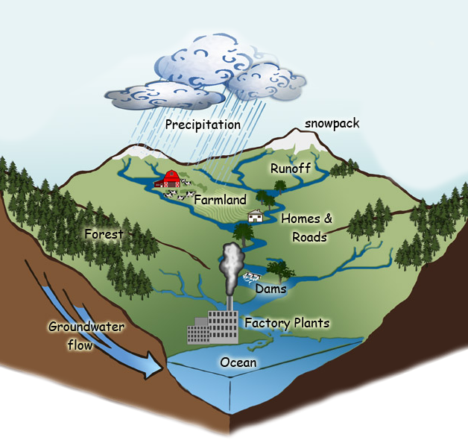
Anatomy of a Watershed
Watersheds drain land areas into a central location, such as a river, lake, or the ocean
Graphic: USFS

Slide 15
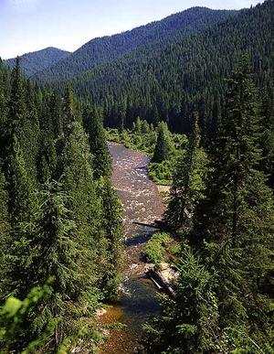
What’s Your Ecological Address?
What watershed do you live in?
Where does your water come from?

Slide 16
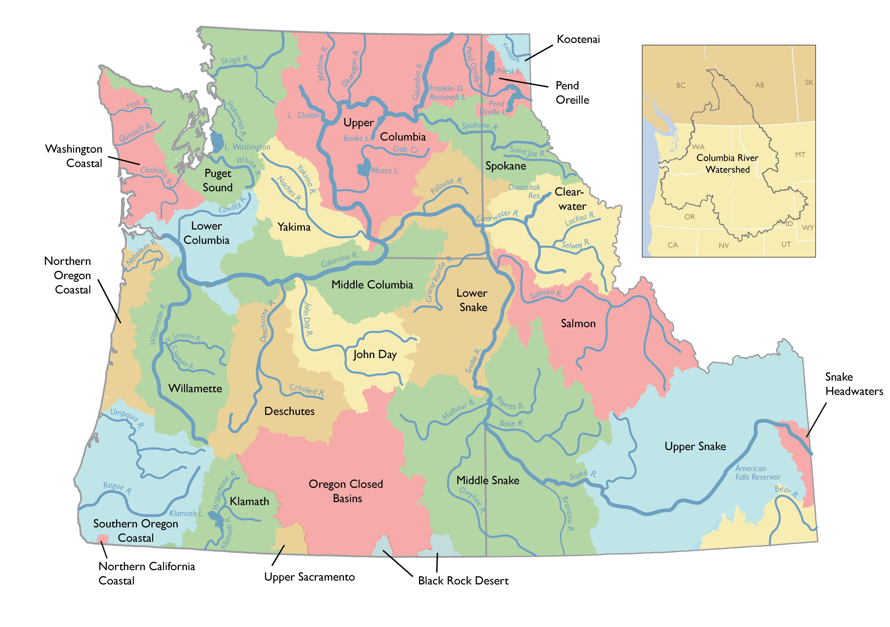
Watersheds of the Northwest
Map: Portland State University

Slide 17
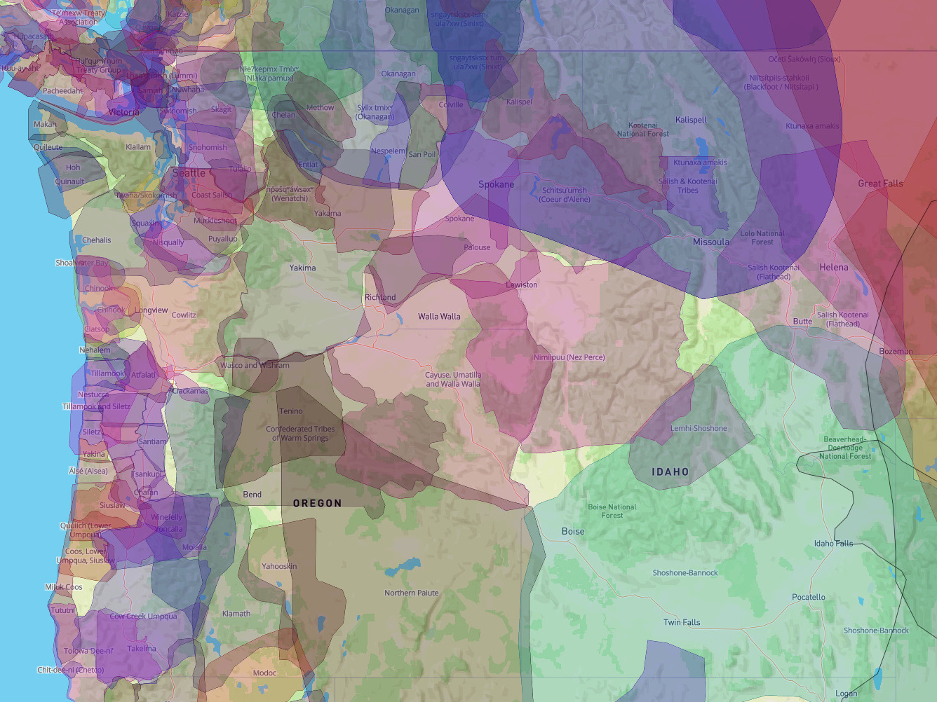
Columbia River Basin: A Cultural Landscape

Slide 18
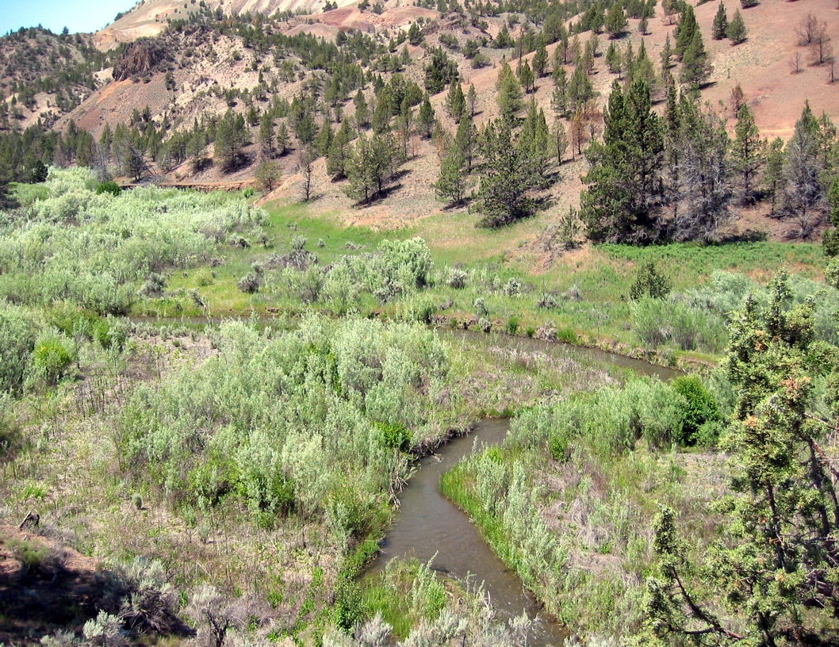
Riparian Corridors
Small but vital ecosystem tying the river to the land
Lush vegetation adapted to and dependent on waterways
Photo: NOAA

Slide 19
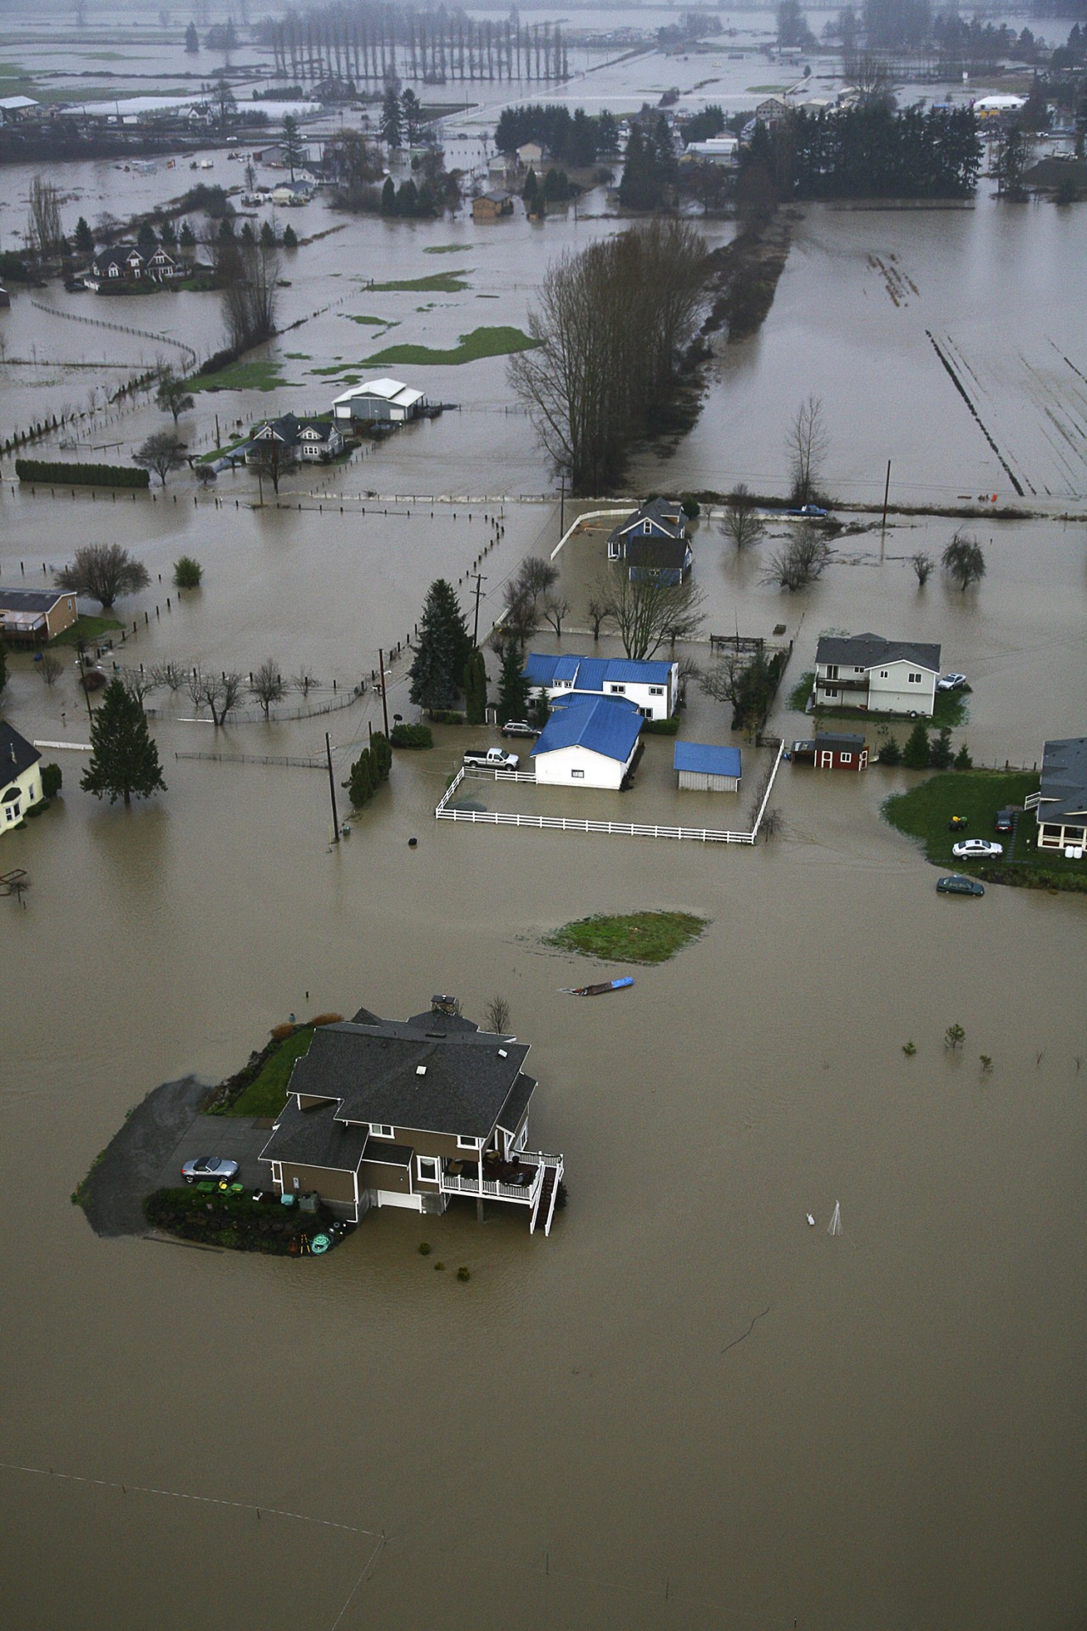
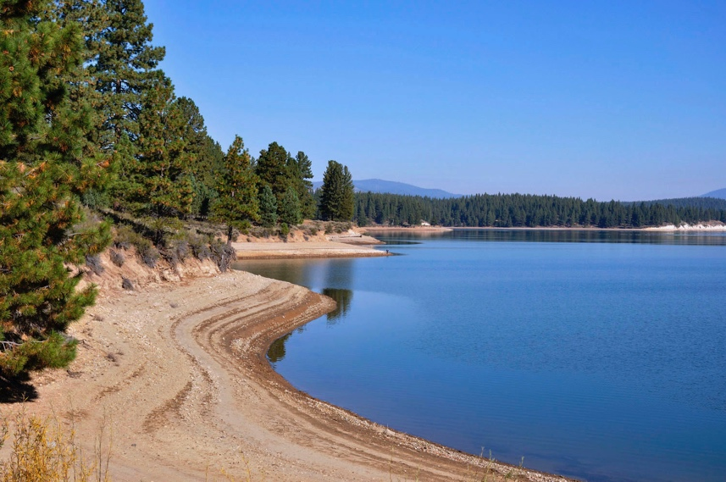
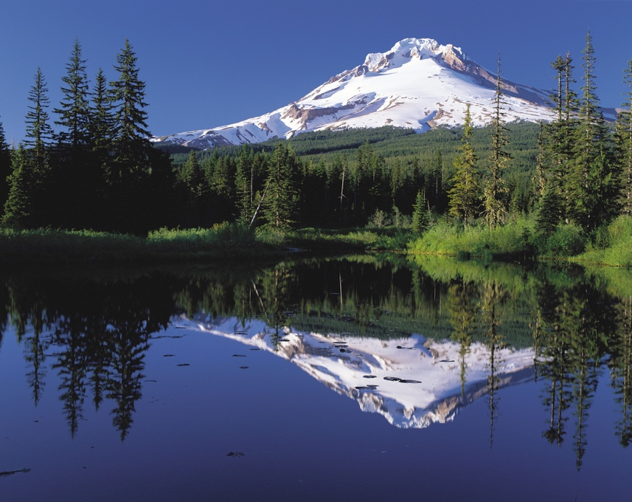
Regional Climate Change Impacts
Photo: USFS
Photo: Forterra/George White
Photo: Wikipedia Commons

Slide 20
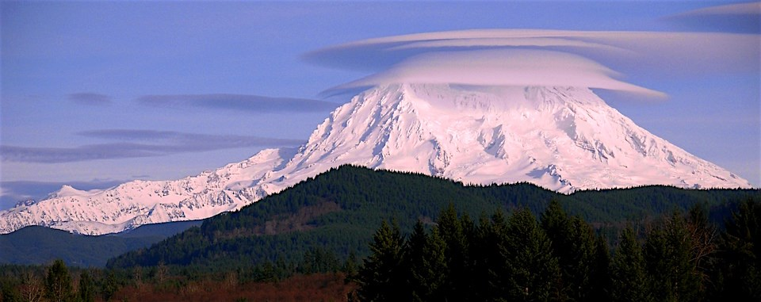
Winter Snowpack
Acts as “savings account,” provides water during dry summers
70% of streams in Columbia River Basin come from snowpack
Warmer, wetter winters mean snow shifting to rain

Slide 21
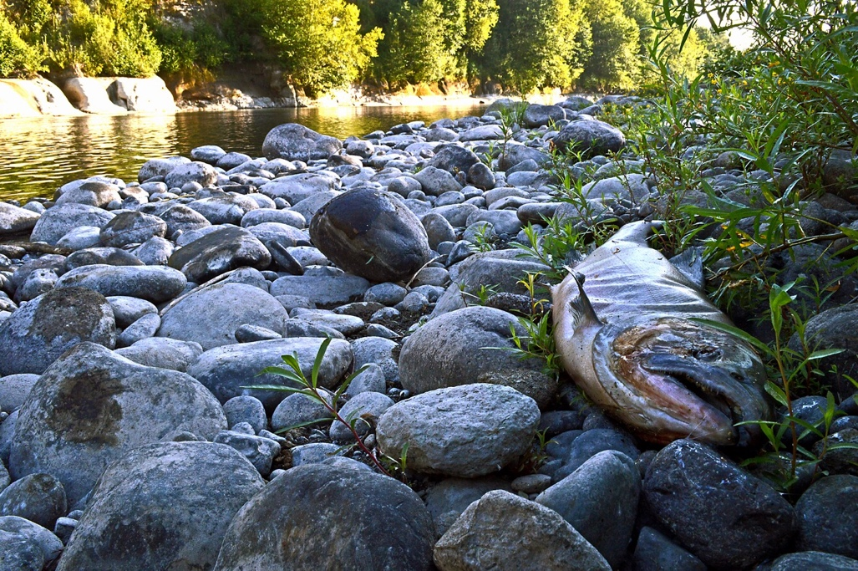
Summer Streamflow
Photo: Oregon Dept. Fish and Wildlife
Reduced snowpack leads to lower summer stream flows
As streamflow decreases, water temperature rises

Slide 22
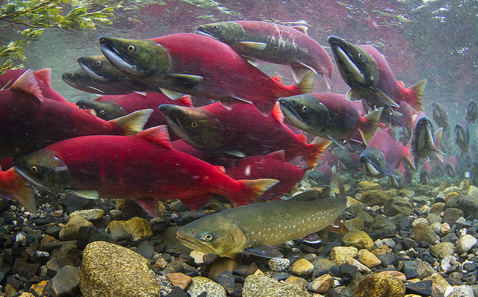
Climate Change and Iconic Species

Slide 23

Climate Impacts: Water & Salmon
Fifty years ago, the Columbia River was too warm for salmon for only a week or two during peak of summer
Today, the Columbia River is too warm for salmon for three months from mid-July through mid-September
Higher water temperatures could eliminate 1/3 of current cold water fish habitat in the Pacific Northwest by 2100.

Slide 24
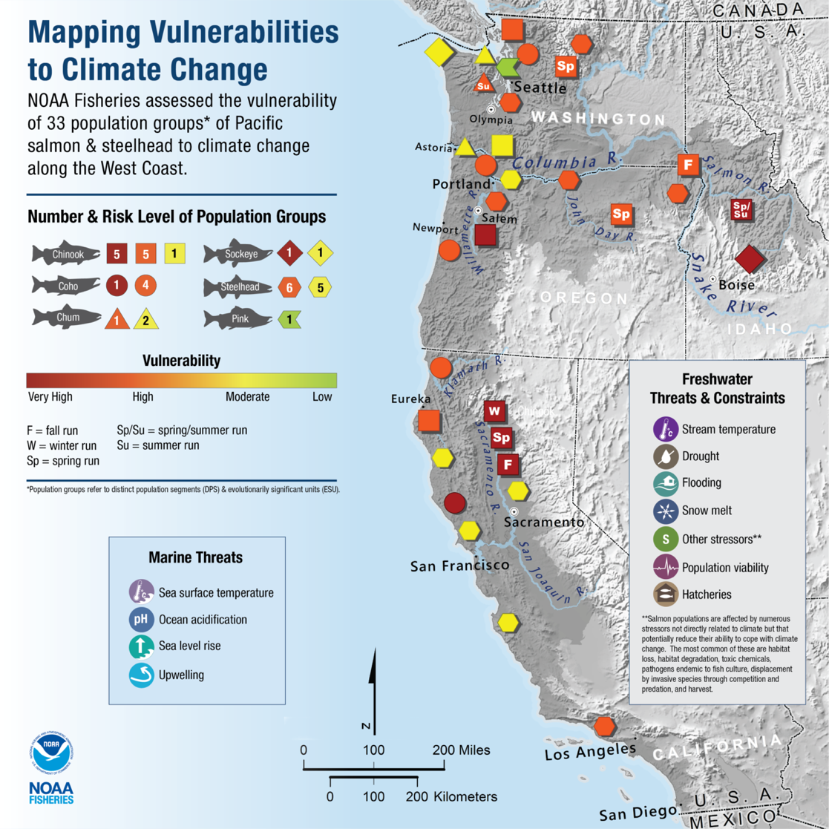
Uneven Climate Change Impacts Salmon
Some areas will be harder hit than others
By 2080, 98% of the Chehalis Basin in SW Washington will be too warm for salmon or steelhead
Source: NOAA

Slide 25
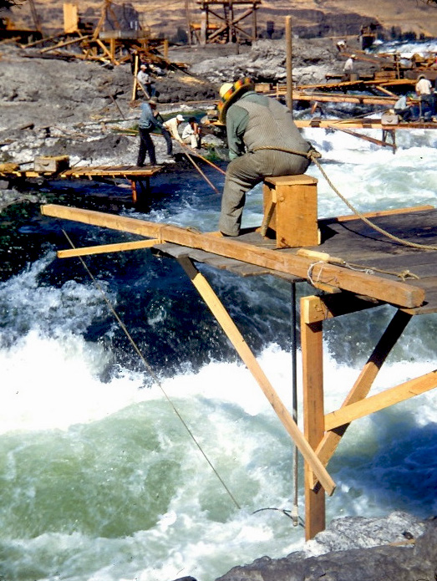
Climate Impacts: Frontline Communities
Children
Older adults
Low income communities
Indigenous communities
People of color
Photo: Columbia River Inter-Tribal Fishing Commission

Slide 26
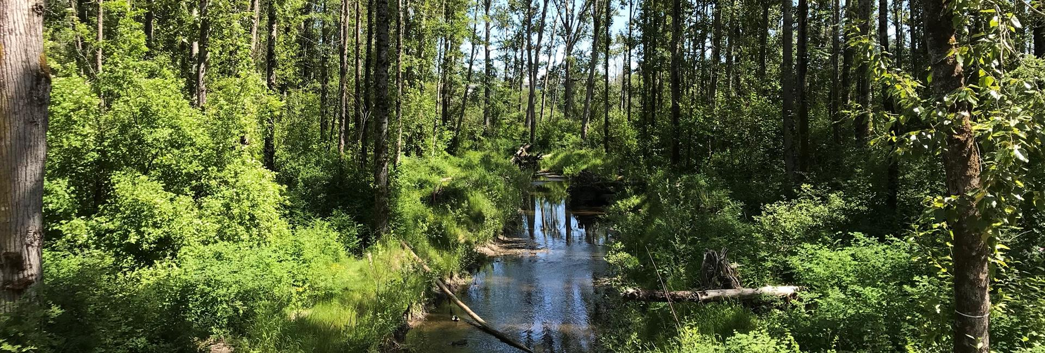
Natural Climate Defense
Photo: City of Bellingham, WA

Slide 27
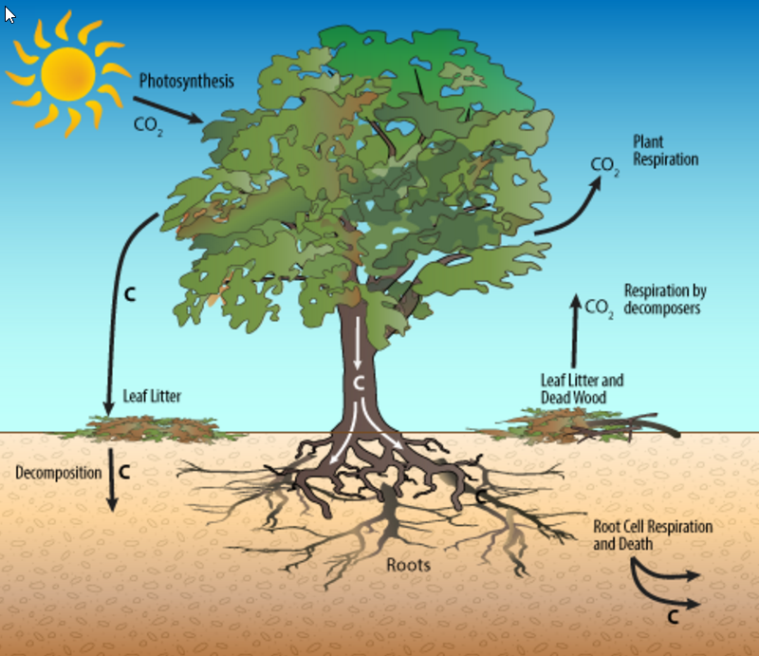
Natural Climate Defense
CO₂ pulled out of atmosphere by trees during photosynthesis
Nearly half of a tree’s total mass is carbon extracted from atmosphere
When a tree dies, carbon is locked away and buried deep underground
Coastal forests in the Pacific Northwest absorb more carbon per acre than the Amazon rainforest
Photo: RGSgeogy

Slide 28
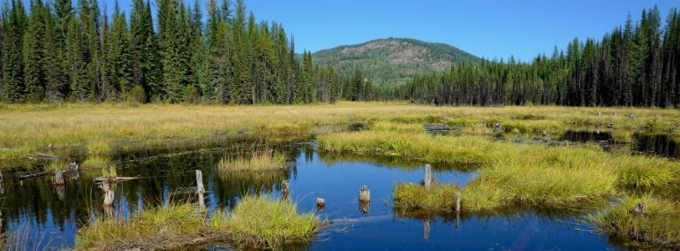
Intact Ecosystems & Climate Resilience
Photo: Washington Department of Natural Resources
Riparian areas absorb moisture like a sponge, preventing flooding
Allow rain to recharge groundwater aquifers, keeping streams flowing during dry season

Slide 29
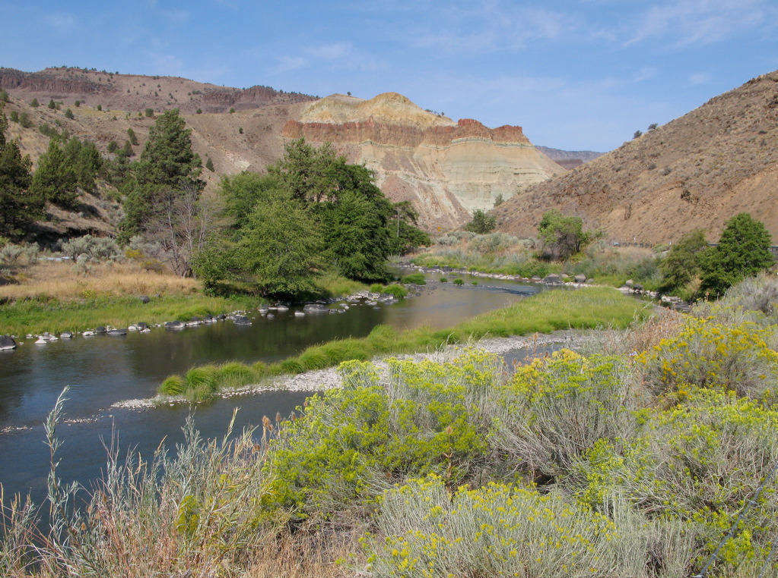
Nature’s Water Treatment Plants
Intact ecosystems trap sediment, prevent erosion, and keep water cool
Soil microbes break down chemical pollutants
Trees filter massive amounts of nitrate runoff

Slide 30
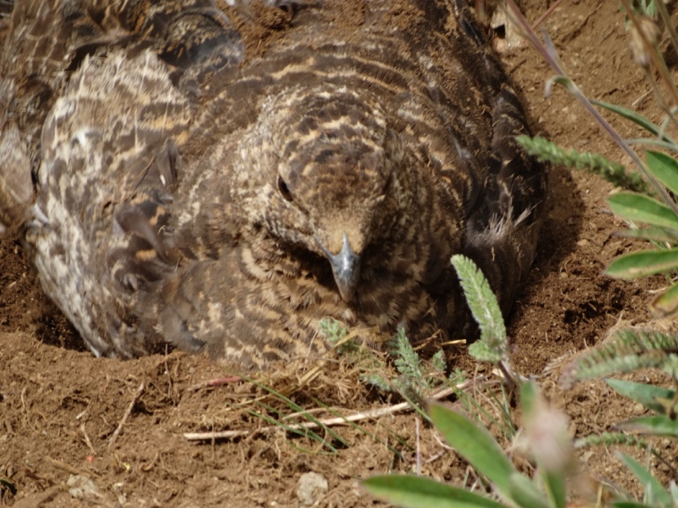
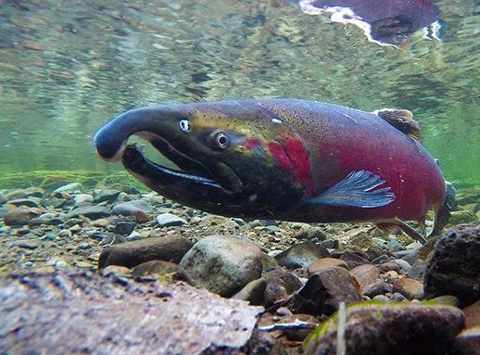
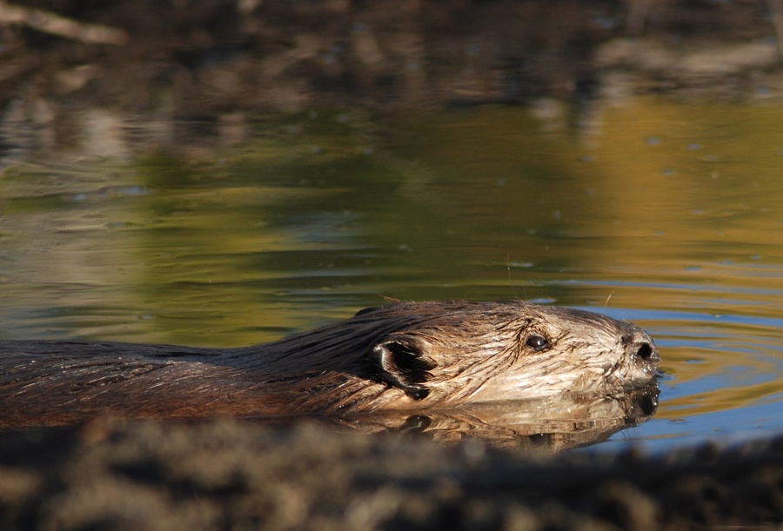
Wildlife Corridors: Headwaters to Ocean
Blue Grouse, Photo: Llyn DeDanaan
Photo: American Rivers

Slide 31
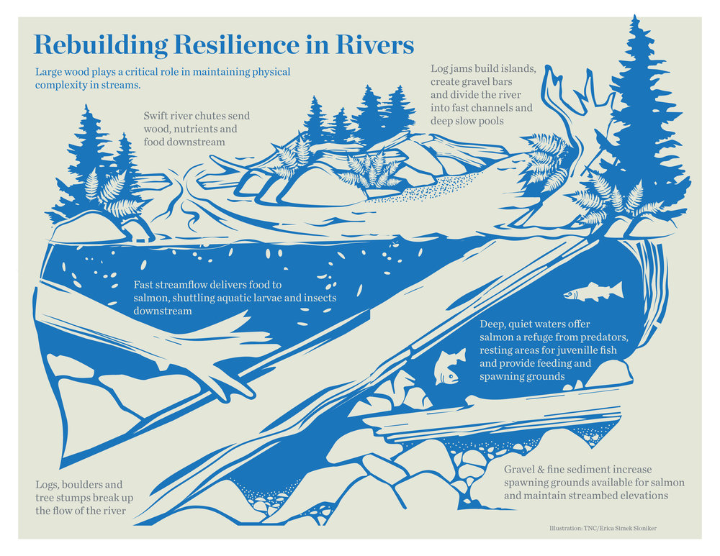
Salmon Refugia
Graphic: The Nature Conservancy
Refugia are “strongholds” that provide good shelter from climate impacts.

Slide 32
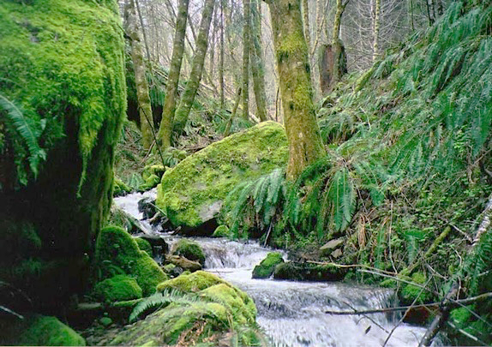
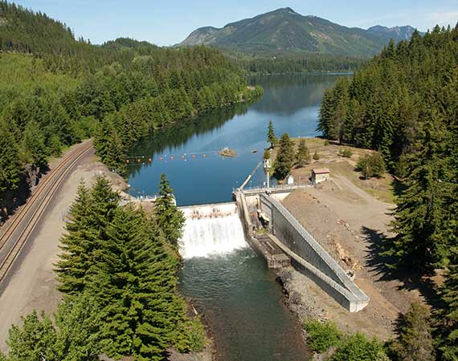
Natural or Engineered
VS.
Photo: U.S. Forest Service
Photo: U.S. Bureau of Reclamation

Slide 33
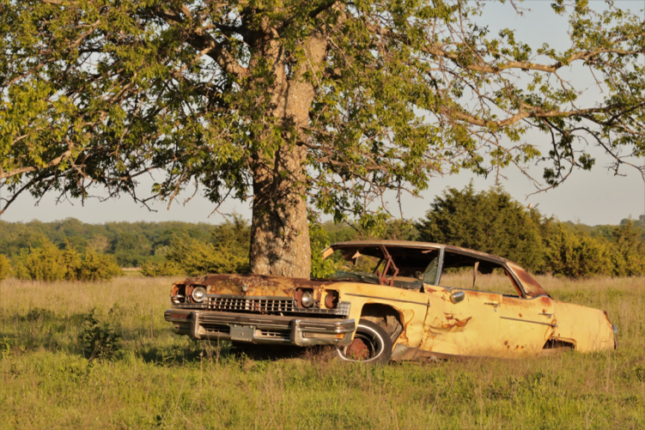
Natural or Engineered?
Engineered alternatives:
Costly to build and maintain
Depreciate in value
Become quickly outdated

Slide 34
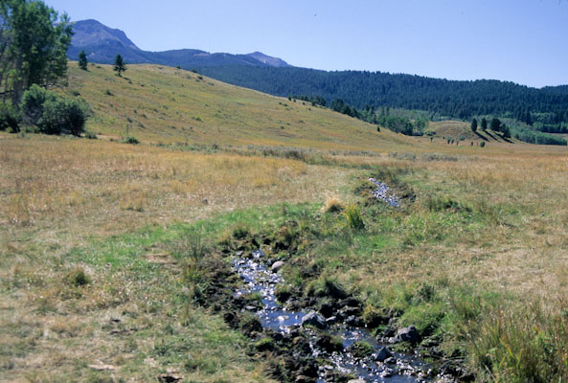
Watershed Resilience
The impacts of:
Habitat fragmentation
Dams
Invasive species
Pollution
Logging
Mining
Overgrazing
Road development
Water diversion from rivers
Recreation management decisions
…will all be made more severe by climate change.

Slide 35
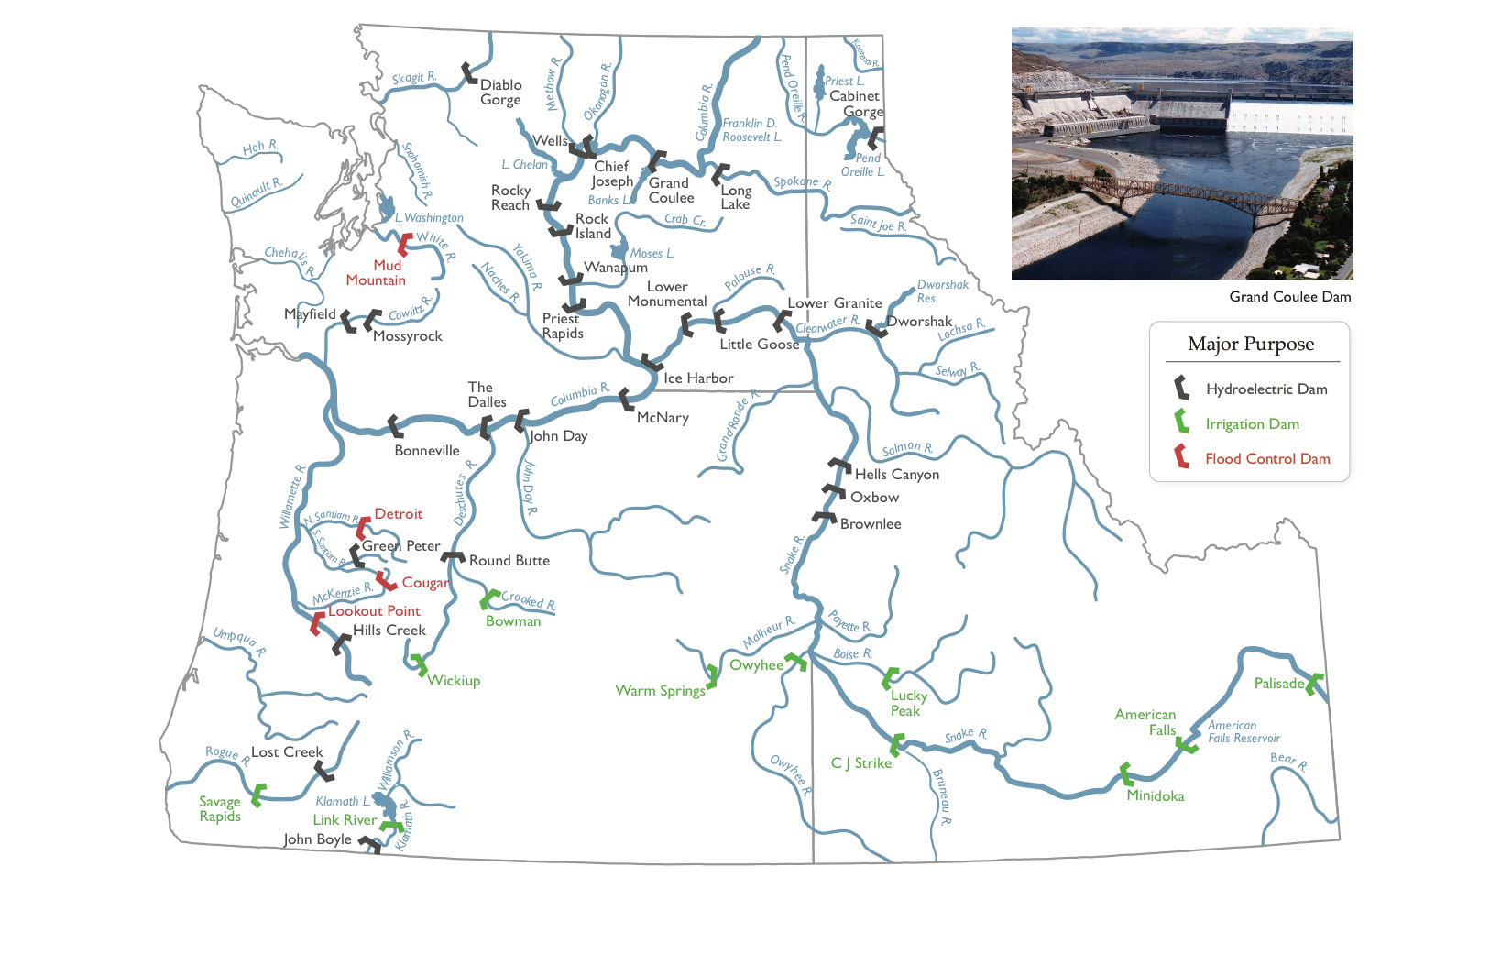
Dams in the Northwest
Source: Portland State University

Slide 36
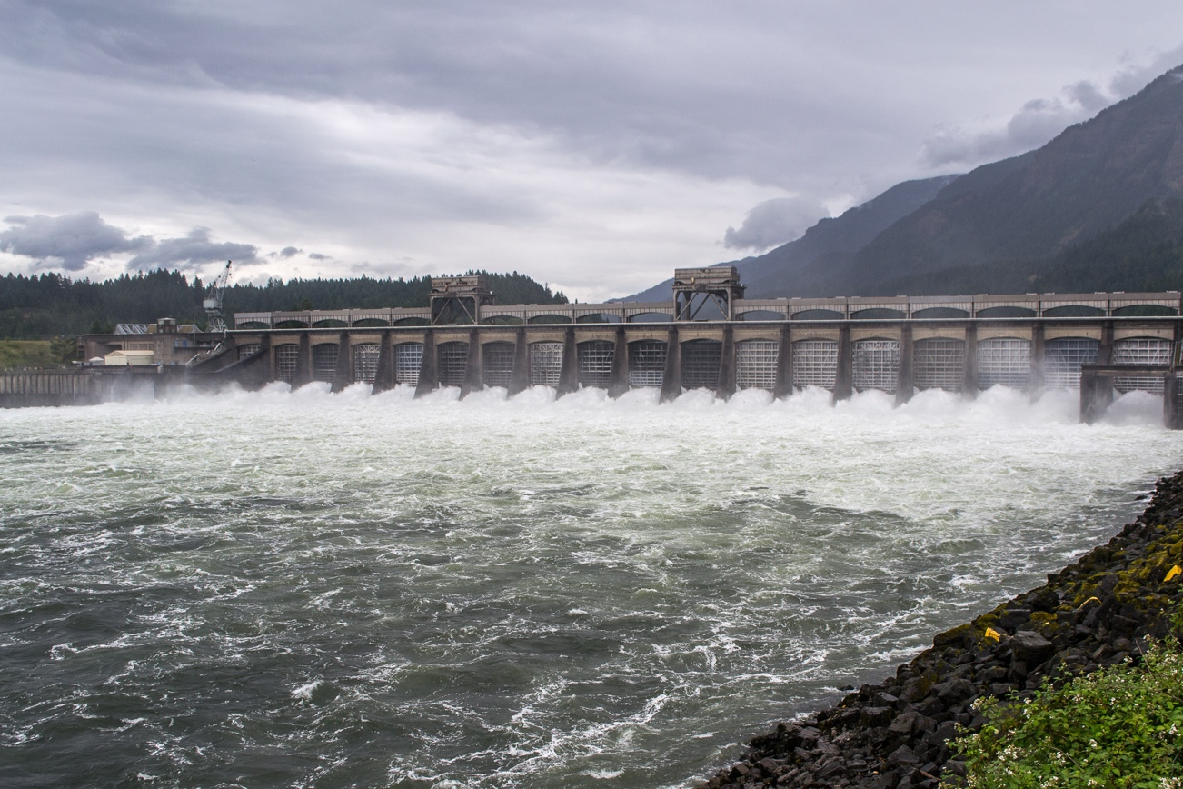
Dam Impacts
Fish migration and habitat
Warmer, more stagnant water
Deteriorating infrastructure
Photo: Wikipedia Commons

Slide 37
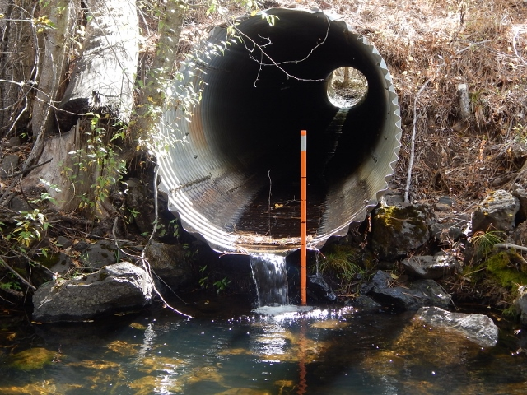
Culverts and Other Fish Barriers
Often too high, steep, or fast-flowing for fish to overcome

Slide 38
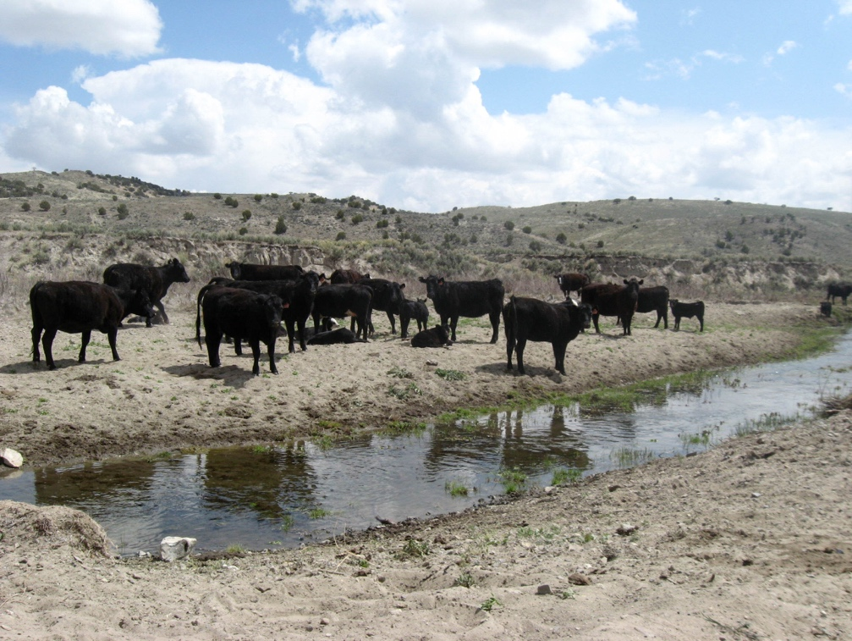
Grazing and Riparian Areas
Grazing…
Damages soils and impacts water quality
Impacts native plant and animal species
Destabilizes streambanks, leading to wider, deeper channels and causing riparian areas to dry

Slide 39
Healthy Rivers and Healthy Trees
Graphic: adapted from The COMET Project

Slide 40
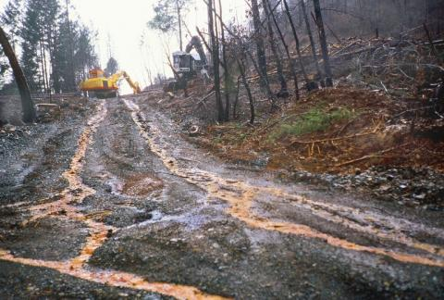
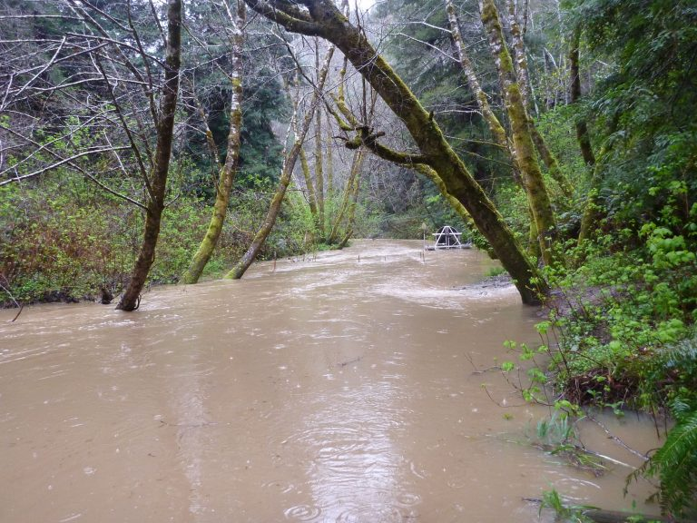
Logging Roads and Erosion
Roughly 110,500 miles of logging roads across the Northwest
USFS only budgets for maintenance on 15% of logging roads
Logging roads send large amounts of sediments to streams

Slide 41
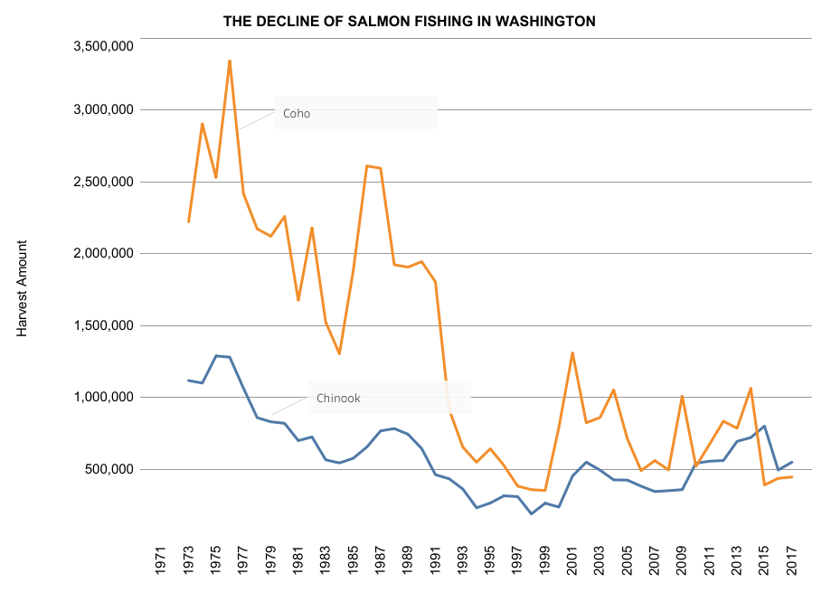
Baseline Amnesia: Salmon
Graphic: Washington Department of Fish and Wildlife

Slide 42
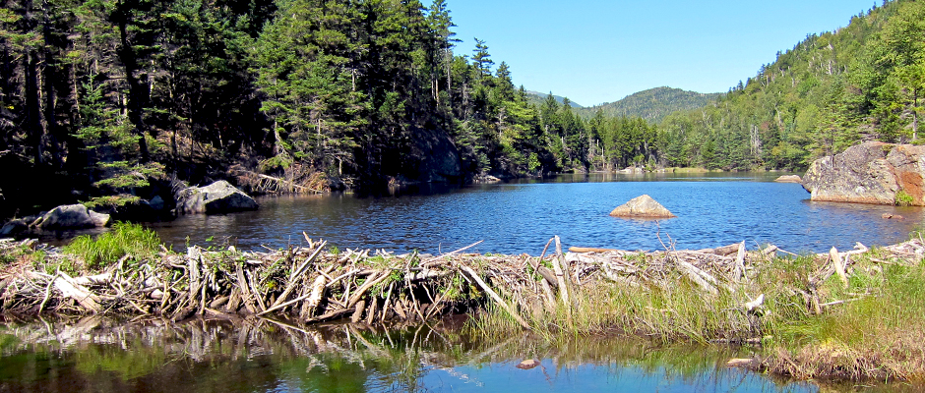
Baseline Amnesia: Beavers
Photo: The Wilderness Society

Slide 43
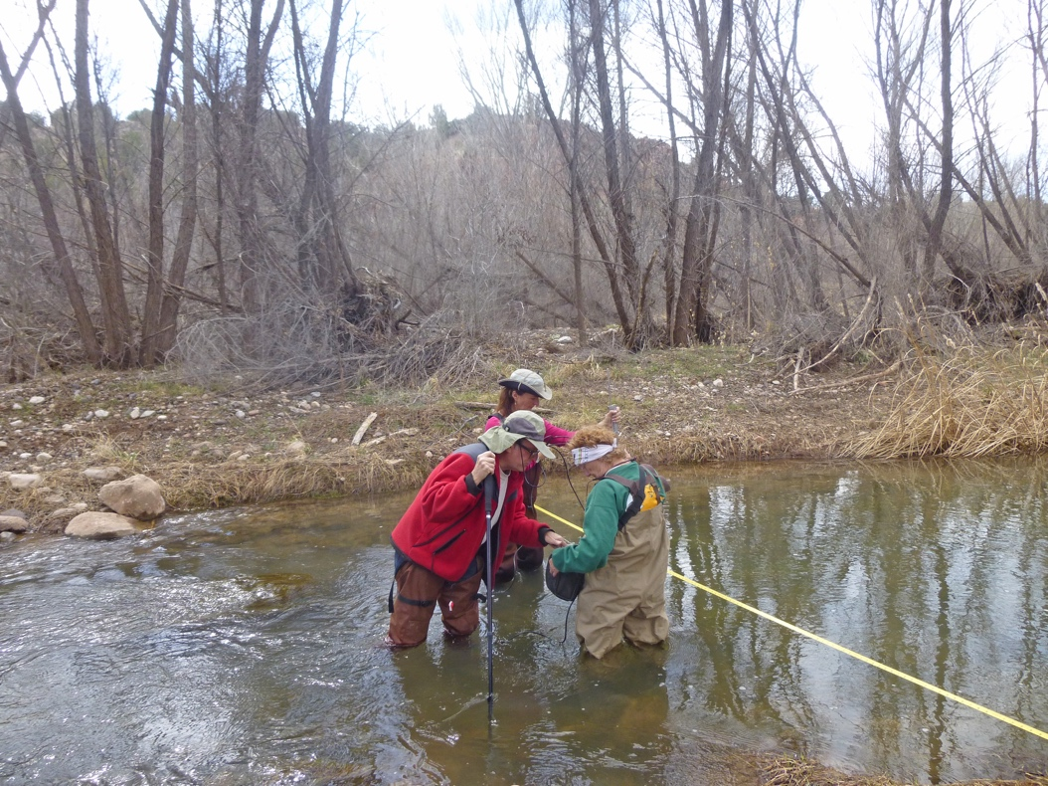
Rebuilding Watershed Resiliency
Excellent potential for enhancement
Trees and mature forests give shade and stabilize the waterway
High economic return

Slide 44
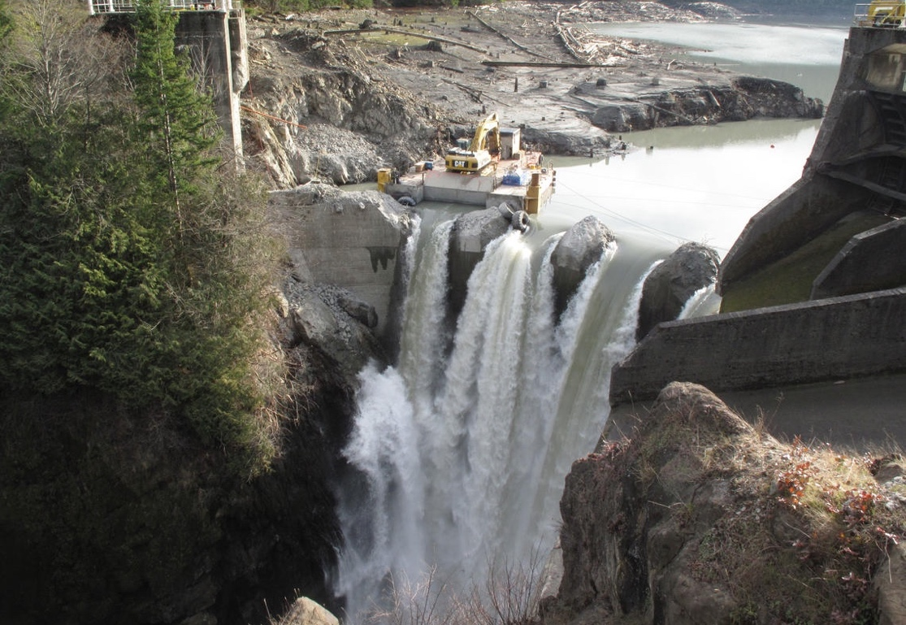
Watershed Restoration: Opportunities Abound
Logging road removal
Dam removal
Beaver reintroduction
Habitat restoration
Create, enhance, and protect “cold spots” for salmon

Slide 45
“There can be no purpose more inspiring than to begin the age of restoration, reweaving the wondrous diversity of life that still surrounds us.”
– Edward O. Wilson, The Diversity of Life

Slide 46
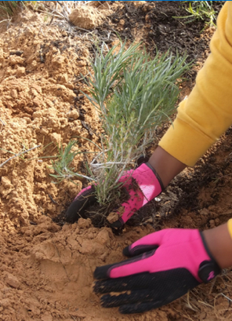
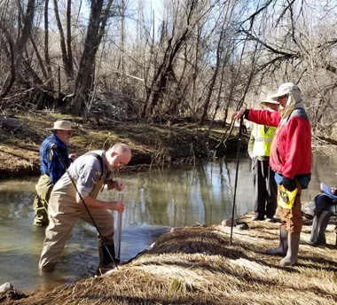

Public Lands Stewardship
Restoring native vegetation
Water quality monitoring
Removing
invasive species
Restoration work heals the land and makes it more resilient to climate impacts

Slide 47

Keep the Conversation Going
Know your local public land management agencies
Participate in public land and waterway planning processes
Learn more about the policies in place for local public lands and streams
Join Great Old Broads for Wilderness!

Slide 48

Upcoming Broads Events in Your Area
www.greatoldbroads.org

Slide 49
Please consider making a tax-deductible donation to Great Old Broads for Wilderness, a 501(c)3 organization, to help continue and expand this program.
We thank you for your support!
www.greatoldbroads.org

