Slide 1
Invasive Species Monitoring Volunteer Training
“You cannot get through a single day without having an impact on the world around you. What you do makes a difference and you have to decide what kind of a difference you want to make.”
—Jane Goodall

Slide 2
Great Old Broads for Wilderness is a national grassroots organization, led by women, that engages and inspires activism to preserve and protect wilderness and wild lands.

Slide 3
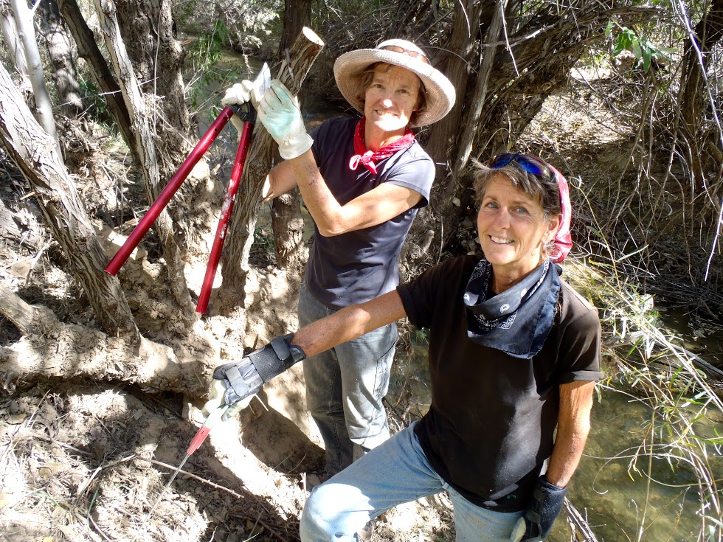
Broads Show Up!
Education
Stewardship
Advocacy

Slide 4
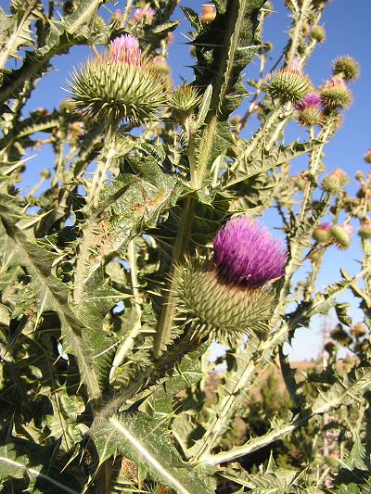
What is an Invasive Species?
Not naturally found in a region.
Capable of causing environmental, economic, or human harm.
Tend to spread rapidly.
Outcompete native species.
Scotch Thistle (Photo: City of Portland, Ore.)

Slide 5
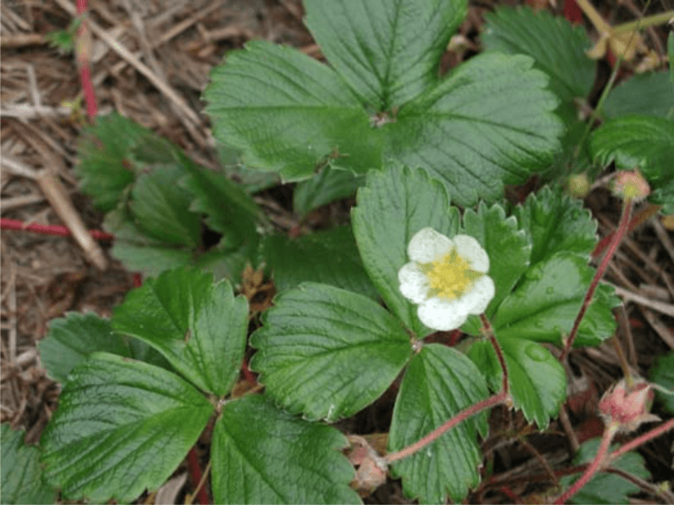
What are Native Species?
Native plant species have evolved to thrive in harmony with other parts of the ecosystem
“Non-native” is foreign but not necessarily “invasive”
Coastal Strawberry (Photo: Oregon State University)

Slide 6
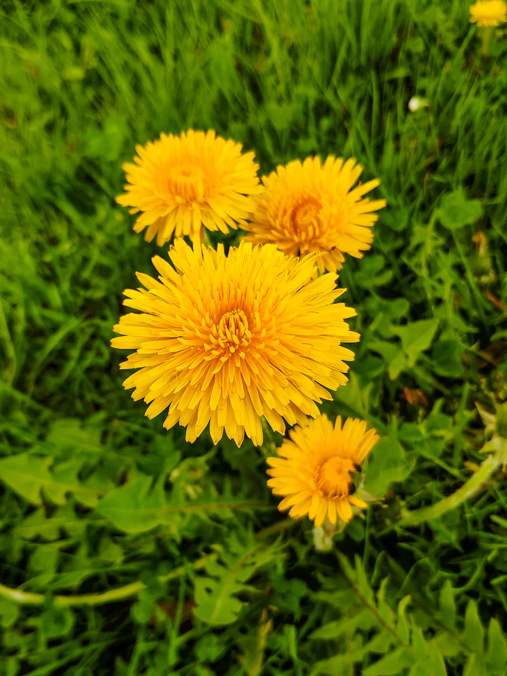
Invasive Species vs. Weeds
Weeds are anything unwanted in a particular location.
Weeds can be native, non-native or invasive.
Dandelion (Photo: Wasco County Public Library)

Slide 7
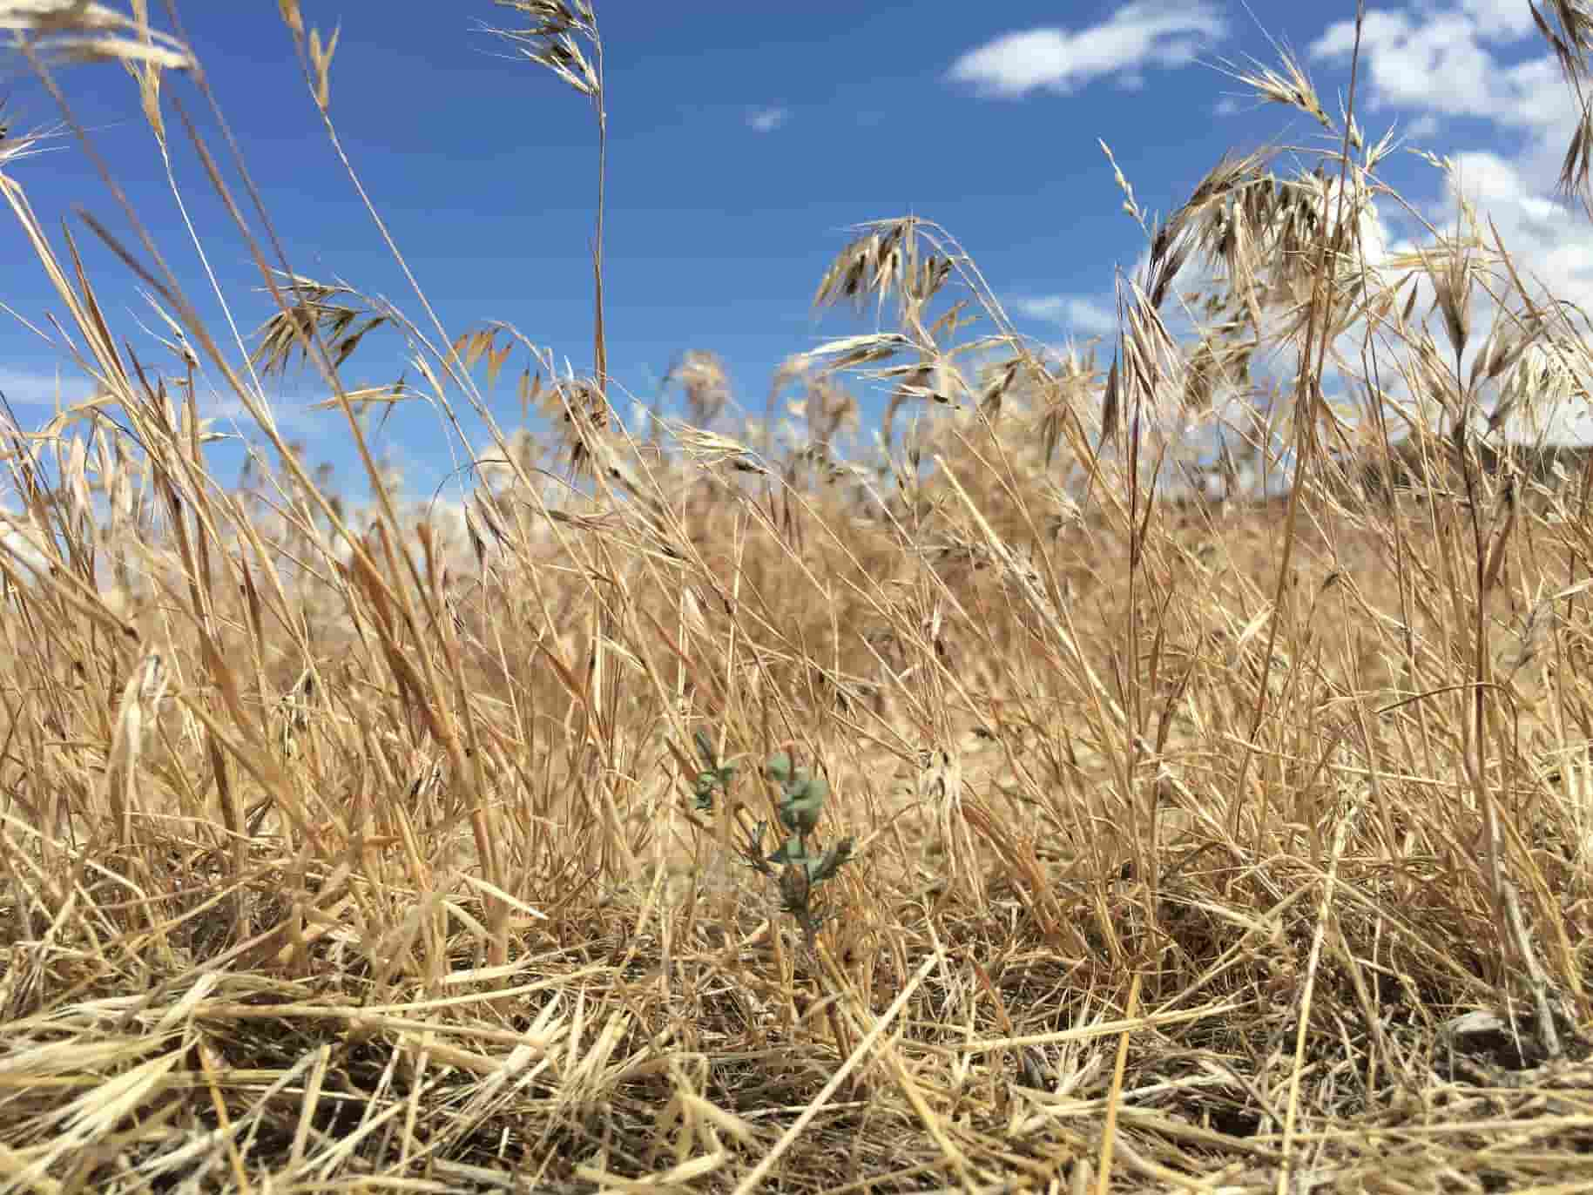
Why Address Invasive Species?
Cheatgrass (Photo: Farmers.gov)

Slide 8
Layered Threats to Public Lands
(Photo: USFS)
(Photo: National Parks Conservation Assoc.)
(Photo: BLM)

Slide 9
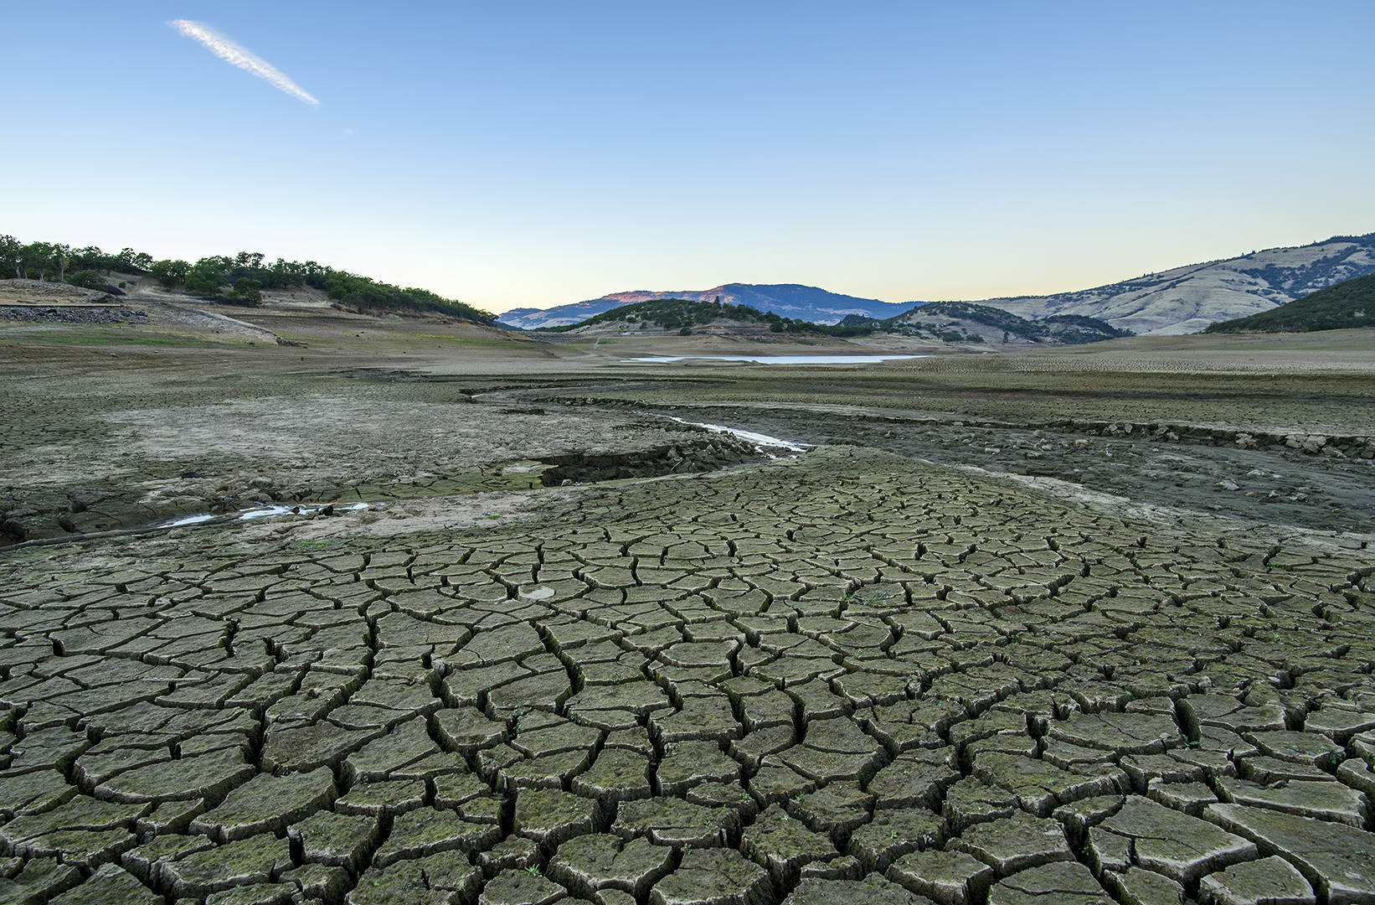
The Biggest Threat to Public Lands:
Climate Change
Emigrant Lake, OR (Photo: Ashland Daily)

Slide 10
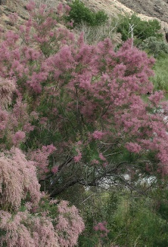
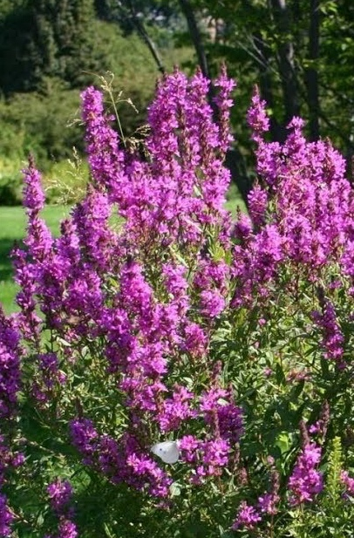
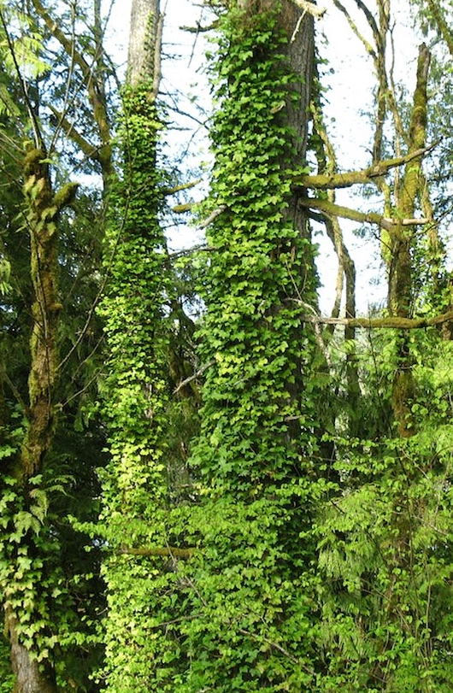
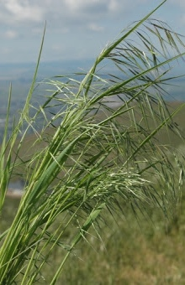
Invasive Species in a Changing Climate:
Species Spotlights
Tamarisk (Photo: Oregon State Univ.)
Purple Loosestrife (Photo: NISIC)
English Ivy (Photo: WSNWCB)
Cheatgrass (Photo: Purdue University)

Slide 11
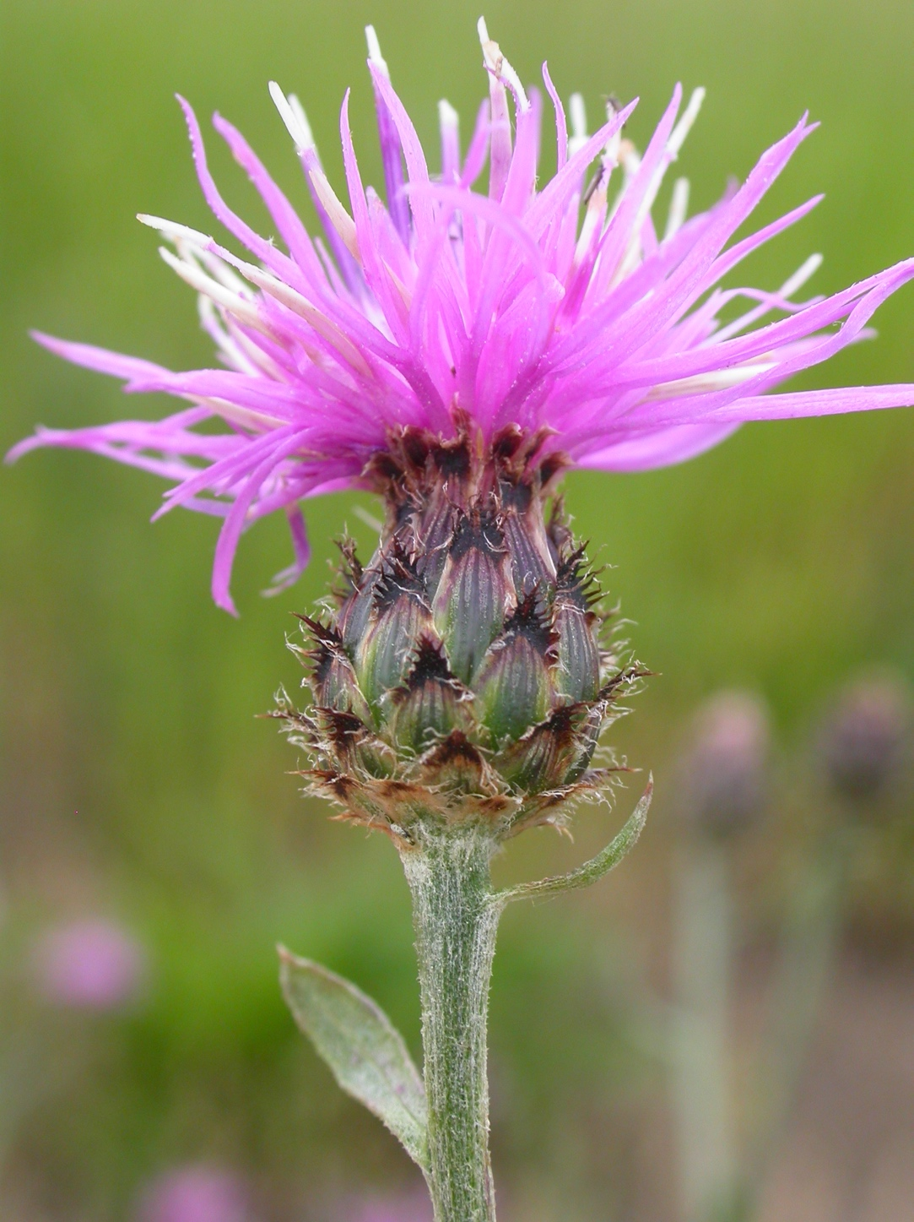
Invasive Spotlight: Spotted Knapweed
Doubled rate of soil erosion
Groundwater recharge decline
Harms water quality
Impacts endangered fish
Spotted Knapweed (Photo: WikiCommons)

Slide 12
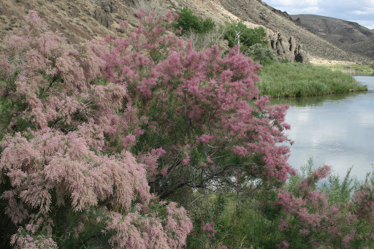
Invasive Spotlight: Tamarisk
Choke out native plants and wildlife along rivers
Very deep tap roots can drain groundwater during worsening droughts
Tamarisk (Photo: Oregon State University)

Slide 13
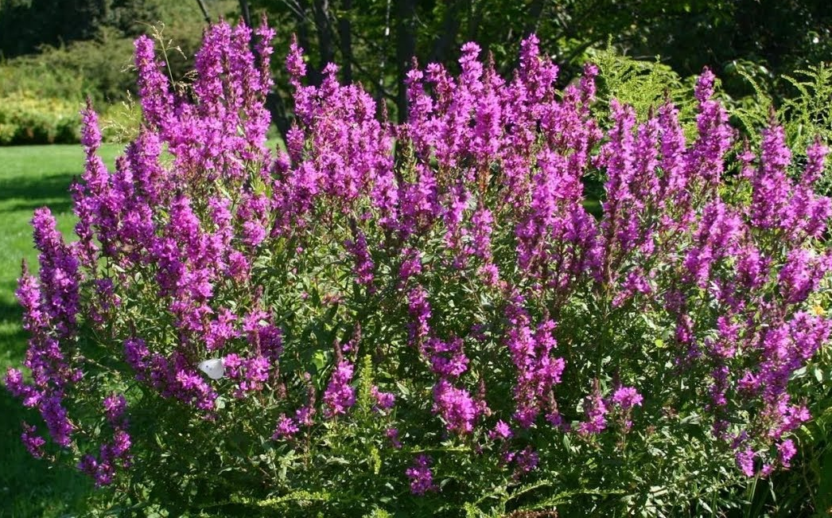
Invasive Spotlight: Purple Loosestrife
Quickly fill in wetlands
Reduce flood retention during extreme weather events
Purple Loosestrife (Photo: Invasive Species Information Council)

Slide 14
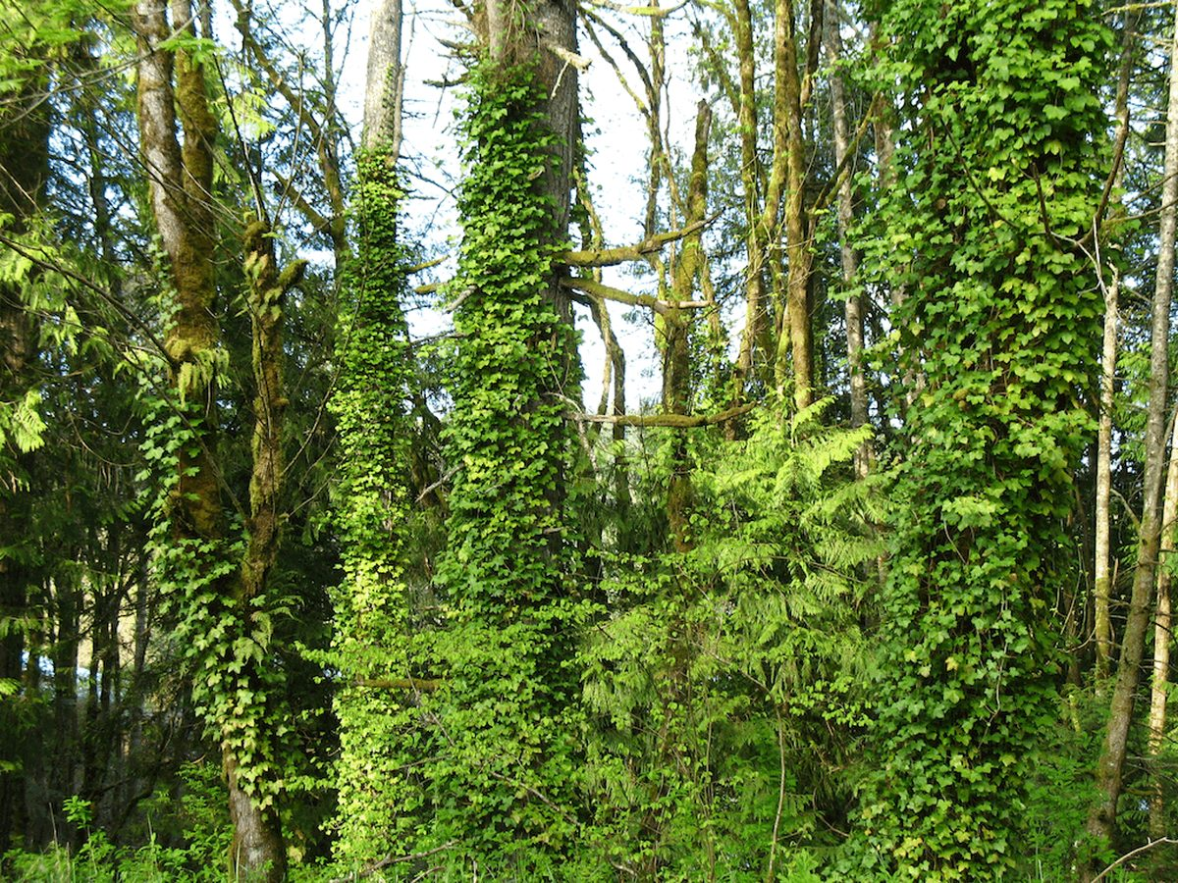
Invasive Spotlight: English Ivy
Shallow root systems that can fail during intense flooding
Cause stream bank erosion
Overtake and kill native trees, compromising forests’ carbon storage
English Ivy (Photo: Wa. Noxious Weed Control Board)

Slide 15
Invasive Spotlight: Cheatgrass
Abnormal, increased fire frequency that feeds their spread
Increasing threat of financially and ecologically damaging prairie fires across the Northwest
Monoculture – a danger to diversity
Cheatgrass (Photo: farmers.gov)

Slide 16
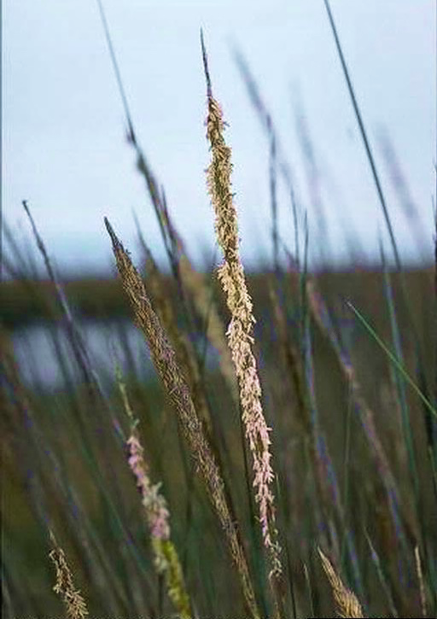
The High Cost of Invasive Species
Invasive species cost the U.S. more than $120 Billion in damages each year.
Spartina (Photo: University of California)

Slide 17
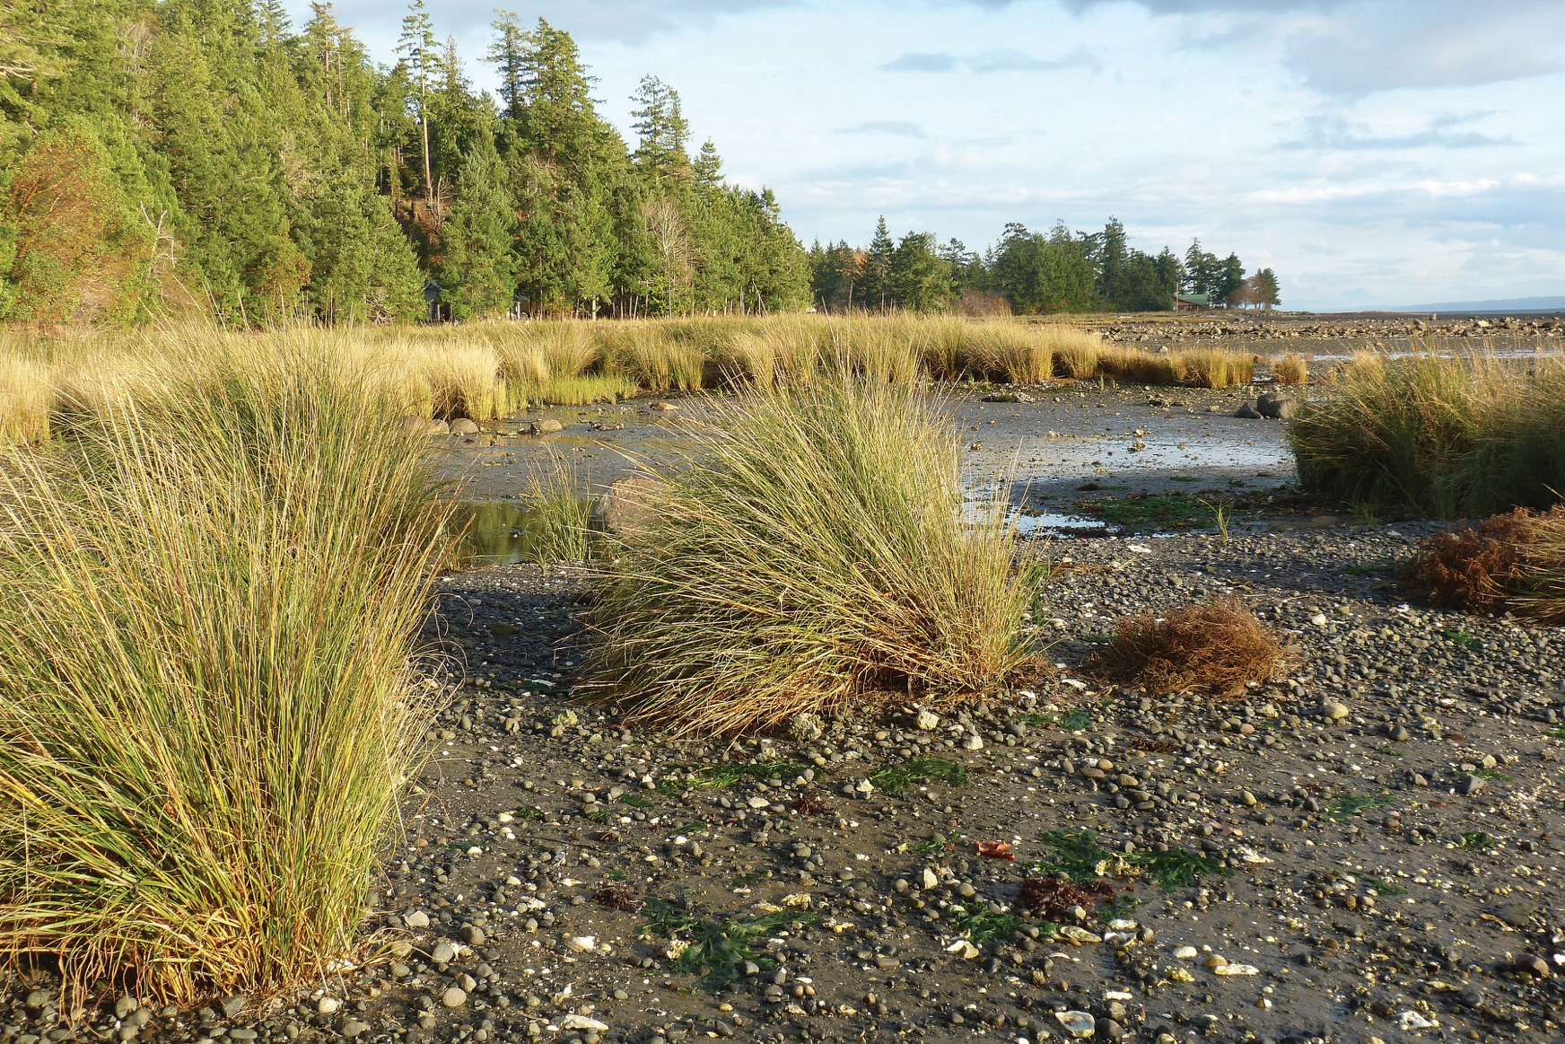
The Pricey Problem of Spartina
Invades intertidal areas and estuaries
Disrupts complex food webs
Alters movement of water, causing coastal flooding
Washington, Oregon, and California spend millions annually on Spartina management
Spartina (Photo: Ducks Unlimited Canada)

Slide 18
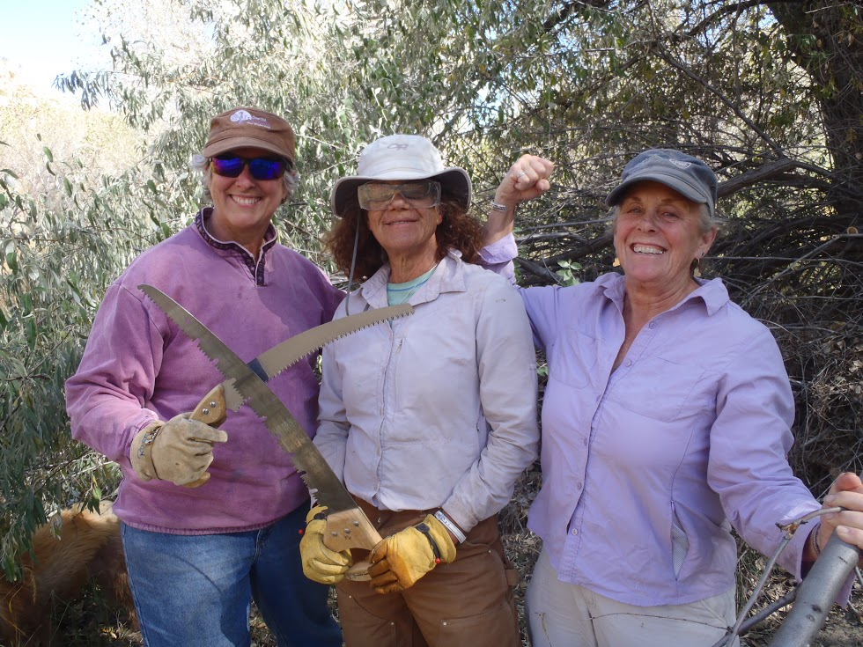
Getting Ahead of the Problem
Prevention is cheaper, more effective than eradication.
Rapid response monitoring helps land managers act quickly.
Early Detection Rapid Response (EDRR)
Volunteers like you are vital!
Broads removing invasive species along Utah’s Escalante River.

Slide 19
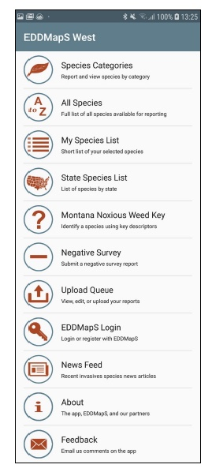
EDDMapS Invasive Species App
Species Field Guide/ID info
• Quickly and accurately identify invasive
species from your phone.
Create a My Species List
• Create a custom list of the invasive species
you find for easy access.
• From the species page, you can create a
detailed report.
Upload Queue
• You don’t need to have a wi-fi connection
or cell signal to operate the app. You can
simply upload your reports when you return
home and have access to a computer.

Slide 20
Please consider making a tax-deductible donation to Great Old Broads for Wilderness, a 501(c)3 organization, to help continue and expand this program.
We thank you for your support!
www.greatoldbroads.org

