Slide 1
Coasts and Climate Protection
Climate Education & Stewardship Program

Slide 2
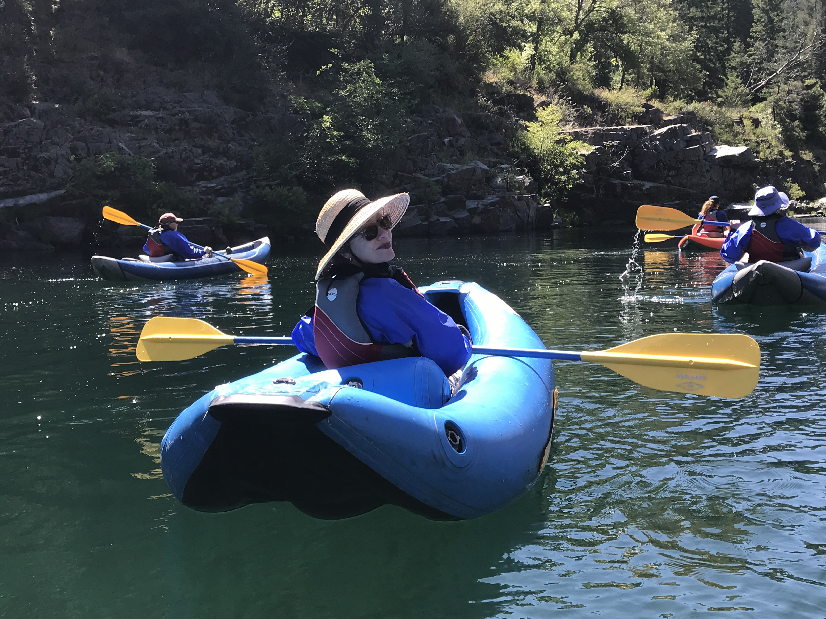
What Is Great Old Broads for Wilderness?
Great Old Broads for Wilderness is a national grassroots organization, led by women, that engages and inspires activism to preserve and protect wilderness and wild lands.

Slide 3
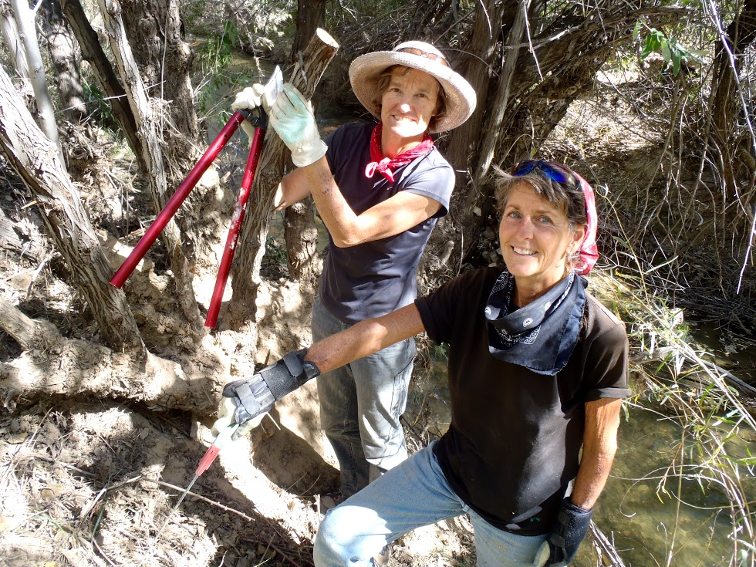
Great Old Broads for Wilderness Mission
Education
Stewardship
Advocacy

Slide 4
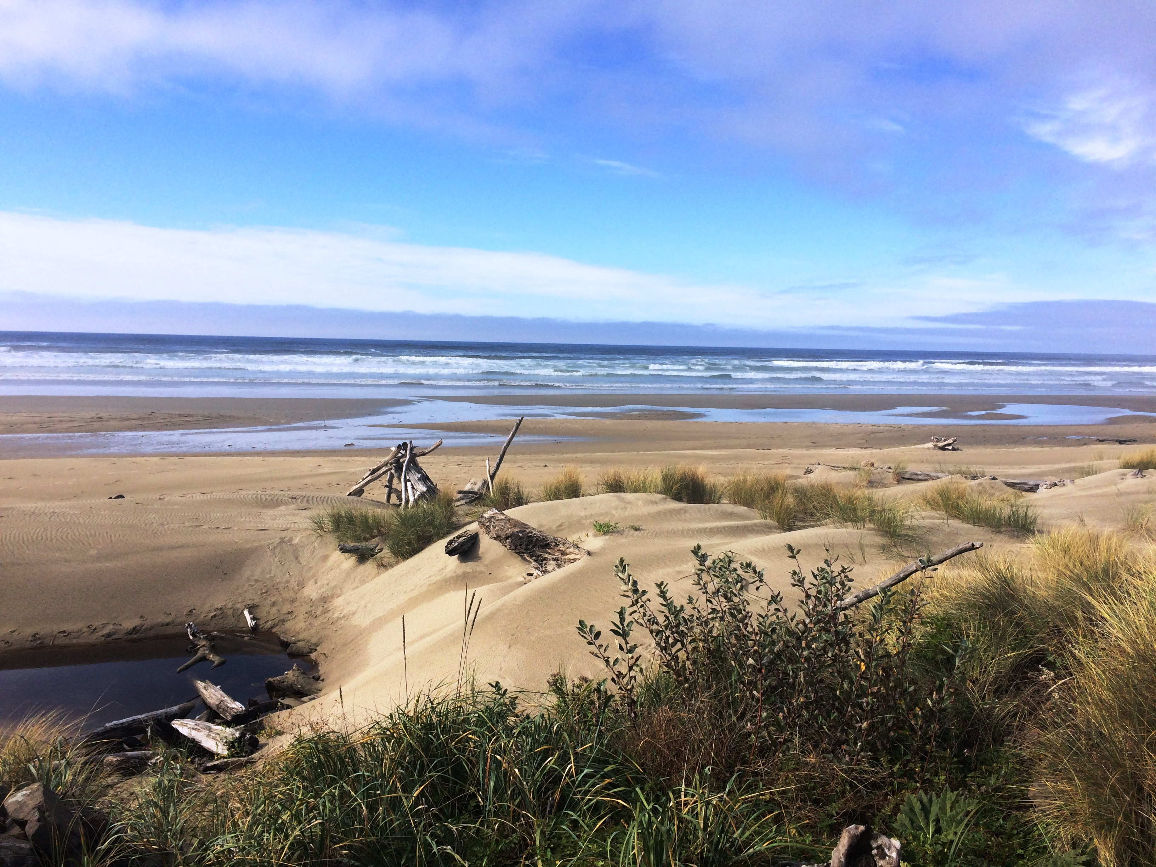
Today We’ll Learn About:
Public lands and their role in climate change
Impacts of climate change on oceans and coastal ecosystems
Ways to build climate resilience in our oceans and coastlines.

Slide 5
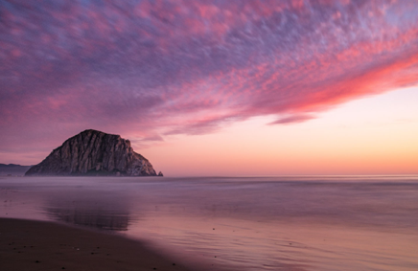
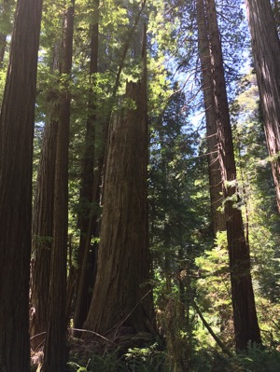
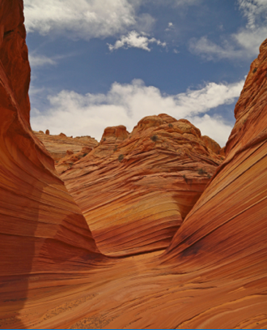
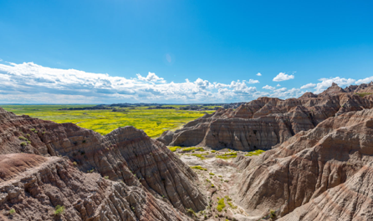
What are Public Lands?

Slide 6
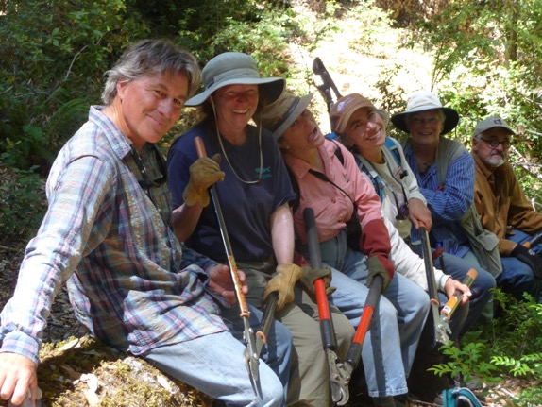
Federal, State, and Local Public Lands
National Parks
National Forests
National Conservation Lands
State Parks
City Parks
Wild and Scenic Rivers
National Monuments
National Recreation Areas
Wilderness Areas
Wilderness Study Areas

Slide 7
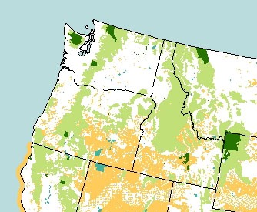
Federal Public Lands in the Northwest
Bureau of Land Management
Fish & Wildlife Service
Forest Service
National Park Service
The federal government manages almost half of the land base in the Pacific Northwest (60% of the land in Idaho, 48% in Oregon, and nearly 30% in Washington).
Map of U.S. public lands by Kara Clauser, Center for Biological Diversity.

Slide 8
How Do Public Lands Relate to Climate Change?

Slide 9
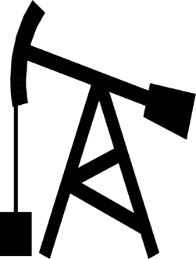
Public Lands Use and Climate Change
Public lands emit 4.5 times the amount carbon they absorb
Center for American Progress, 2013; in Millions of Metric Tons of Carbon-Equivalent (mmCO₂e); in 2012, the U.S. gross emissions were 6545 mmCO₂e with gross offset of 881 mmCO₂e

Slide 10
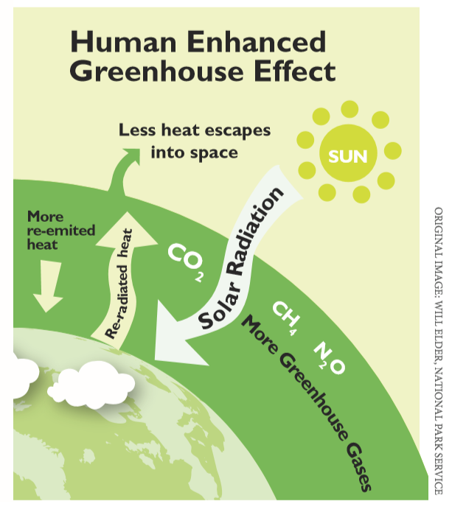
Public Lands Use and Climate Change

Slide 11
Oceans and Coasts Taking the Heat
90% of the Heat
1/3 of the CO₂
As a result, today’s ocean is…
Warmer
More acidic
Oxygen deprived
Less productive

Slide 12
Northwest Coastal Public Lands

Slide 13
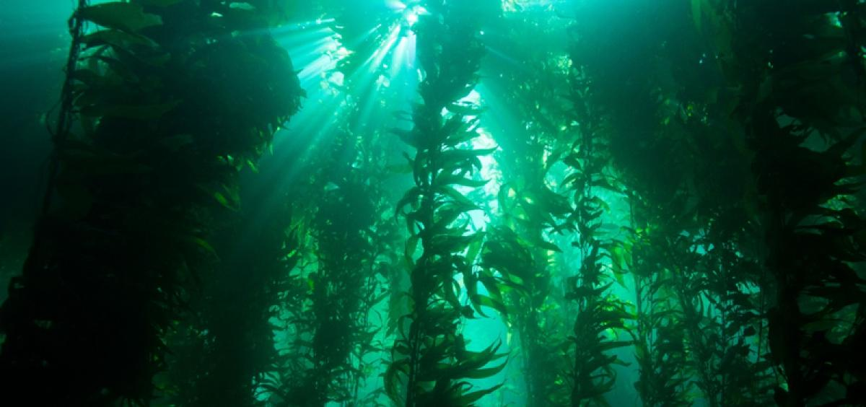
Marine Protected Areas
(Photo: Oregon State University)

Slide 14
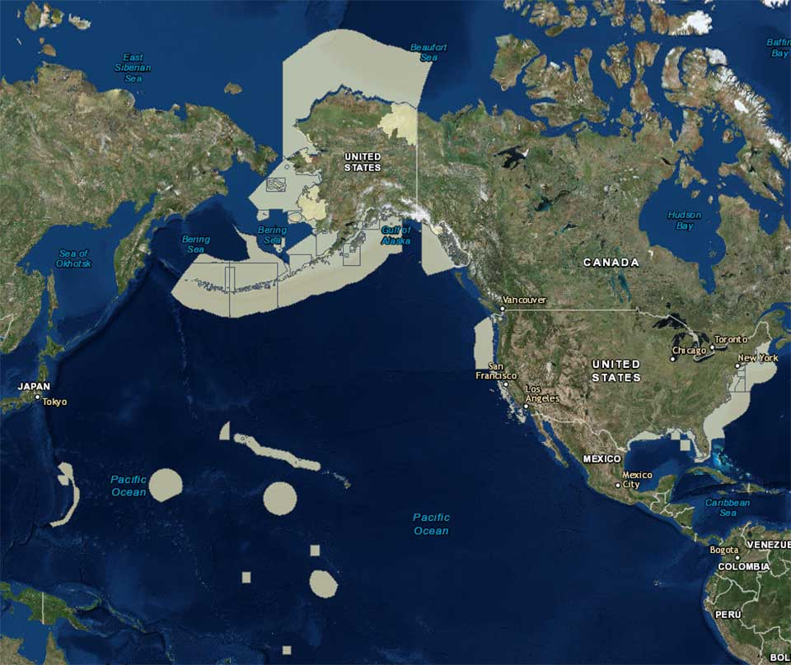
Where are Marine Protected Areas?
Over 1,700 designated Marine Protected Areas in the United States
Only 3% of U.S. oceans are “fully” protected, another 20% are “highly” protected (some fishing allowed)
(Map: NOAA)

Slide 15
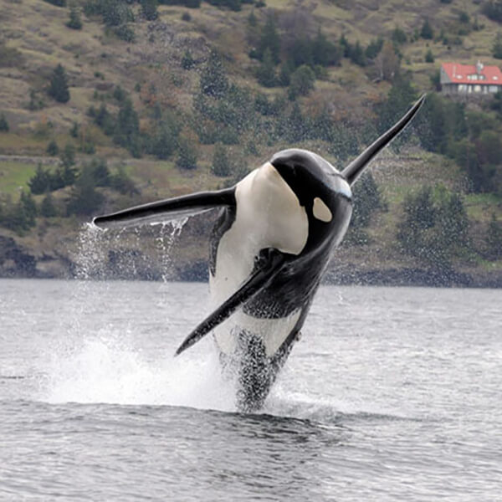
Who Manages Our Marine Public Areas?
77% are managed by coastal states and territories
15% are managed by the federal government
8% are managed by federal/state partnerships
Orca (Photo: Marine Mammal Commission)

Slide 16
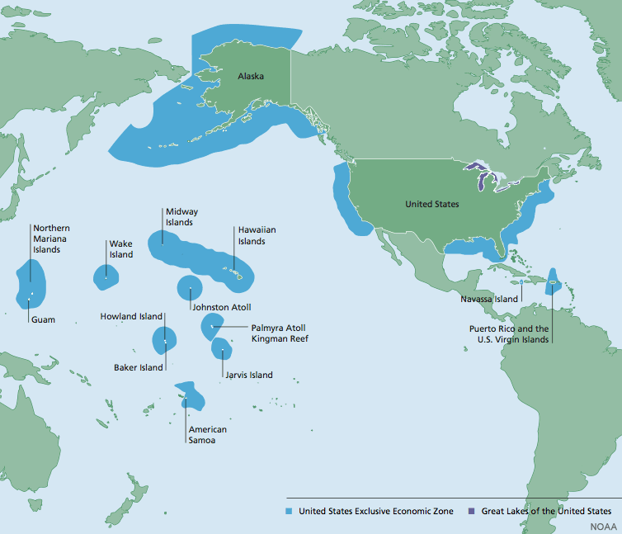
Ocean Territories and the United States
The United States has more ocean territory than land!
(Graphic: NOAA)

Slide 17
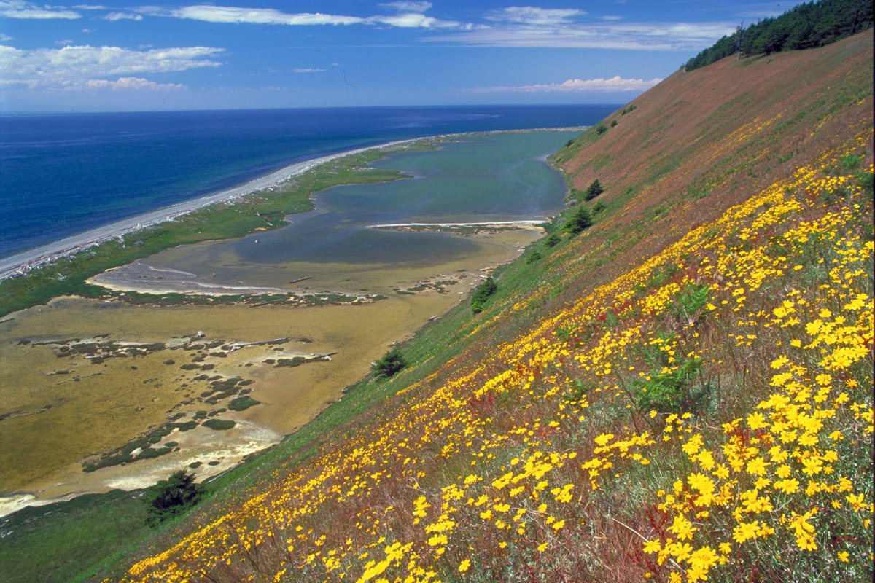
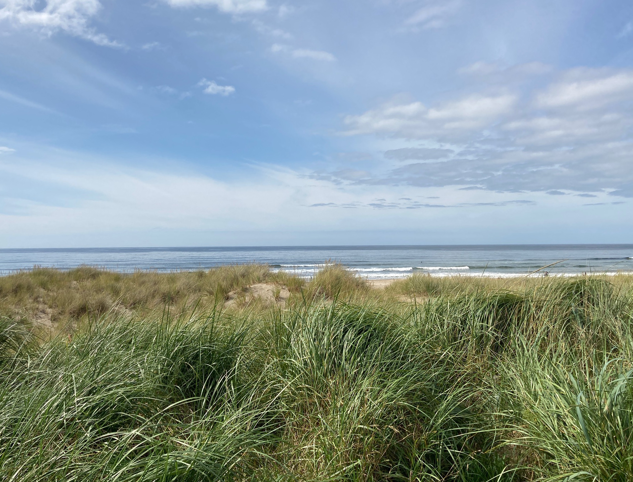
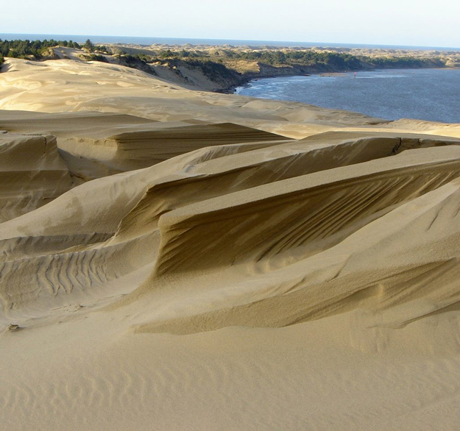
Coastal Ecosystems
Ebey’s Landing, WA (Photo: The Nature Conservancy)
(Photo: Judy Todd)
Oregon Dunes (Photo: SaveOregonDunes.org)

Slide 18
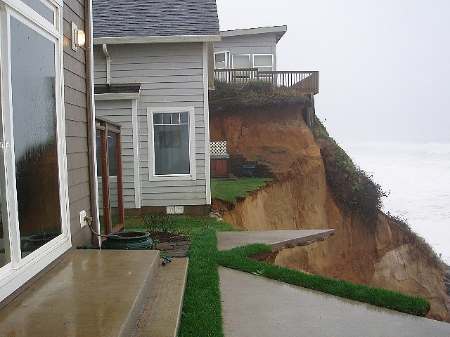
Coastal Climate Change Impacts
(Photo: Phys.org)

Slide 19
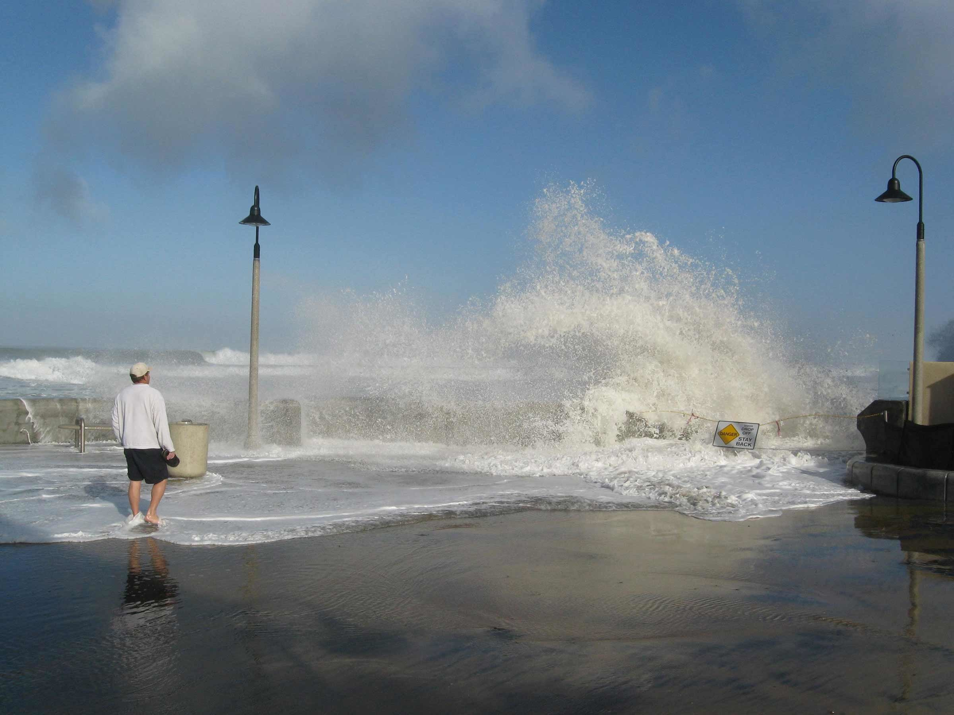
Coastal Climate Change Impacts
Extreme weather events like flooding and hurricanes
Coastal erosion and sea level rise
Ocean acidification and temperature rise
Disproportionate impacts to frontline communities
Photo: Phys.org

Slide 20
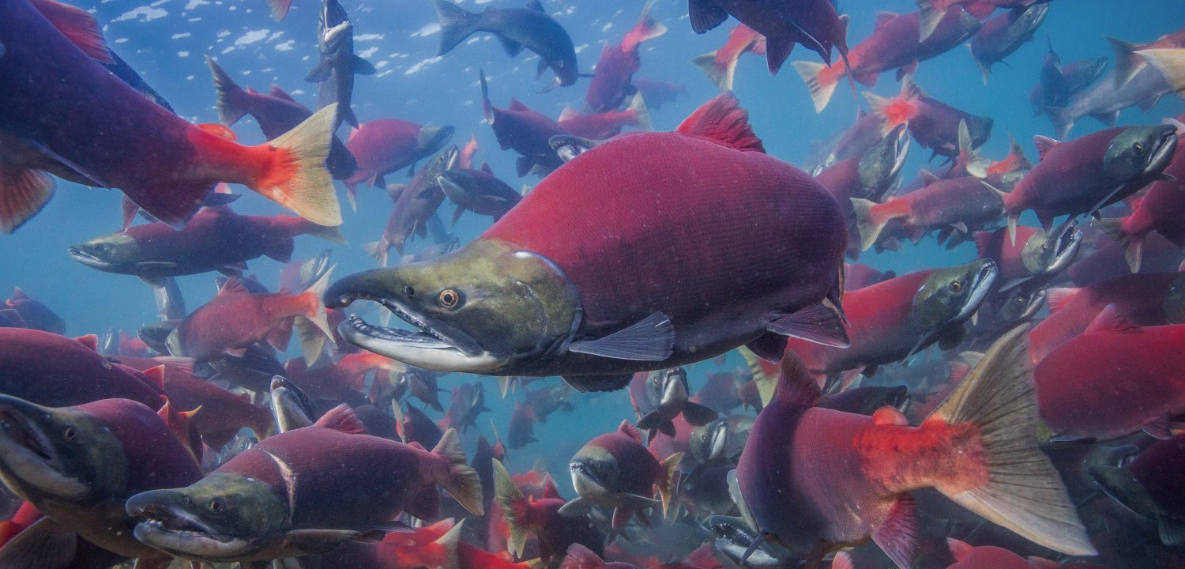
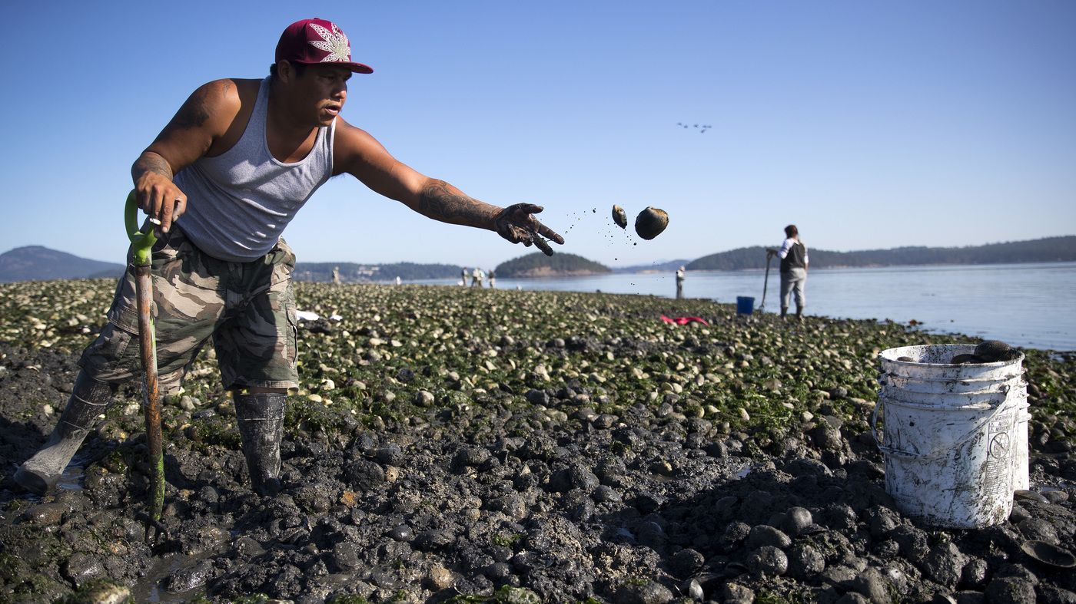
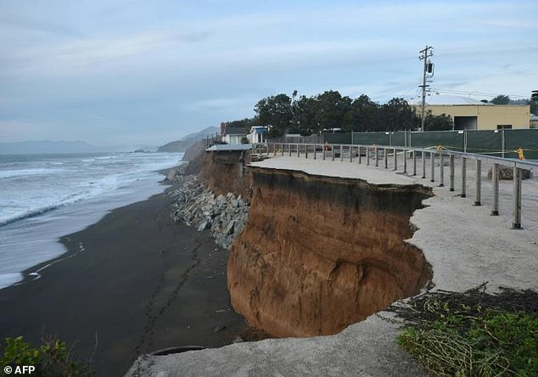
Coasts and Climate Change Impacts
Coho Salmon (Photo: Wild Salmon Center)
(Photo: NPR)
(Photo: AFP)

Slide 21
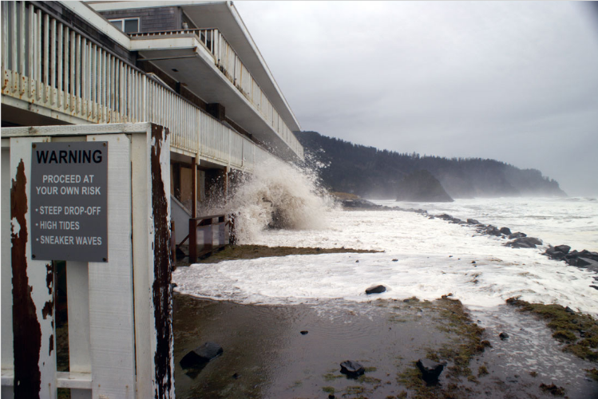
Climate-driven Sea Level Rise
Photo: Oregon Dept. of Geology and Mineral Studies

Slide 22
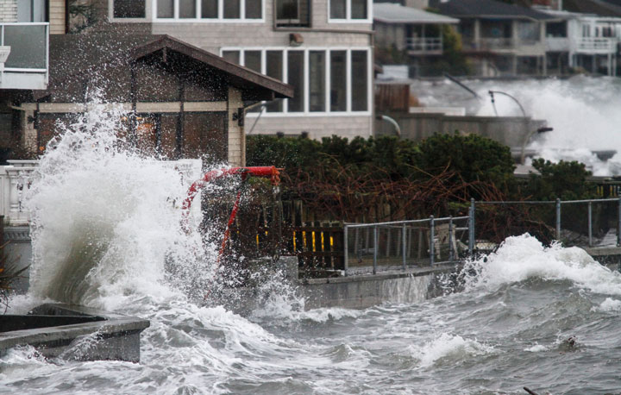
Impacts of Sea Level Rise on People
By the year 2100…
Sea-level rise of 3 feet places 4.2 million people at risk of inundation.
Sea-level rise of 6 feet could affect 13.1 million people.
Photo: City of Seattle

Slide 23
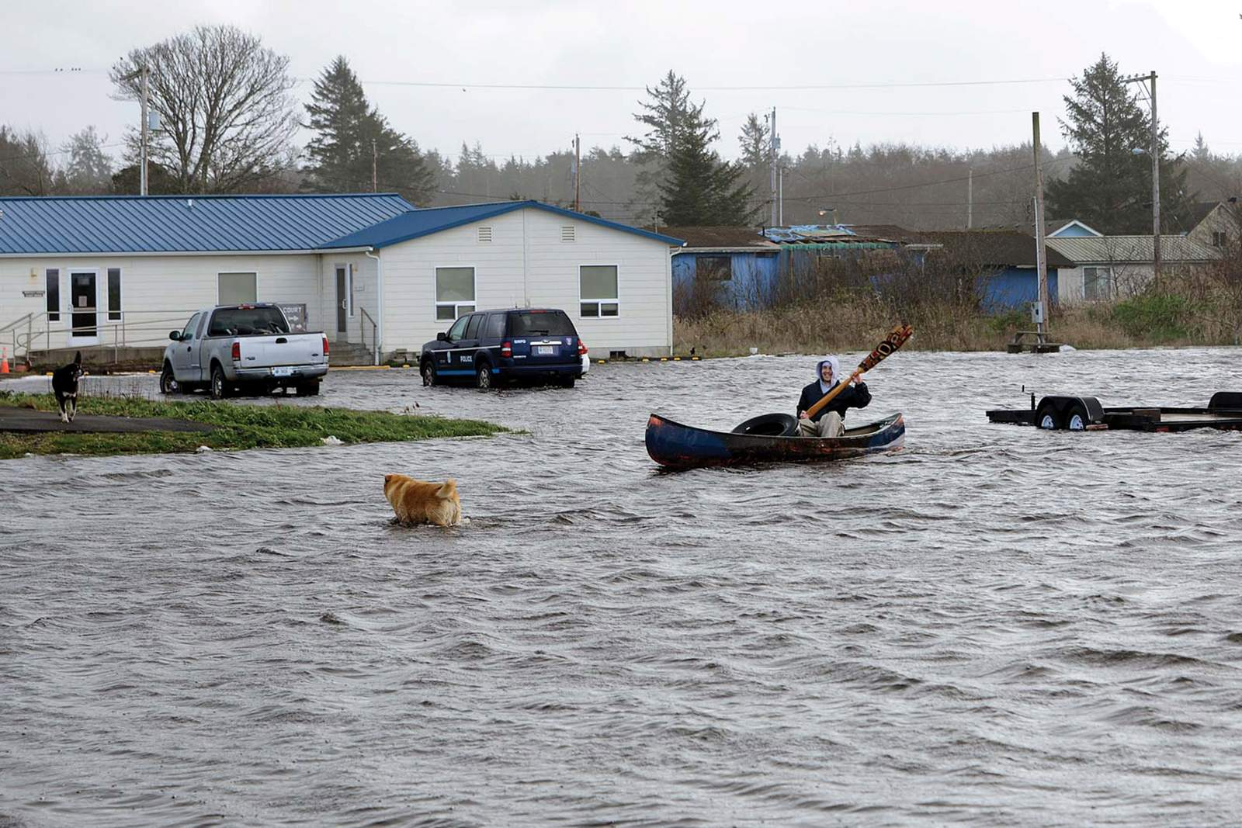
Frontline Communities
Taholah, WA (Photo: Quinault Indian Nation)

Slide 24
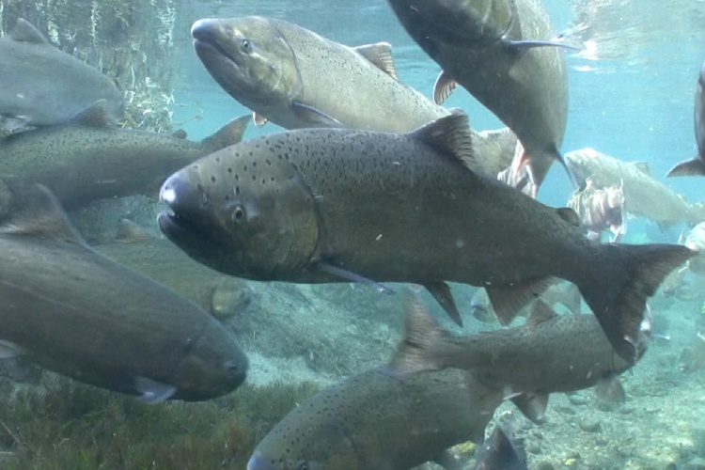
Sea Level Rise Impacts to Ecosystems
Chinook Salmon (Photo: NOAA)

Slide 25
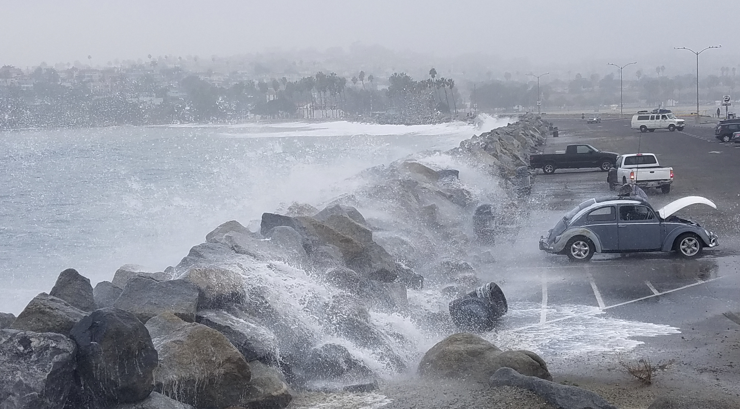
Climate Impacts: Storm Surges
Storm surges magnify sea level rise by 5X
Photo: USGS

Slide 26
Climate Impacts: Ocean Acidification
Graphics: EPA, NEEF

Slide 27
Climate Impacts: Ocean Acidification
Graphics: EPA, NEEF

Slide 28
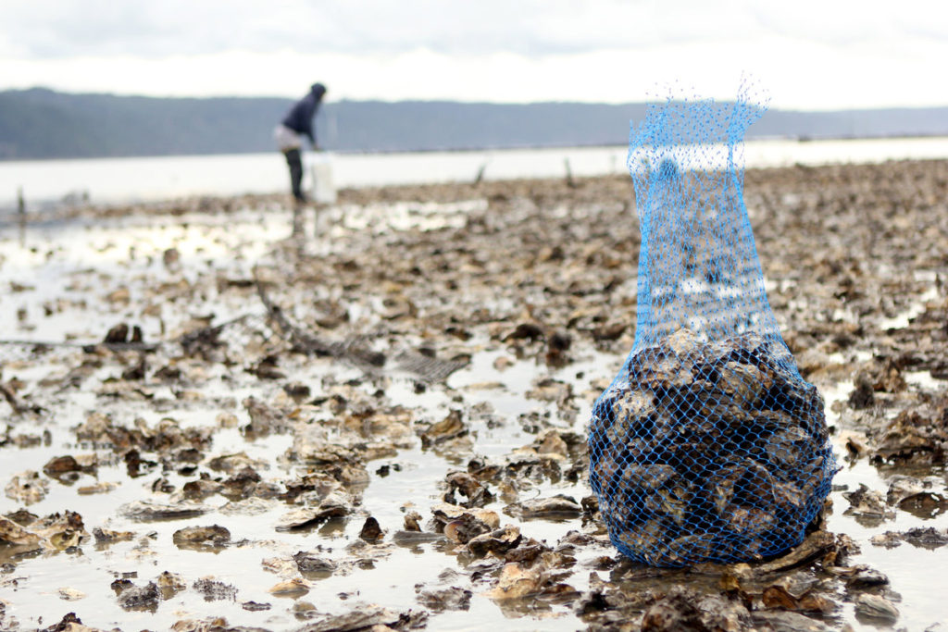
Climate Impacts: Ocean Acidification
Shellfish farmers and coastal Indigenous communities
Wildlife that depends on shellfish as food source
Oyster harvest along the Washington coast. (Photo: Pacific Coast Shellfish Growers Assoc.)

Slide 29
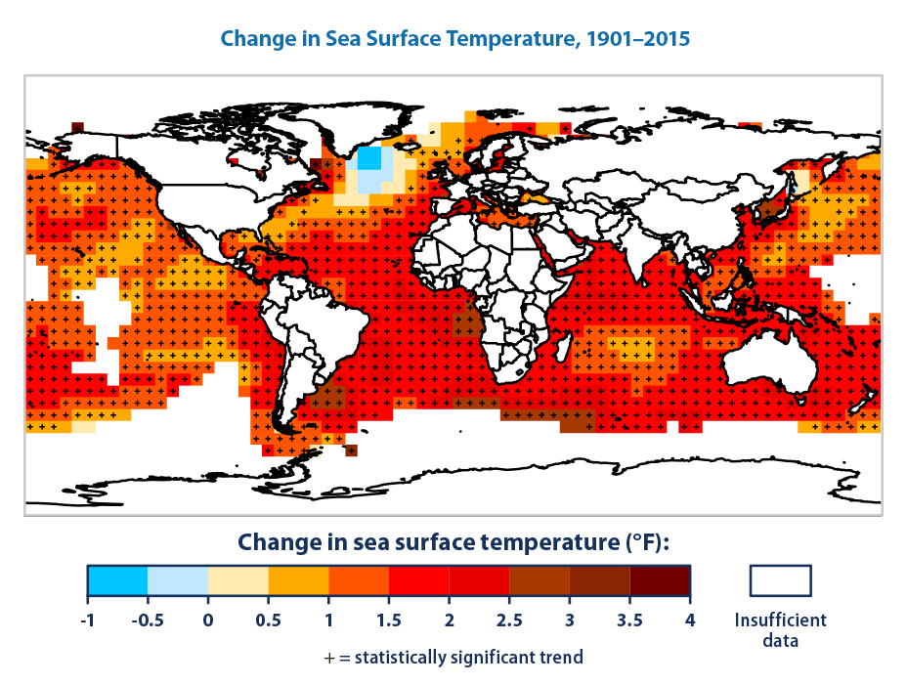
Climate Impacts: Ocean Temperatures
(Graphic: EPA)

Slide 30
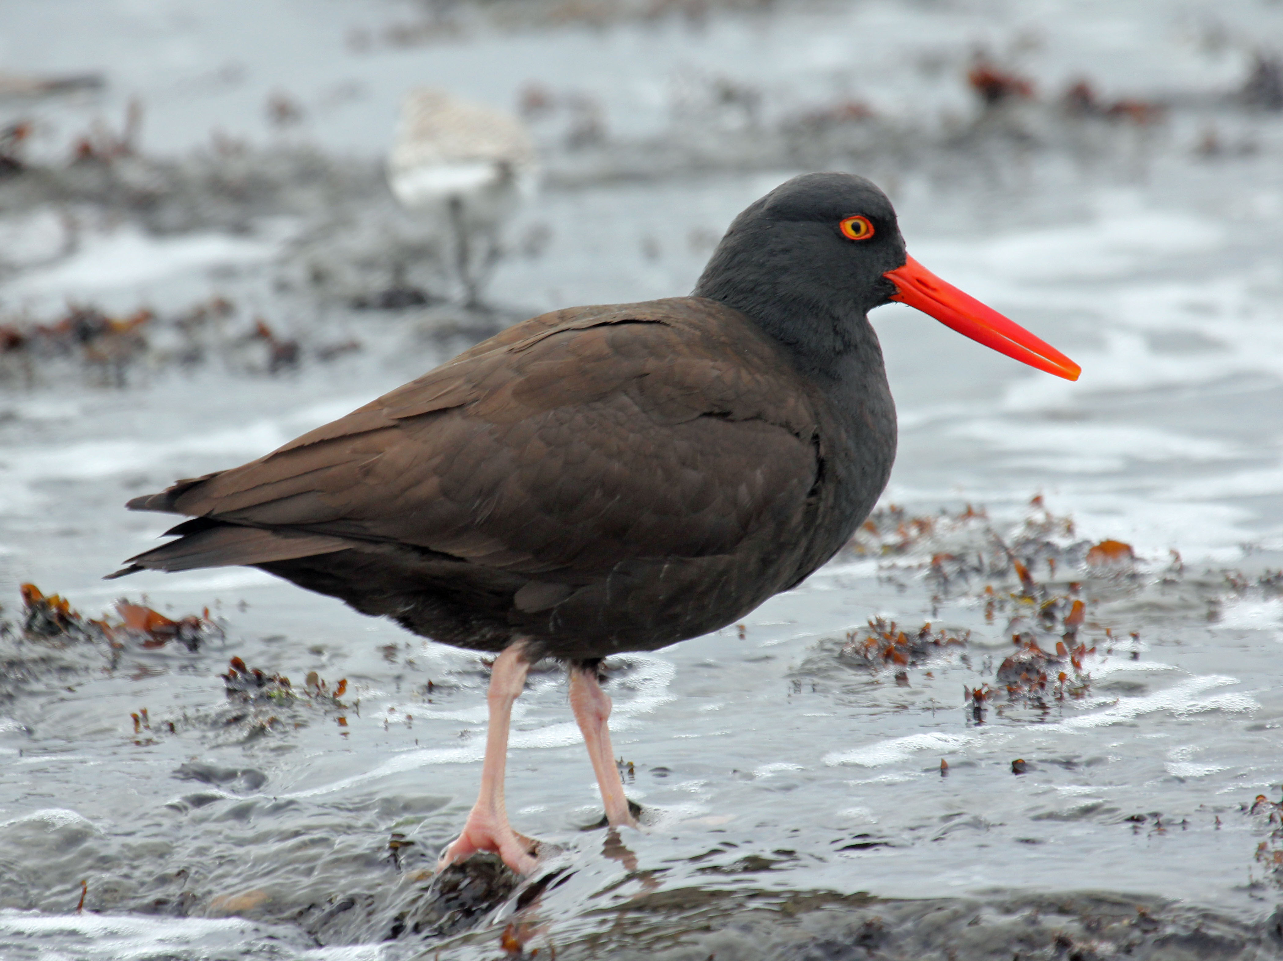
Climate Impacts: Wildlife
Water temperature changes decrease food sources and suitable habitats.
Chances for species recovery decrease the longer and more severe the climate-related disruption.
Black Oystercatcher (Photo: Wikipedia)

Slide 31
Natural Climate Defense
Heceta State Beach, Oregon (Photo: Judy Todd)

Slide 32
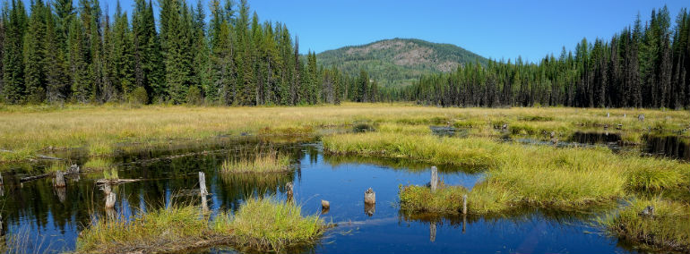
Coastal Ecosystems & “Blue” Carbon Sinks
(Photo: Washington Department of Natural Resources)
Tidal marshes, seagrass beds, and tidal forests are very efficient at storing “blue” carbon
Coastal wetlands store 10X the carbon per acre compared to forests
Coastal ecosystems in the PNW hold more carbon on average than other U.S. ecosystems

Slide 33
Coastal Ecosystems: Benefits Beyond Carbon
Proven protection from storm surges and flooding
Shoreline stabilization

Slide 34
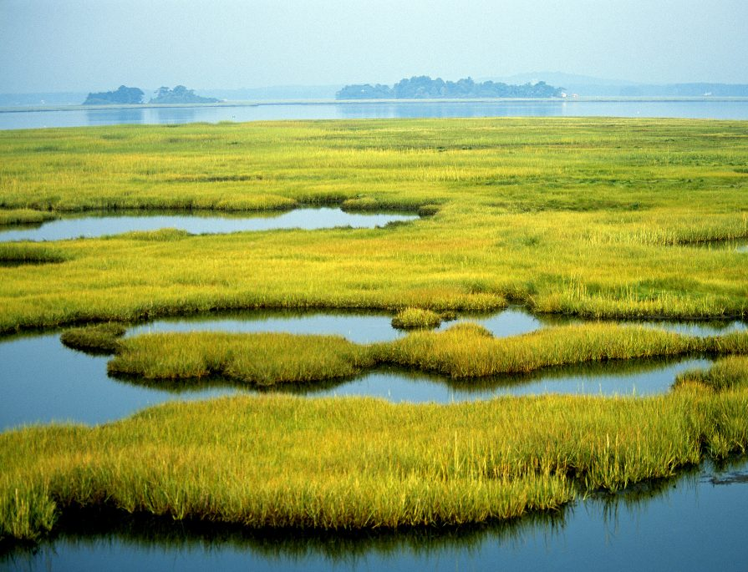
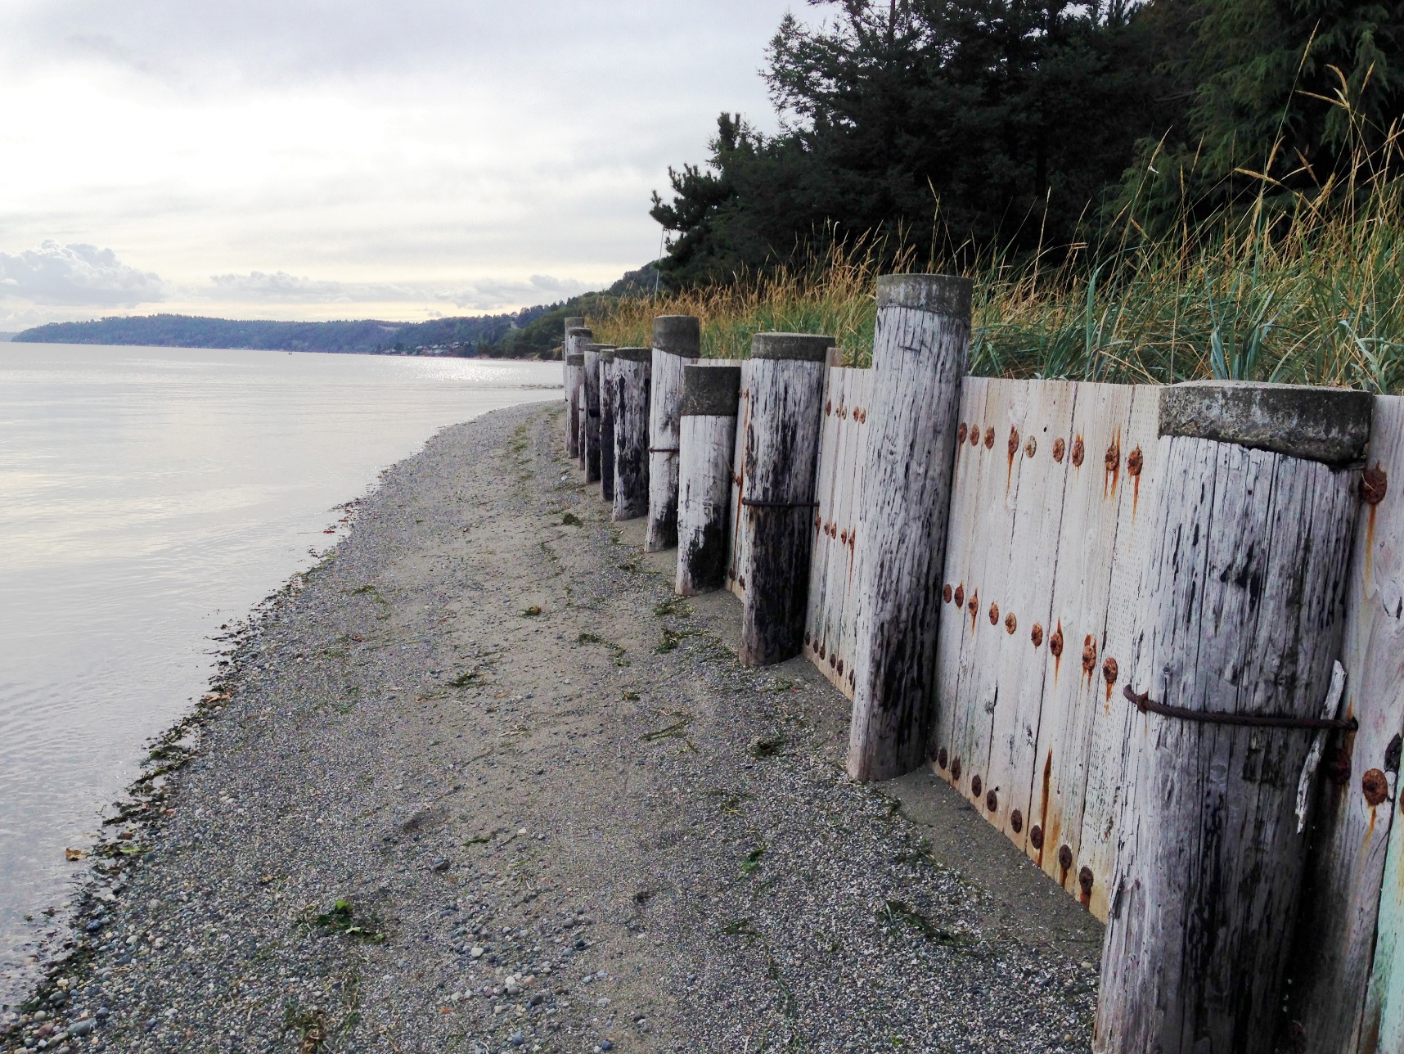
Nature’s Benefits vs. Engineered Alternatives
vs.
(Photo: PBS)
(Photo: Puget Sound Institute)

Slide 35
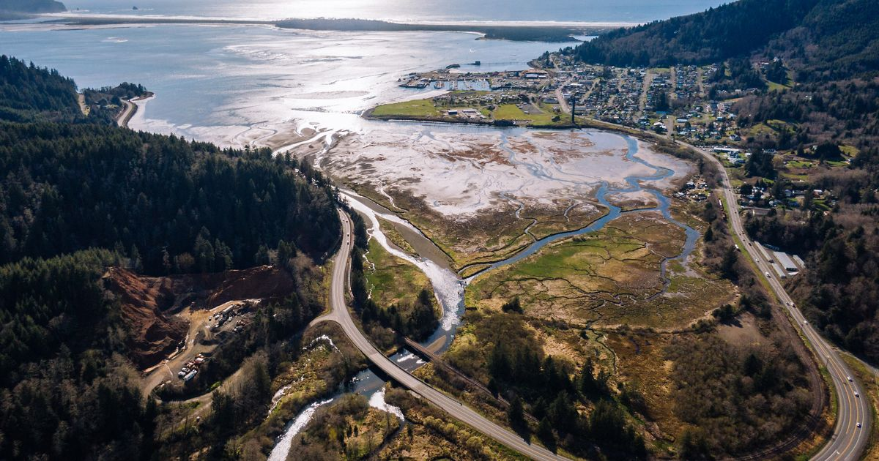
Baseline Amnesia: Coastal Ecosystems
Did you know…
Half of all freshwater and saltwater wetlands in the U.S. have disappeared
95% of Oregon’s coastal forest swamps are now gone
(Photo: The Nature Conservancy)

Slide 36
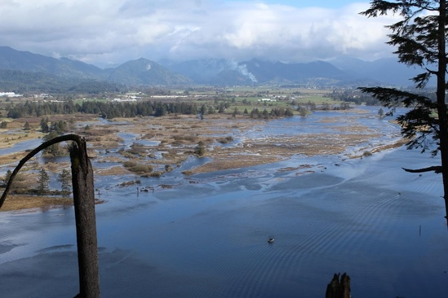
Building Coastal Resilience
Restoration and protection benefits outweigh the costs by 5 to 1 margin.
Oregon Coastal Habitat Project (Photo: NOAA)

Slide 37
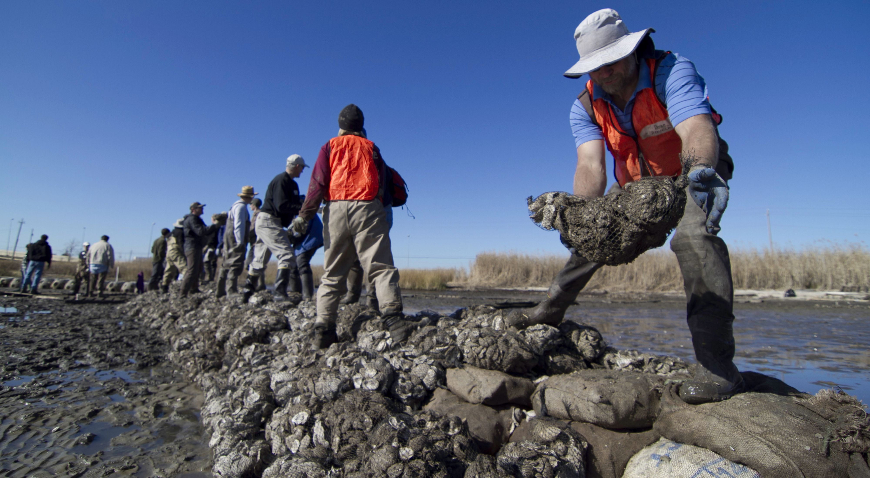
Abundance of Coastal Restoration Projects
Forest marsh replanting
Eelgrass bed restoration
Oyster reef restoration
Dike removal and wetland connectivity enhancements
Oyster bed restoration. (Photo: The Nature Conservancy)

Slide 38
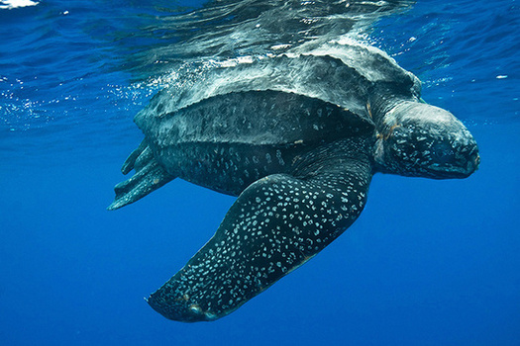
Creating New Marine Protected Areas
Leatherback sea turtle (Photo: NOAA)

Slide 39
“There can be no purpose more inspiring than to begin the age of restoration, reweaving the wondrous diversity of life that still surrounds us.”
– Edward O. Wilson, The Diversity of Life

Slide 40
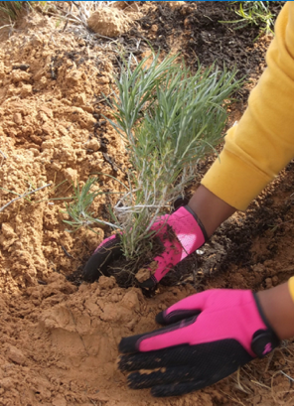
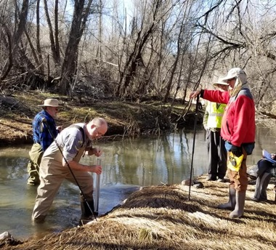
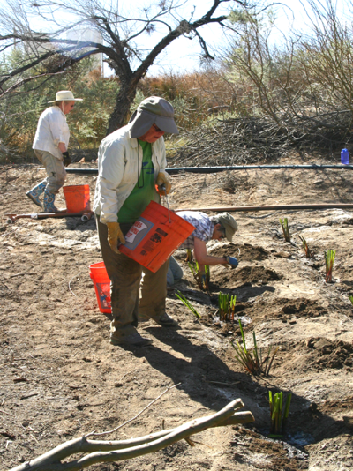
Public Lands Stewardship
Restoring native vegetation
Water quality monitoring
Removing invasive species
Restoration work heals the land and makes it more resilient to climate impacts.

Slide 41
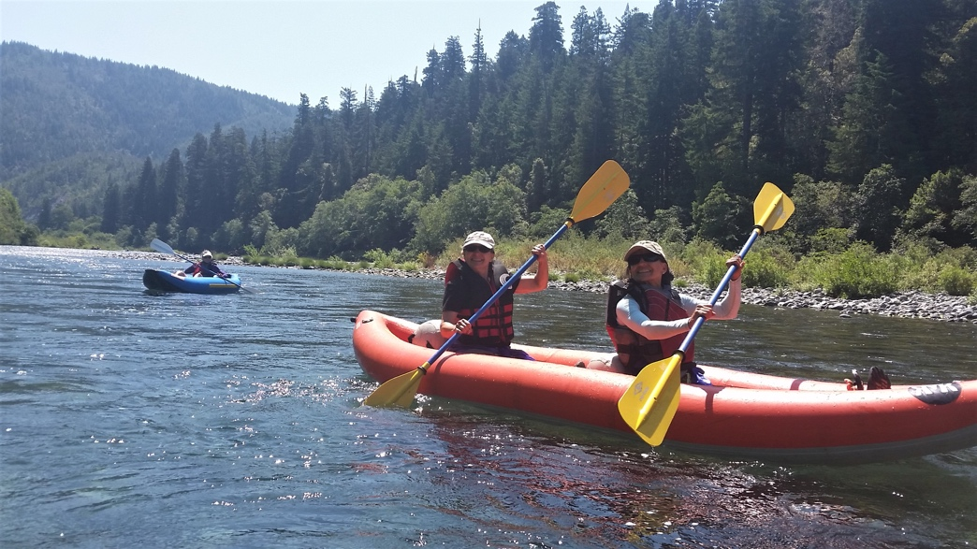
Keep the Conversation Going
Know your local public land management agencies
Participate in public land and waterway planning processes
Learn more about the policies in place for local public lands and streams
Join Great Old Broads for Wilderness!

Slide 42
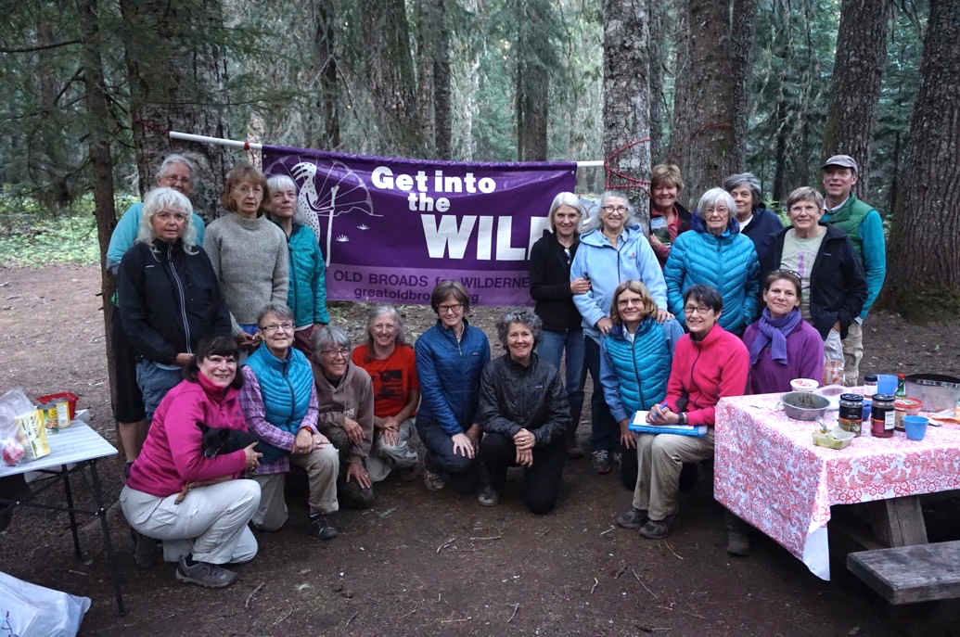
Upcoming Broads Events in Your Area
www.greatoldbroads.org

Slide 43
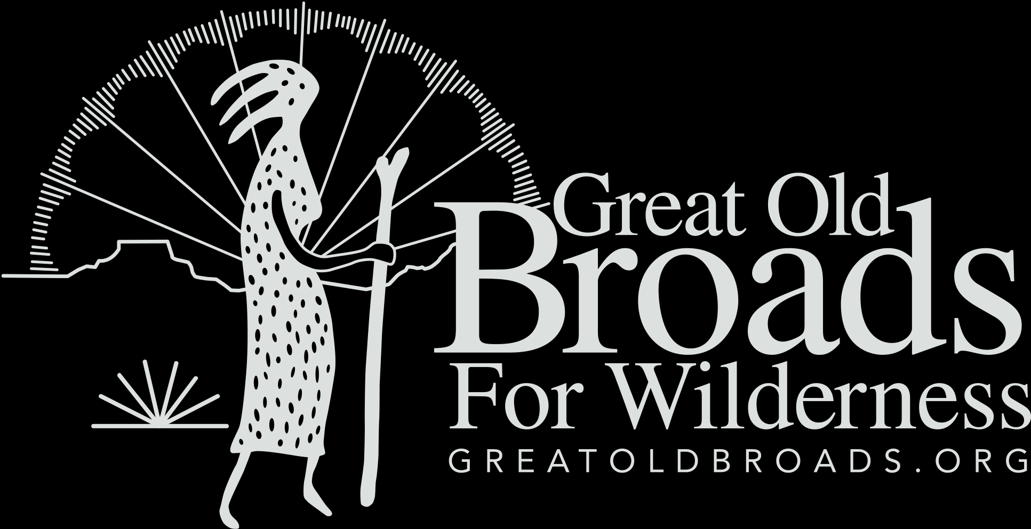
Please consider making a tax-deductible donation to Great Old Broads for Wilderness, a 501(c)3 organization, to help continue and expand this program.
We thank you for your support!
www.greatoldbroads.org

