Slide 1
FORESTS AND CLIMATE CHANGE
Climate Education & Stewardship Program
Notes:
Thank you <share a bit about yourself… your passion for public lands and forests, but be sure to keep your intro brief>

Slide 2
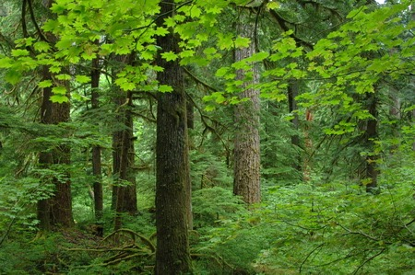
Climate Change in the Pacific Northwest
What communities can expect
Which communities are most threatened
How to be proactive
Notes:
What does all this mean to the ecosystems and our own communities in the region—especially those communities that are most at risk? What impacts are we seeing now and what can we expect in the future?

Slide 3
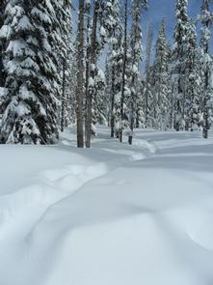
Climate Change in the Pacific Northwest
More winter rain =
reduced snowpack
Less snow =
tributaries dry up by summer
Less water =
warmer rivers, impacting salmon
Photo: Department of Interior
Notes:
Changing winters here in the Pacific Northwest:
Warmer winters will lead to a shift from snowfall to rain in the mountains.
Boosting winter river flow,
lack of a lingering snowpack reduces summer river flow, causing tributaries to dry up.
Cold rivers warmer
Creates major problems for endangered salmon when they return to spawn in late summer and fall.
winter precipitation is actually expected to increase over the long term—but with greater year-to-year variability.
This means that there will be more years of very low rainfall and extended drought. But this also means extreme weather events—such as heavy, flooding rainfall—happening more often.

Slide 4
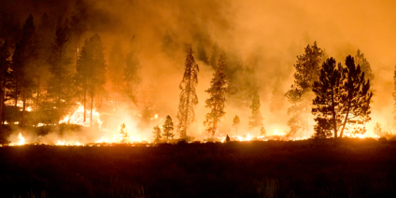
Climate Change in the Pacific Northwest
Increased temperatures and
deepening droughts
Photo: USFS
Wildfires • Insects • Disease
Notes:
Climate change means hotter and drier summer conditions that escalate the risk of dangerous and damaging wildfires to communities across the region.
Forests that are stressed by drought are also more susceptible to insect outbreaks and diseases that are becoming more aggressive due to climate change.
The mountain pine beetle now develops faster and infects far more trees due to warming winters.
Beetle outbreaks are moving higher in elevation to places where beetles have not been recorded before.

Slide 5
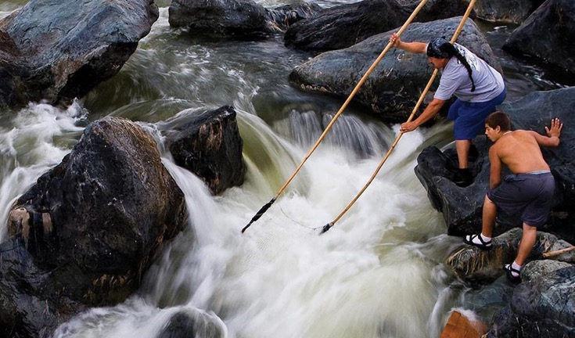
Impact on Northwest Communities
Indigenous peoples
Children and older adults
Communities of color
Those dependent on natural resources for livelihoods
The economically disadvantaged
Photo: National Climate Assessment
Notes:
Climate change is also impacting communities across the Northwest
effects of climate change are not felt equally across communities
Frontline communities are experiencing the first—and often the worst—effects of climate change.
Tribes and Indigenous peoples
Those most dependent on natural resources for their livelihoods
The economically disadvantaged
Why? Tribes and Indigenous communities often rely on the natural environment in ways that are critical to cultural survival.
These communities often have fewer economic resources to prepare for and cope with climate disruptions.

Slide 6
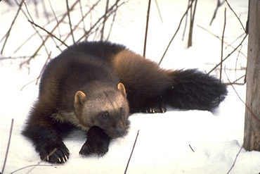
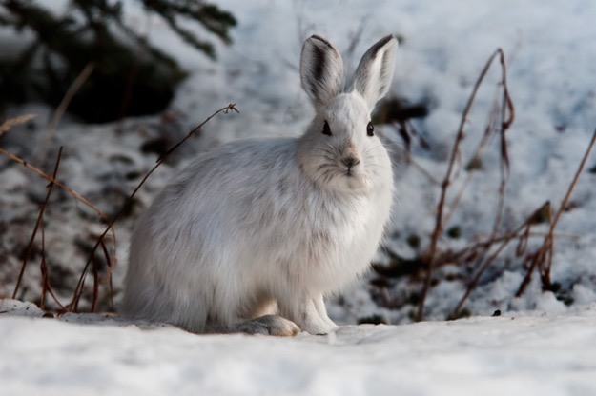
Impacts on Wildlife
Loss of native habitat
Introduction of invasive species
Increase in disease
Disruption of balance
Endangered species vulnerable
Wolverine. Photo: California Academy of Sciences
Snowshoe Hare. Photo: NPS
Notes:
How wildlife responds to climate change can be a complex
Temperature shifts,
changes in water availability,
extreme weather events,
and layered impacts from existing threats like habitat fragmentation all impact wildlife.
vulnerable endangered species
species that are dependent on a winter snowpack for their survival, (such as wolverines and snowshoe hares)

Slide 7
Public Lands
and Climate Defense
Notes:
Climate change is altering our landscapes and impacting our communities in substantial ways.
As these impacts intensify, they threaten to destabilize entire ecosystems and cultures that are connected to these landscapes.
But what is the role of our public lands—especially forests on public lands—as a climate change defense? What role to these landscapes play in the fight against climate change?

Slide 8
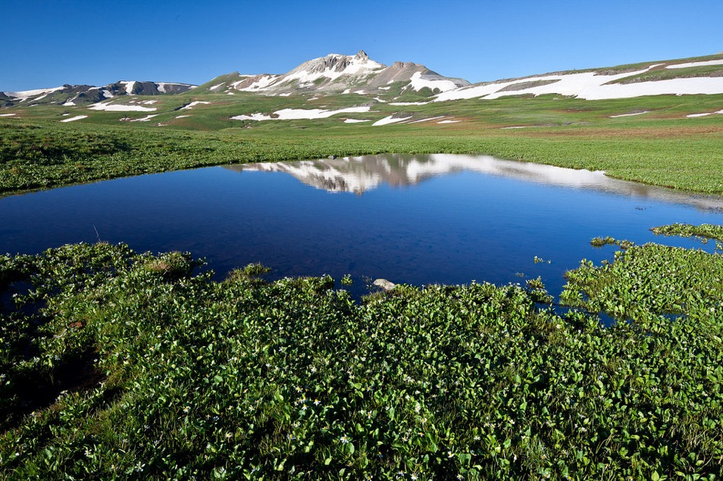
Climate Defense Toolkit
Carbon storage
Clean water & air
Biodiversity & Pollination
Land connectivity (adaptation)
Storm & flood protection
Notes:
Public lands—especially forests—have a natural, but largely unnoticed, toolkit to combat climate change.
This includes
the ability to pull and store massive amounts of carbon from the atmosphere.
But forests also help provide clean water and air, biodiversity—especially for vital pollinators, land connectivity to help wildlife adapt to a changing climate, and storm and flood protection for downstream communities.

Slide 9
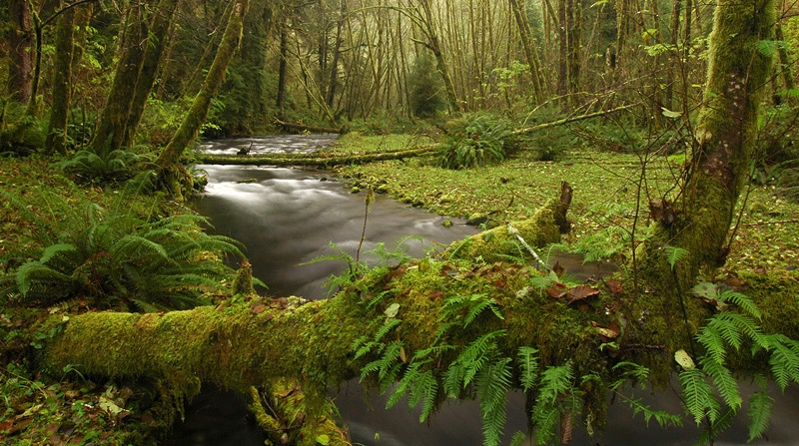
Forests Lock Up Carbon
Forests on public lands are a critical carbon “sink”
Photo: Greg Leif, WikiCommons
Notes:
Undisturbed old-growth forests on public lands are some of the country’s best “carbon sinks.”
Put simply, carbon goes into the forest, but very little of it ever comes back out… as long as the forest remains undisturbed.

Slide 10
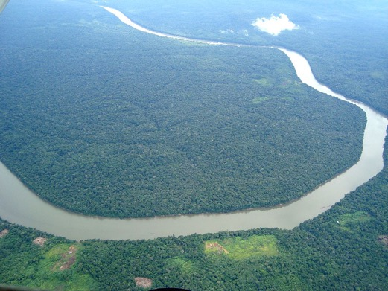
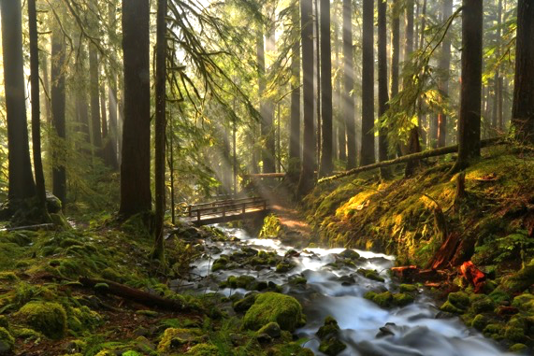
Pop Quiz!
Which region stores more carbon per acre?
Or
Photo: Jorge Kike Medina
Photo: U.S. NPS
The Amazon Rainforest
Old Growth Forest of the Coastal Pacific Northwest
Notes:
Time for a pop quiz! Which region stores more carbon per acre—the Amazon or the Pacific Northwest?

Slide 11
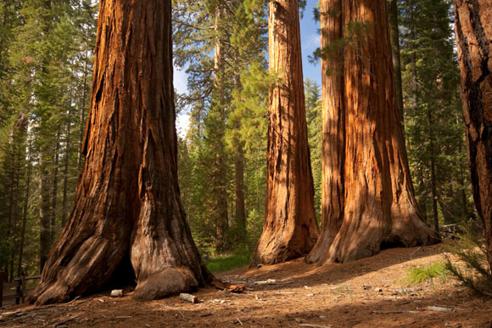
Answer: The Pacific Northwest!
Oregon and Alaska forests store nearly two times the carbon per acre
California’s redwood forests store nearly seven times the carbon per acre
Photo: USFS
Notes:
The Pacific Northwest wins!
The expansive Amazon tropical rainforest of South America is one of the world’s largest carbon sinks by area.
But on a per-acre basis, the Amazon is not nearly as efficient at absorbing carbon as the coastal rainforests of the Pacific Northwest.
In fact, the Douglas fir forests of Oregon and the hemlock and cedar forests of Alaska store about twice as much carbon per acre as the Amazon!
But the real grand prize goes to the giant coastal redwood forests of Northern California, which store seven times as much carbon as the Amazon in each mile of forest. They are regarded as the most carbon dense forests in the world.

Slide 12
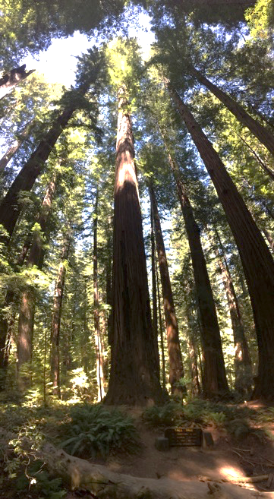
Old Growth Forests Get Better with Age
Trees accelerate growth throughout their lifespan
A tree in a coastal rainforest can live over 800 years
Old growth forests hold more carbon—and increase storage over time
Never underestimate an old Broad!
Notes:
The thinking used to be that a tree became “less useful” over time…sort of like, say the outdated thinking about, an “old broad”?
But now we understand that a tree’s growth actually accelerates over time. A tree in a Pacific Northwest coastal forest remains viable for centuries—they often live for over 800 years!
Imagine crosscut of a tree: all those tree rings growing out and out?
It takes a lot of carbon to keep wrapping bigger and bigger rings of wood around a very old tree every year.
Never underestimate Great Old Broads!
Wild forests with diverse tree species absorb more sunlight and gather more carbon than young, industrial tree plantations.
However, much of this carbon—even soil carbon—will move back to the atmosphere if these forests are disturbed.

Slide 13
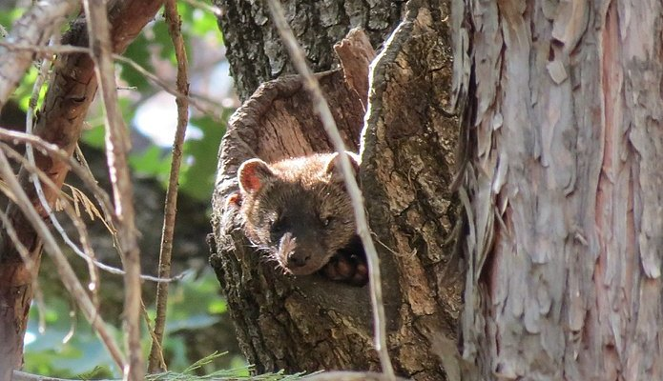
Old Growth’s Contributions to Wildlife
Gives space to adapt
More diverse habitats
Refuge from fragmented habitat
Humbolt marten (Photo: USFS)
Notes:
Wildlife is far more likely to thrive in old-growth forests
provide more space for species to adapt, allowing them to be more resilient to a changing climate.
Undisturbed old-growth forests are critical refuge from the fragmented habitats affected by human activities.
So, what do we mean by “fragmented”?
When habitat becomes smaller, travel between now-divided habitat becomes more dangerous.
Many species that require intact forests will not inhabit the edges of forests
It’s not just clear-cutting, though. Roads, vehicle traffic, utility lines, pipelines, and any kind of development can also create a fragmented habitat.

Slide 14
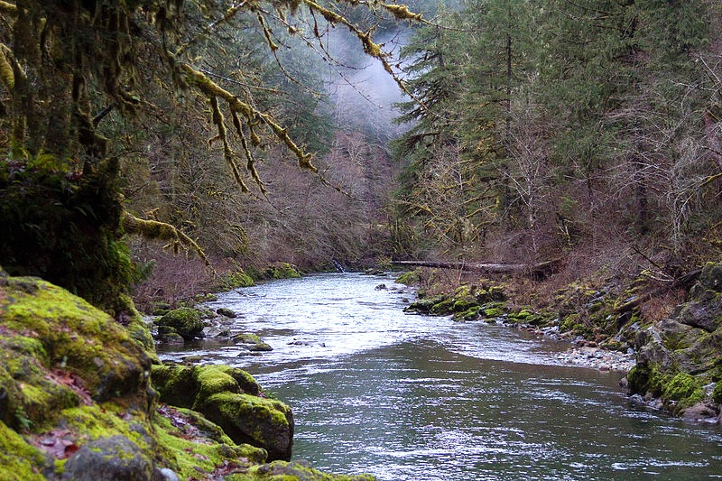
Old Growth Forests and Fresh Water
Cool and filter drinking water
Recharge aquifers
Replenish surface waters
Photo: U.S. Forest Service
…and provide drinking water for over 180 MILLION people
Notes:
One of the most important (and irreplaceable) direct benefits old-growth forests offer to communities across the Northwest is fresh water.
Old-growth forests are vital sources of drinking water for more than 180 million people in the United States.
These undisturbed forests naturally cool and filter drinking water, recharge underground aquifers, and replenish surface waters like streams and rivers.
These sources of clean water are likely to become even more important to the region’s population as summers continue to get warmer and generally drier, and other sources of water become stretched to their limits by competing human demands.

Slide 15
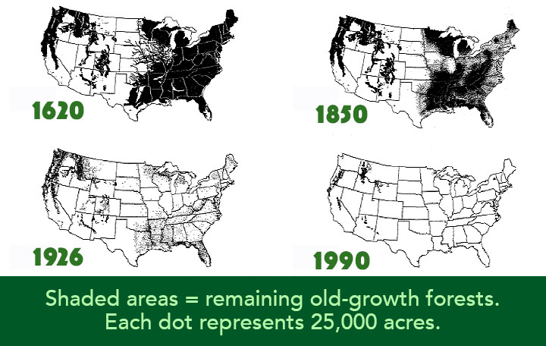
Old-Growth Amnesia
Since the mid-17th Century, the U.S. has lost nearly 85% of its old-growth forests to logging
Graphic: National Geographic/Wilderness Society
Notes:
We tend to have a remarkably short memory when it comes to nature.
around 85% of America’s original old-growth forests are now gone!

Slide 16
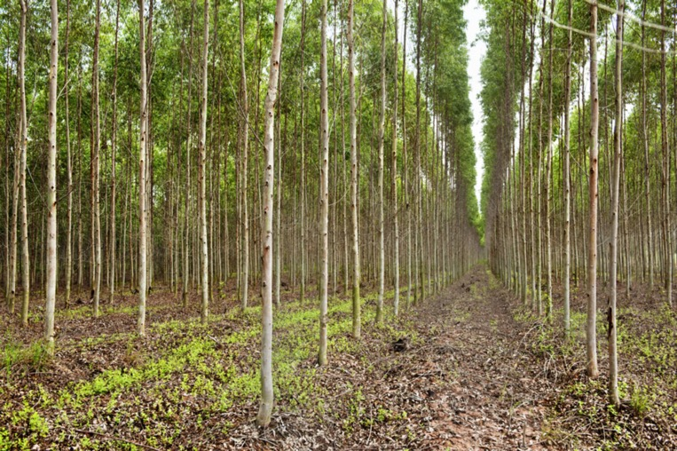
Protect the Old or Plant the Young?
Tree plantations lifespan = 40 years
It takes up to 800 years for forests to reach full carbon capacity
Photo: Oregon Dept. of Forestry
Notes:
The average lifespan of an industrial farm tree is just 40 years.
This is not enough time to reach its full carbon capacity (remember, a tree in an old-growth coastal rainforest can live more than 800 years).
In addition, tree farms tend to be monoculture—that is, just one species.
This lack of diversity lowers the overall carbon capacity of the forest, also lessens the ability of the forest to provide the many other benefits offered by old forests...
maintaining intact forests that have already built up massive carbon stores offers the most immediate climate benefits.

Slide 17
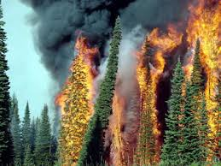
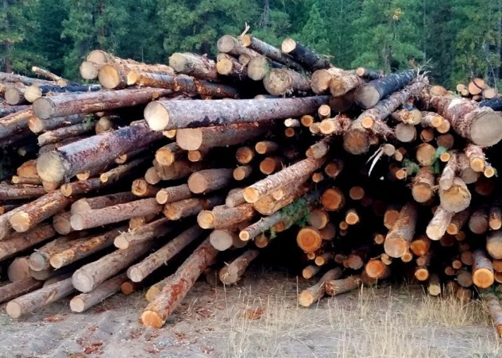
The Forces that Impact Forests
Photo: USFS
Photo: USFS
Notes:
How can we improve the climate change resilience of our forests and what might be holding them back?
There are two primary forces that have a direct impact on forests—fire and logging.
Let’s look first at wildfires.

Slide 18
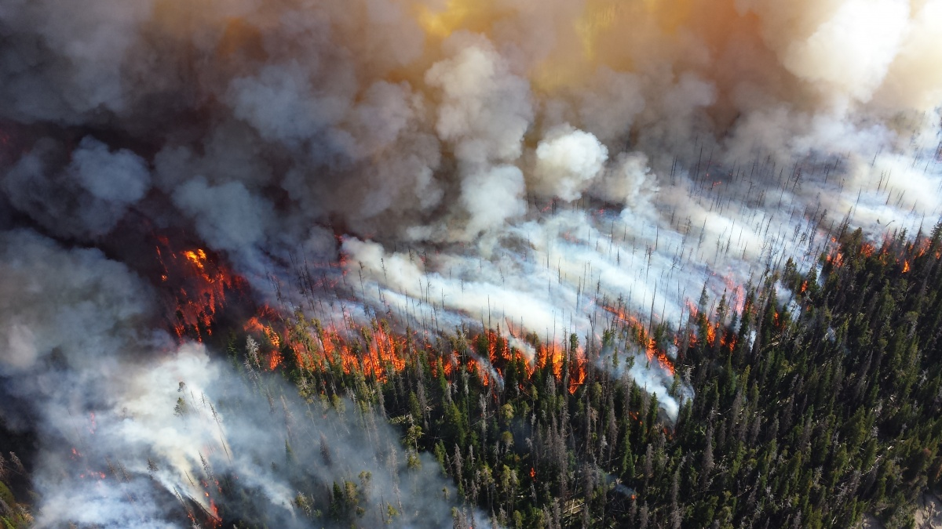
Wildfires
Photo: National Park Service
Washington: 36% of the population live in areas at an elevated risk of wildfire
Oregon: 33% of the population live in areas at an elevated risk of wildfire
Notes:
wildfires have an immediately recognizable impact on a forest.
because of the increasingly warmer and drier climate, forests in the United States are more prone to wildfires than in past decades.
The size and severity of these fires are on the rise,
an increasing number of people live in or on the margins of forested areas.
some 33% of Oregon residents / 36% of Washington residents live in areas that are at an elevated risk of wildfires

Slide 19
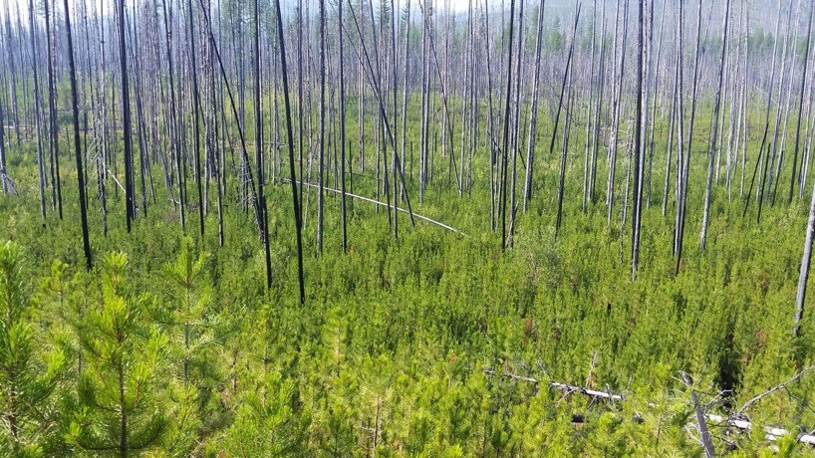
Fire and Carbon
Even major fires only release 5-10% of the carbon held in the forest
Photo: USFS
Notes:
Most wildfires only release about 5-10% of the carbon held in the forests.
Not an overwhelming source of greenhouse emissions, as some might think.

Slide 20
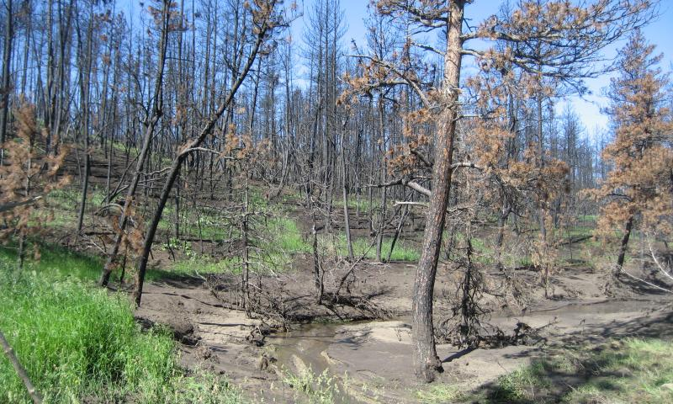
Fire as a Restorative Force
Creates new habitat for plants and wildlife
Helps control invasive insects and disease
Stimulates release of new seeds in some species
Photo: Oregon State University
Notes:
Wildfires are a vital part of maintaining a healthy fire-adapted forest ecosystems.
government policy to suppress virtually every wildfire has deprived fire-adapted forests of the fires they need to thrive, rejuvenate, and refresh themselves.
Fires leave standing dead trees and sunny openings, which are important new habitat for plants and wildlife,
and they help control the spread of invasive insects and disease.
Many animal and plant species have evolved to thrive with fire.
Some tree species like the Lodgepole pine, actually need fire to stimulate the release of new seeds.

Slide 21
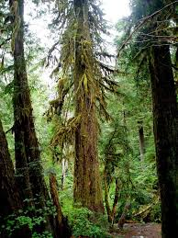
What About Logging?
Greatly reduces nature’s ability to combat climate change
Destroys ecosystems benefits
Photo: U.S. Forest Service
Notes:
what about logging?
may not seem as immediately dramatic as wildfire, but the climate impacts can be far more consequential.
Every tree that’s removed is one less tree capable of absorbing and holding on to carbon—and we have removed a lot of trees
Second, logging old-growth forests takes away the other ecosystem benefits necessary for downstream communities, such as clean water, flood and landslide protection, and the economic opportunities many small communities rely on across the region (especially tourism).

Slide 22
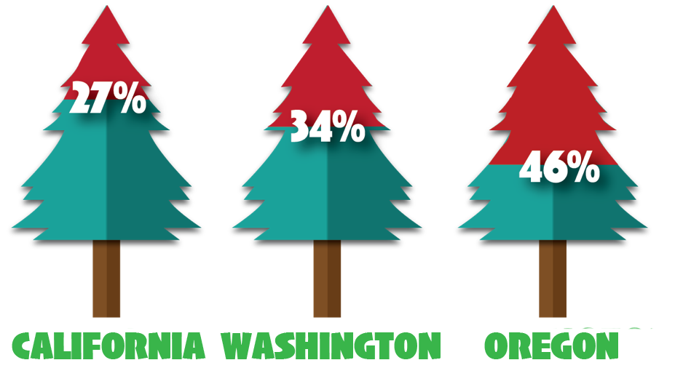
Logging’s Carbon Footprint
Carbon sinks lost due to logging in the Northwest over the past 100 years.
Notes:
Logging and logging-related emissions have reduced the natural carbon sink in California by 27%, in Washington by 34%, and in Oregon by very nearly half.
in just over 100 years, Oregon has removed the equivalent of all live trees in the state’s Coast Range forests.
Between 2001 and 2014 alone Oregon experienced a net loss of 1.2 million acres of forest cover. Most of the carbon those trees held now resides in either the atmosphere or in landfills.

Slide 23
“There can be no purpose more inspiring than to begin the age of restoration, reweaving the wondrous diversity of life that still surrounds us.”
– Edward O. Wilson, The Diversity of Life
Notes:
Cleary, there is some work to be done to optimize our public land’s role in combatting climate change.
So, how can the public contribute when it comes to forests on public lands?

Slide 24
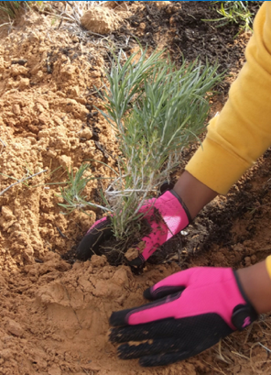
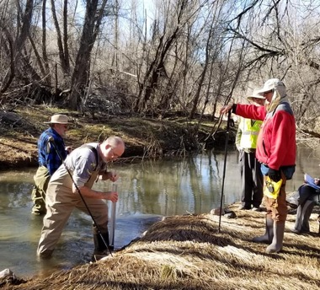
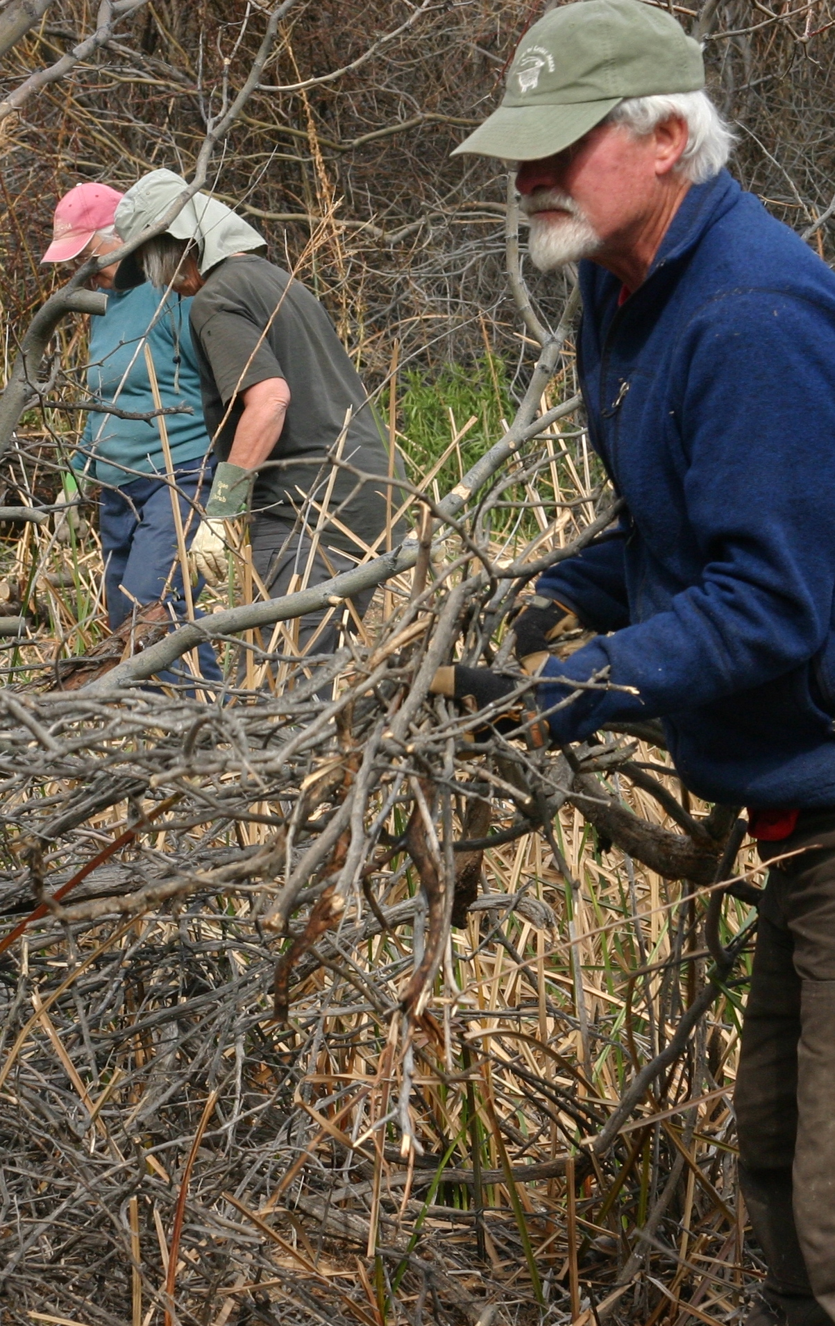
Public Lands Stewardship
Restoring native vegetation
Water quality monitoring
Removing invasive species
Restoration work heals the land and makes it more resilient to climate impacts
Notes:
public lands stewardship events, like those offered through your local Broadband.
Making the land more resilient to the impacts of climate change. It’s also a great way to make some new friends!

Slide 25
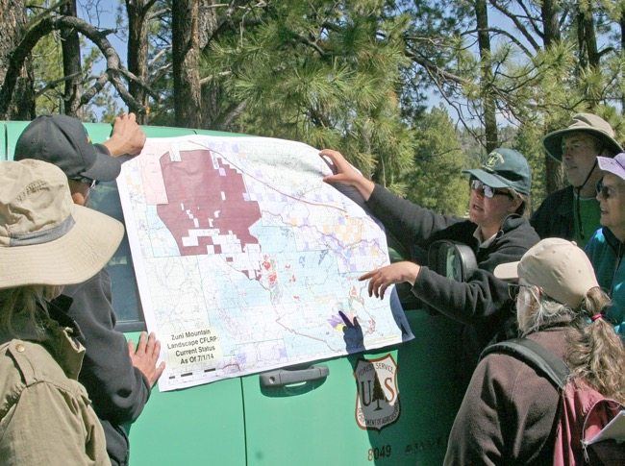
Dive in Deeper
Education – keep the conversation going
Get to know your local public land management agencies
Participate in public land planning processes
Learn more about the policies in place for local public lands
Join your local Broadband!
Notes:
become more educated about forests—especially the ones in your area—and the forces that are impacting them,
and then collaborating and sharing that knowledge with others.
Keep informed, and keep a dialog going!
Second, get to know the local, state, and federal agencies that manage the public lands in the area.
Stay in contact with your elected officials at all levels of government and make sure they’re aware of the impacts facing old-growth forests on public lands.
Getting involved in these conversations can help lead to the decisions that keep forests standing.
Third: Participate in the public lands planning process.
Attend and take an active part in meetings, and volunteer to serve on advisory boards and committees.
Be heard!
Fourth: Get to know and understand the policies already in place for local public lands.
Ask if these policies go far enough to protect sensitive landscapes like old-growth forests.
Fifth: Join your local Broadband!

Slide 26
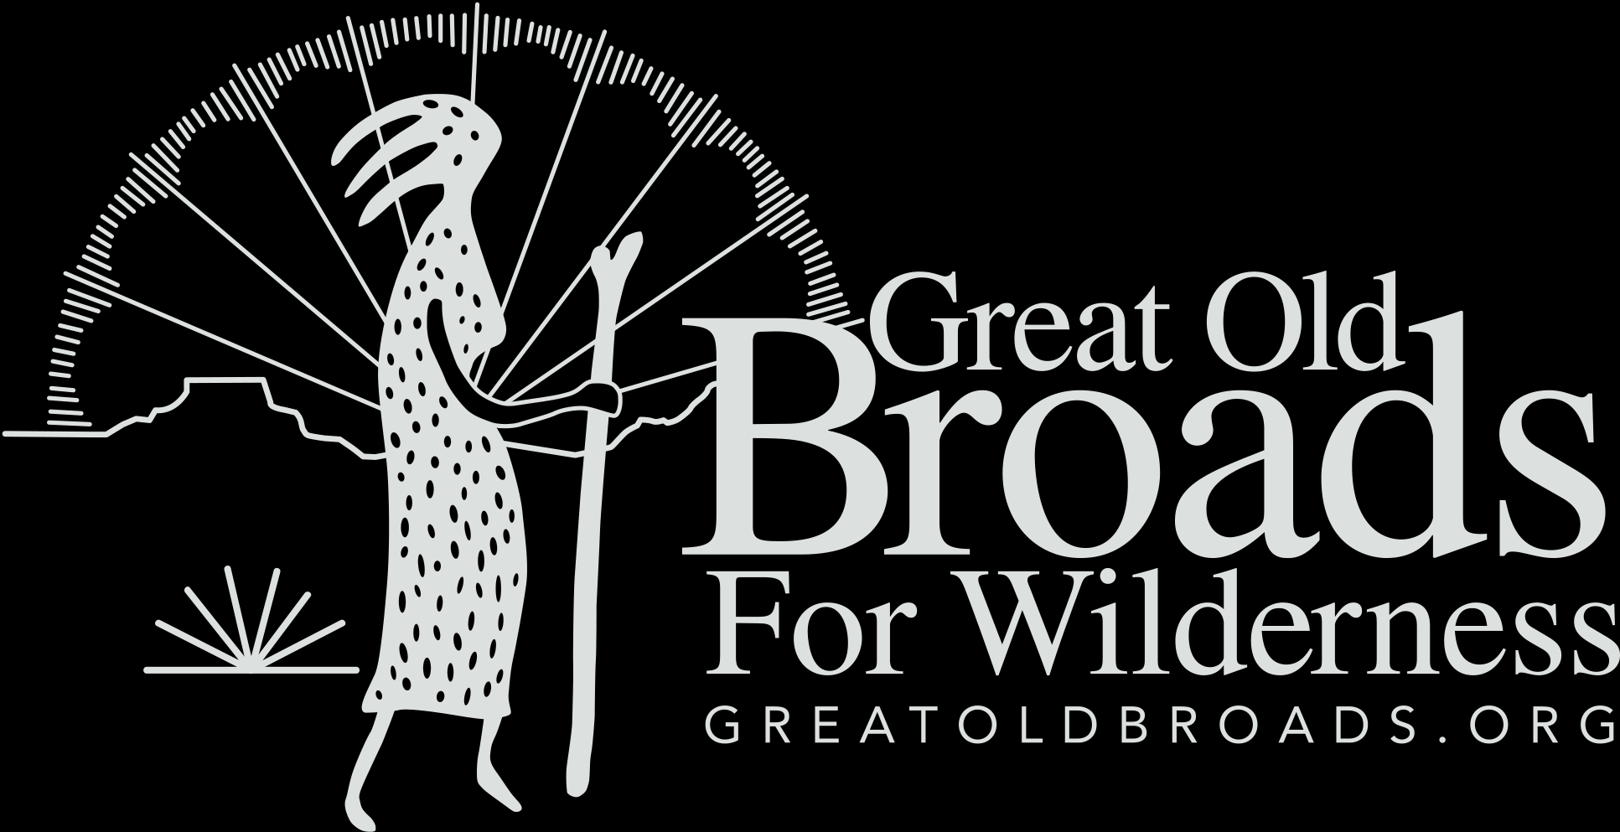
Please consider making a tax-deductible donation to Great Old Broads for Wilderness, a 501(c)3 organization, to help continue and expand this program.
We thank you for your support!
www.greatoldbroads.org
Notes:
If you’re interested and want to learn more…
we have some great upcoming events in this area you might be interested in…(calendar events)

