Slide 1
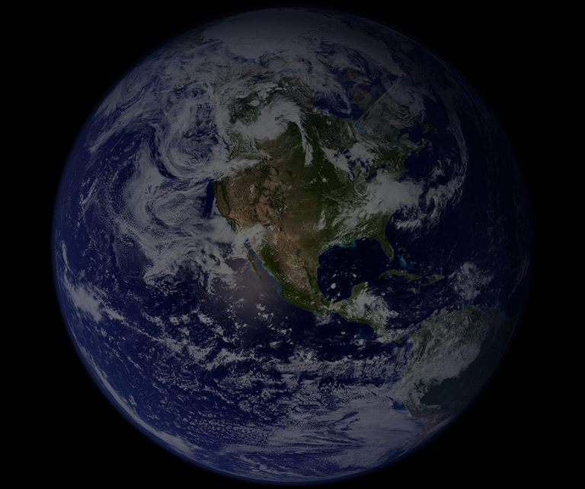
PUBLIC LANDS AND
CLIMATE CHANGE 101
Climate Education & Stewardship Program
Notes:
Welcome and thank you for coming… share a bit about yourself and your passion for public lands.

Slide 2
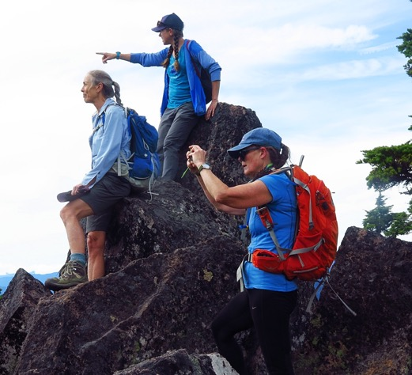
Today we’ll explore:
What are public lands?
How are public lands used?
How are public lands and climate change related?
How does public lands management impact climate change resilience?
How can we get involved?

Slide 3
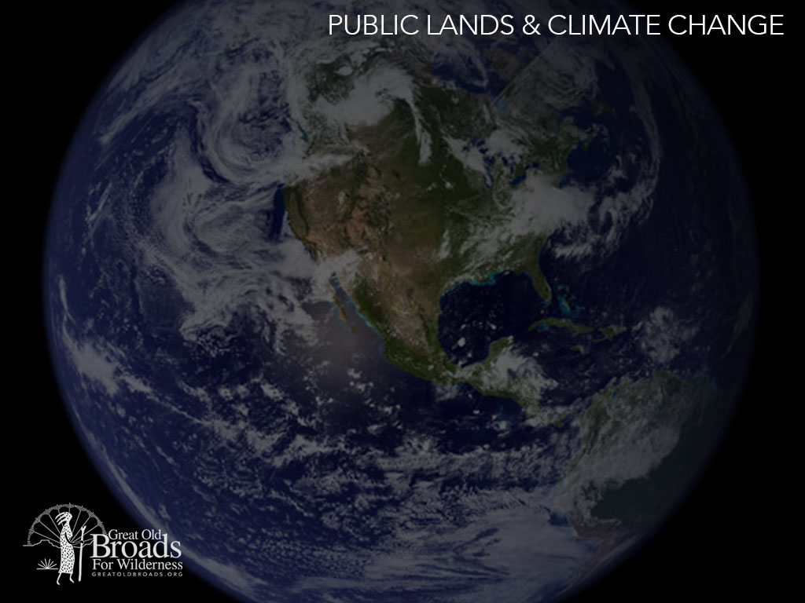
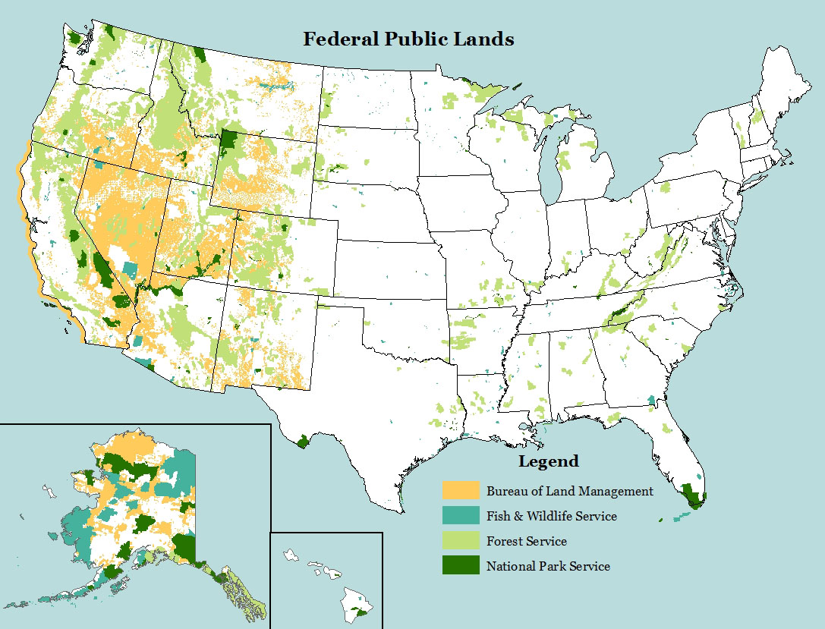
Map of all U.S. public lands by Kara Clauser, Center for Biological Diversity.
Notes:
Federal public lands are held in trust for all Americans
Managed for long-term health of land and American people
Not evenly distributed across US

Slide 4
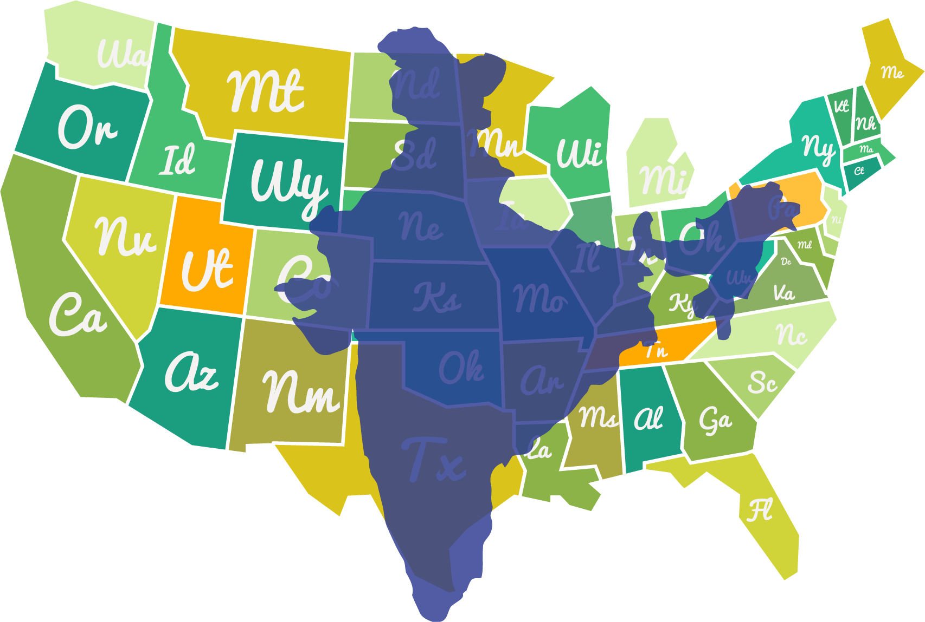
How big are public lands?
Russia
Canada
China
United States
Brazil
Australia
U.S. Public Lands (State and Federal)
India
India!
Notes:
What if all public lands were combined into its own country?
- 7th largest, larger than India! That’s 640 million acres! **Important to note that this is just for scale, not the actual location of public lands

Slide 5
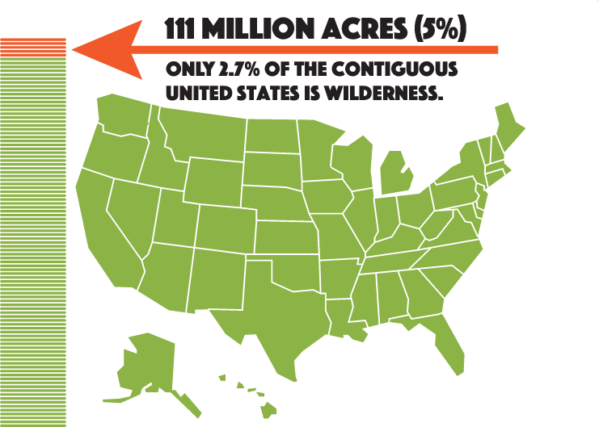
How Much of that is Wilderness?
Notes:
We like to think of Wilderness as…
our gift to future generations of Americans.
It’s one piece of the ecological puzzle
It’s biological diversity.
It’s refuge and corridor for wildlife.
It’s untamed forest, desert, coast, and mountain.
It’s quiet. It’s restorative. It keeps us sane.

Slide 6
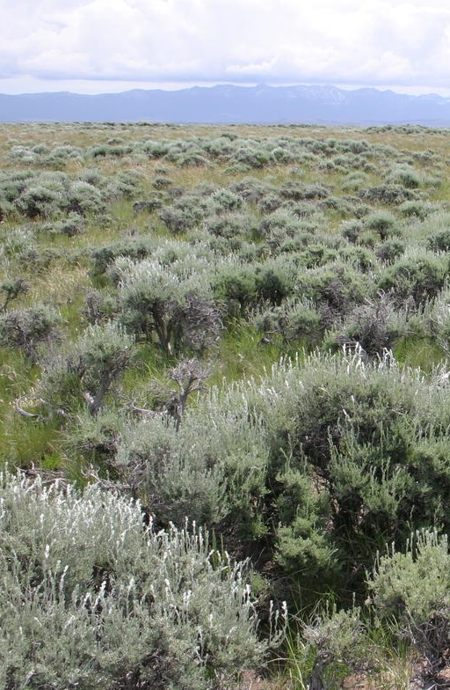
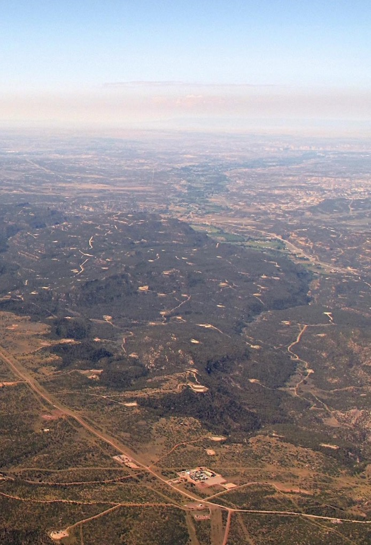
climate-change-5.jpg
Are public lands... protected?
Cameron Aldridge
Photo: Ecoflight
Oil & Gas Development
Notes:
multiple use: from recreation to timber harvest.
Some lands protected for recreation, conservation, or cultural significance.
Other lands are preserved for wildlife and the intrinsic value of the ecosystem.
Other lands managed for commercial use: mining, logging, grazing, and energy development.
About 73% of the publicly owned land in Western states is grazed, 270 million acres, equal to the total acreage of OR, WA, CA, and ID.

Slide 7
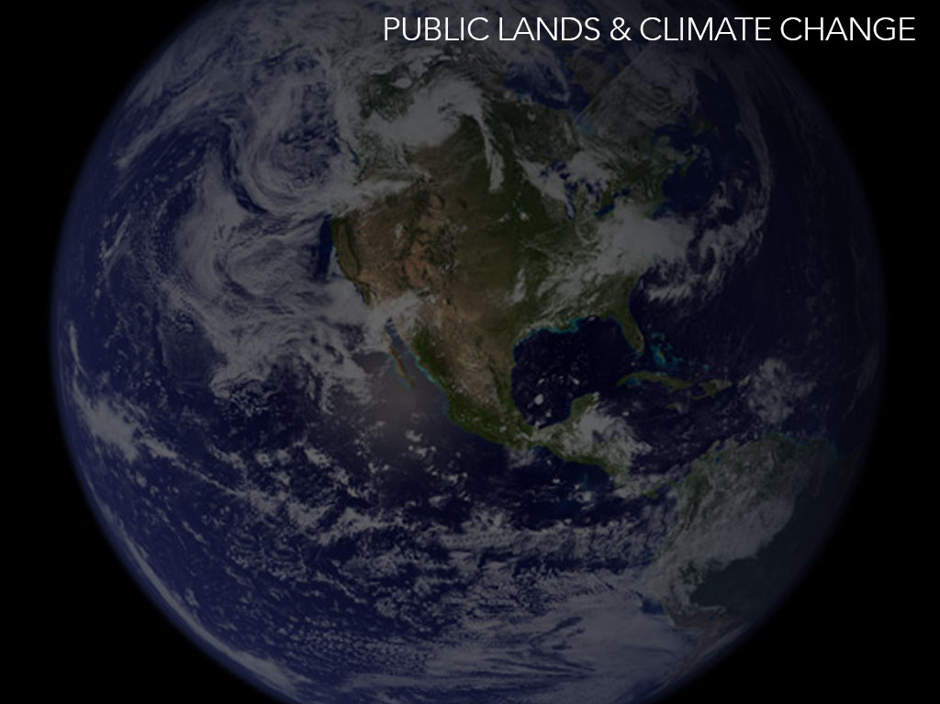
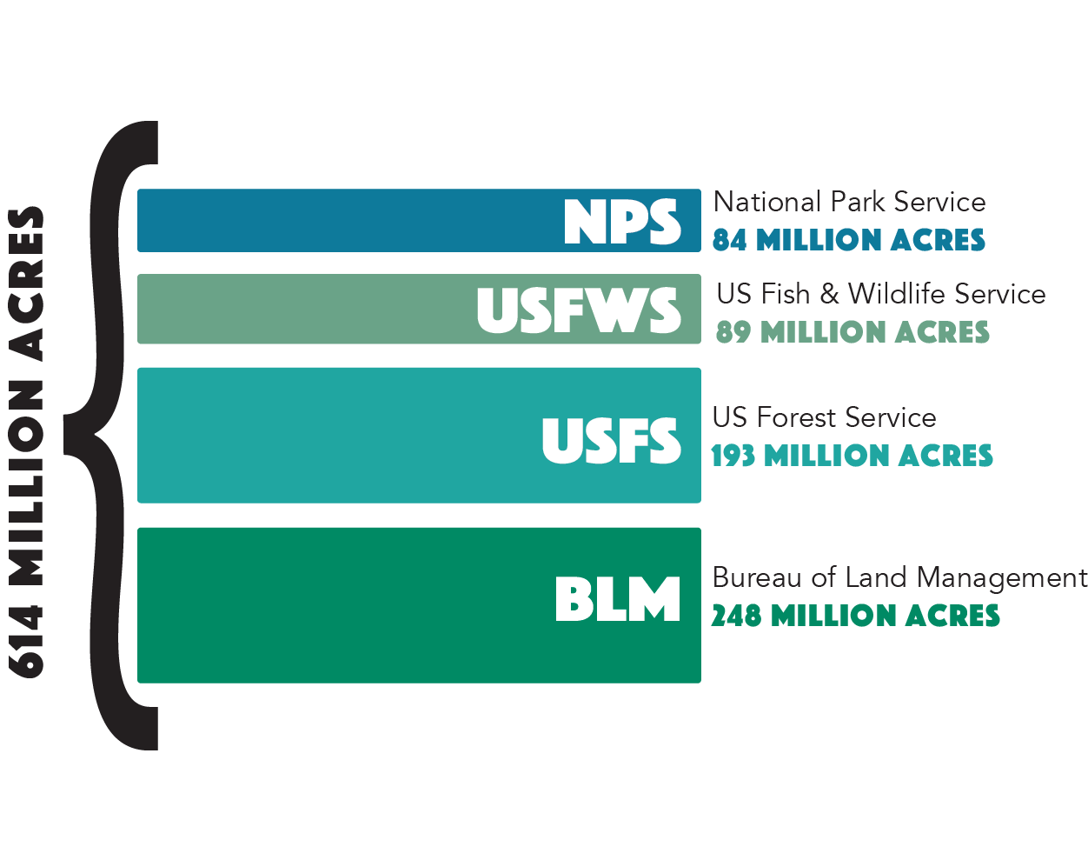
Who Manages our Public Lands?
Notes:
The Bureau of Land Management
In charge of the most federal lands
One in every 10 acres of land in the United States and
30% of the Nation’s minerals
multiple-use mandate: resources and uses on public land must be a balanced combination that will best meet the needs of the people (current and future).
BLM lands are found in every state
Encompass forests, mountains, sagebrush prairies, arctic tundra, and deserts.
The US Forest Service
stablished in 1905 to provide quality water and timber for the nation.
Congress later broadened its mandate of multiple uses and benefits, ie. sustained yield of renewable resources (water, forage, wildlife, wood, and recreation)
The National Park Service
preserves the natural and cultural resources and values of these lands
focus on preservation and education
The US Fish & Wildlife Service
manages the National Wildlife Refuge System
Operate over 70 National Fish Hatcheries and 65 fishery resource offices.

Slide 8
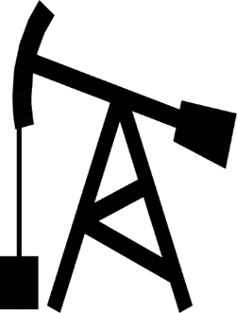
Public Lands: Carbon Source or Sink?
Are public lands making things better or worse?
VS.
Sink
Source
Notes:
Public lands function as a carbon sink
Plants performing photosynthesis in forests, wetlands, coastal marshes store carbon
Meanwhile, current industrial uses of public lands remove ancient carbon from public lands
This is a source for carbon to enter the atmosphere
If we compare, what is the balance?
Is our management of public lands making things better or worse?

Slide 9
Energy Extraction on Public Lands
42%
24%
13%
CRUDE
OIL
GAS
COAL
Today, more than 90% of BLM multiple-use
lands are open to oil and gas development.
As of 2017: The Wilderness Society
Notes:
Public lands are actually a huge producer of oil and gas.
What kind of impact is that having on the land?
42% of US coal, 24% of the crude oil, and 13% of the natural gas comes from public lands.

Slide 10
Public Lands emit 4.5 times more CO₂ than they absorb
1153MMTCO₂e
259MMCO₂
Source: Center for American Progress
Notes:
Unfortunately, public lands emit more carbon than the ecosystems can sink (or store).
Through oil and gas extraction, we are introducing 4.5 times the carbon into the atmosphere than our public lands can absorb.

Slide 11
Public Lands Share of Global Emissions
As of 2013
The Methane Rule was overturned by the current administration…
Notes:
To further put these emissions into perspective, US public lands 5th in the world, accounting for 20% of the nation’s emissions.
These emissions are greater than entire countries such as Germany, Brazil and Canada.

Slide 12
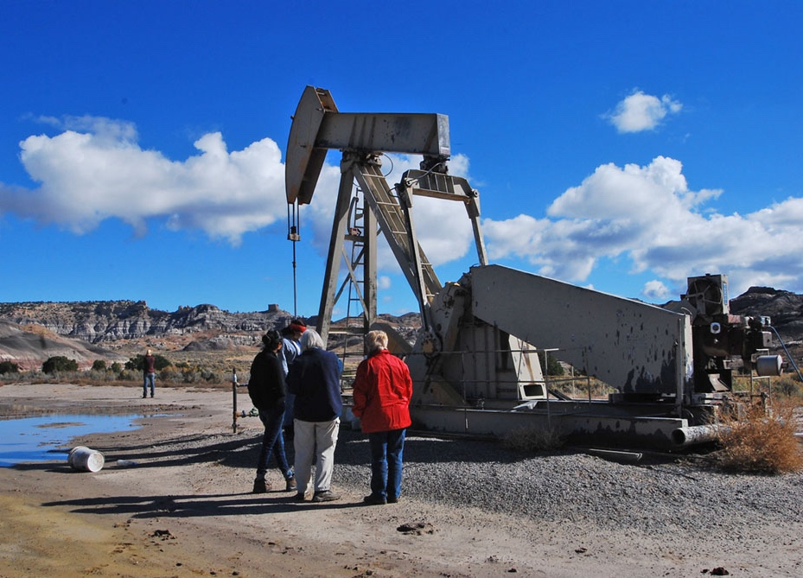
January 2017
to January 2020
9,928,409 acres
Sold as leases to oil and gas companies for energy development.
Notes:
In the last 3 years, leases have continued to climb
If drilled, could cause 1 billion and 5.95 billion metric tons of CO2e.
From 2017 to 2020, nearly 10 million acres of public land has been leased for new extraction
Same size as TEN Olympic National Parks.
A third of this land is being leased for merely $2.00 an acre. A very low price to pay for permanent harm to ecosystems.
Significant and long-term ramifications for climate
Emissions on track to drastically exceed emissions reductions needed to avoid the worst effects of warming.

Slide 13
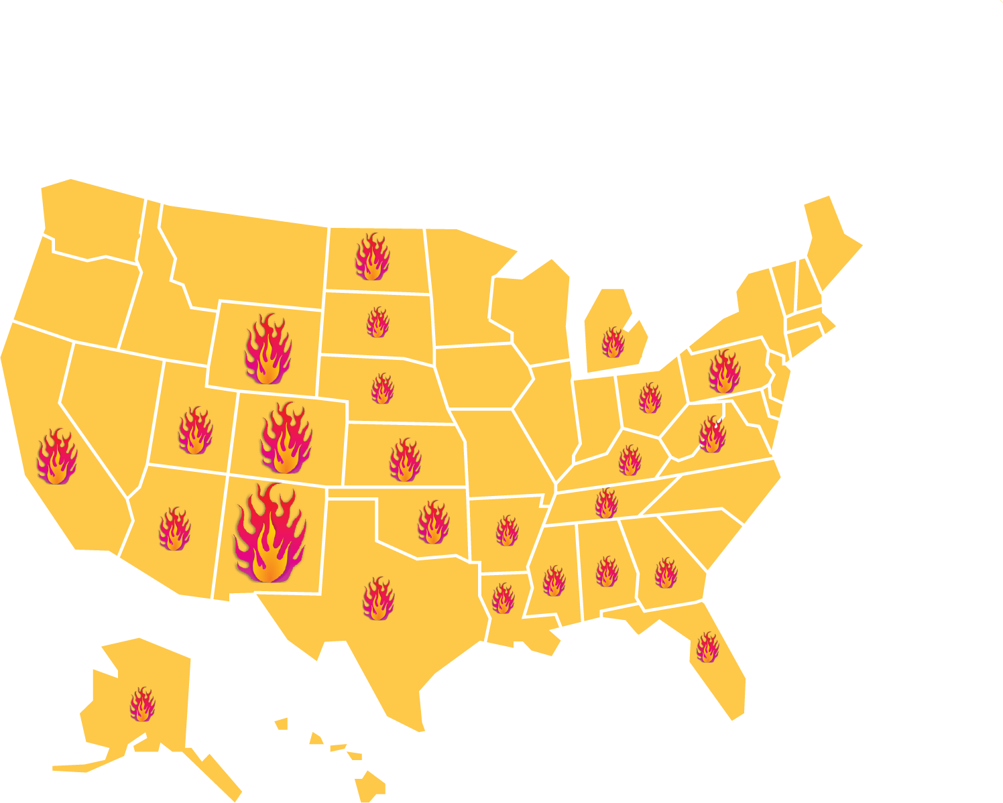
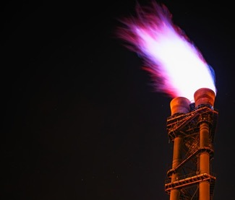
Natural Gas Wasted on Public Lands
States with the highest waste:
1. New Mexico
2. Wyoming
3. California
4. Colorado
Wasted through:
Flaring 41%
Venting 33%
Leaking 26%
Value of wasted gas
$ 2.5 Billion
(since 2013)
Source:
Notes:
Much of the natural gas taken out of the ground is wasted
Value of lost gas estimated at 2.3 billion dollars since 2013
Equivalent to the emissions of 3.3 million cars driven for a year
Much of flaring and venting is intentional, justified for economic reasons
Volatile compounds released known to pose a significant human health threat
Natural gas is mostly methane, a powerful greenhouse gas

Slide 14
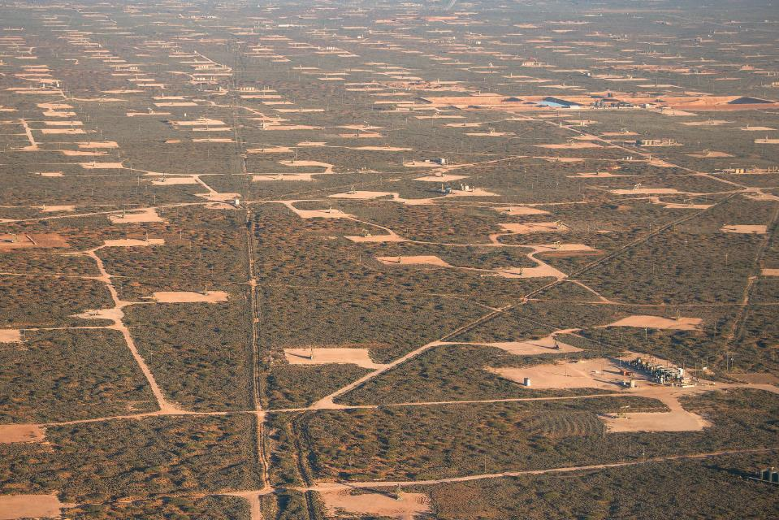
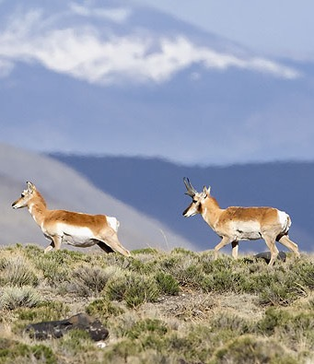
Collateral Effect of Oil & Gas
Wildlife Habitat Fragmentation
Notes:
Energy development impacts to landscape:
- Surface vegetation and soils are often removed.
- Water sources can be altered or depleted.
- Transmission lines and roads: fragment habitat, displace wildlife, and increase predation and accidental wildlife deaths.

Slide 15
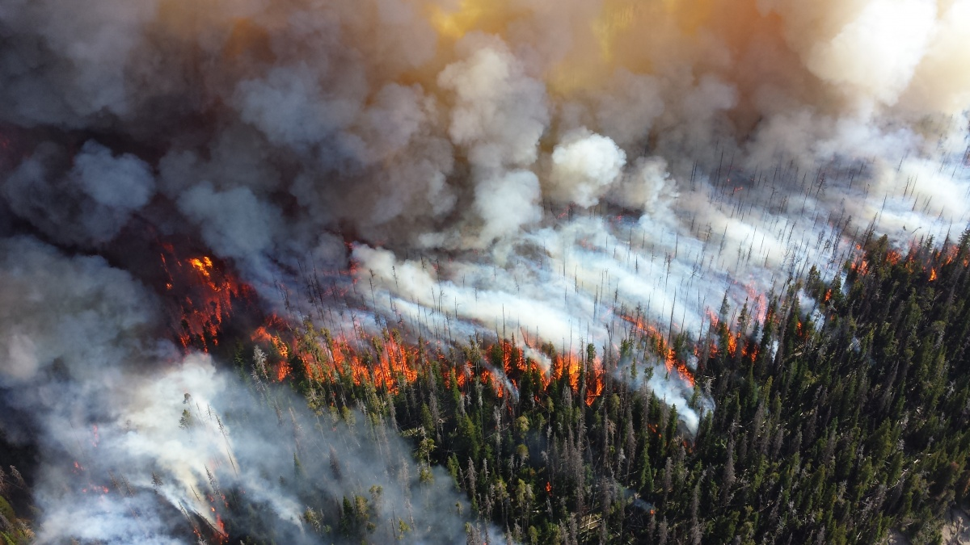
Wildfires
Photo: National Park Service
Washington: 36% of the population live in areas at an elevated risk of wildfire
Oregon: 33% of the population live in areas at an elevated risk of wildfire
Source: www.statesatrisk.org
Notes:
Forests are getting drier and trees are stressed by lower water availability.
More hot, dry, and windy days that heighten wildfire conditions.
Size, duration, and number of wildfires are increasing.
Climate change contributed to an additional 10 million acres of forest fires during 1984–2015, nearly doubling the expected area.
challenge to communities: now over 40-million homes in fire-prone landscapes across the West.

Slide 16
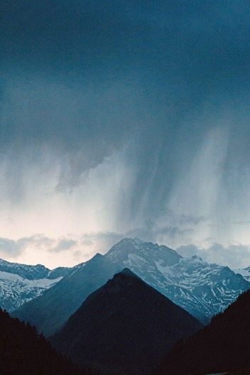
Rain & Snow
Reduced snowpack
Higher winter streamflow
Lower summer flow
Source: University of Washington Climate Impacts Group
Notes:
Reduced snowpack,
reduced water storage,
irrigation shortages,
and winter and summer recreation losses.
A higher winter streamflow: flooding, stormwater management, need for flood protection.
With the melt happening earlier, there is a lower summer flow, conflicts over water resources, reduced hydropower, and negative effects on salmon populations (and all wild life dependent upon riparian systems).
year-to-year precipitation variability projected to increase.
Years of abnormally low precipitation and extended drought
More extreme events, such as heavy rainfall, more often.

Slide 17
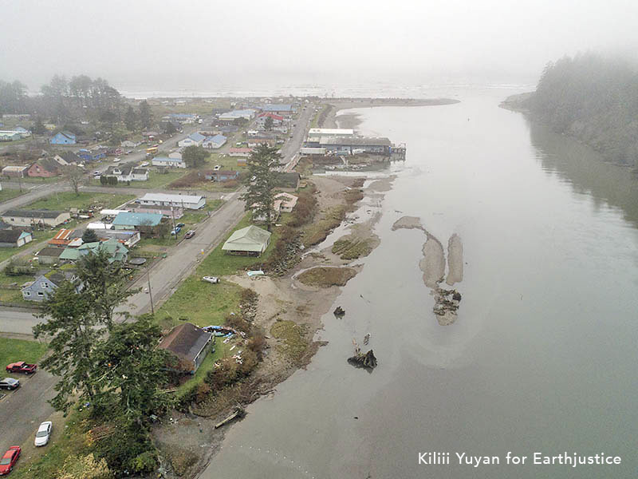
Coastal Flooding
www.statesatrisk.org
Notes:
Sea level rise impacts shorelines, ecosystems, and coastal human populations.
The worst sea level rise projection: 4.3 feet by 2100
Would heavily damage infrastructure throughout the Northwest
Low-lying urban areas of the Puget Sound and Portland
Deeply harming and displacing vulnerable coastal communities, including Indigenous groups.

Slide 18
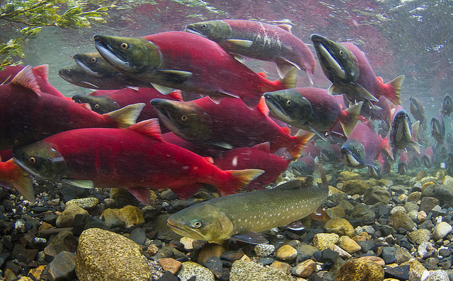
Fish & Wildlife
Notes:
Climate impacts have catastrophic impacts on species central to Northwest culture
Rising stream temperatures, intense storms, and loss of habitat
More intense winter storms cause higher river flows with more runoff, increasing sediments that can bury salmon eggs and reduce salmon survival.
Increased winter streamflow and decreased summer flow are projected to threaten salmon spawning, compromising salmon hatchery and reintroduction efforts.

Slide 19
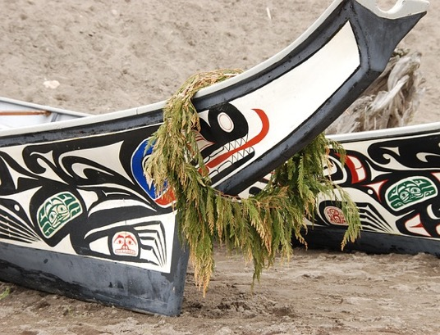
Frontline Communities
Children
Older Adults
Low Income Communities
Indigenous Communities
Communities of Color
Notes:
Climate change impacts have disproportionate impacts on:
Tribal nations, Their ways of life are at risk because they rely heavily on the natural environment in ways that are critical to cultural survival. These communities often have fewer resources to prepare for and cope with climate disruptions.
Communities of color
Communities who are dependent on natural resource economies,
and lower income communities.
Vulnerable older adults & children
Air pollution is a direct impact of both fossil fuel extraction and climate change. 158 million Americans—nearly half of the country—live in counties where air pollution exceeds national health-based standards. Each year, air pollution causes 200,000 premature deaths.

Slide 20
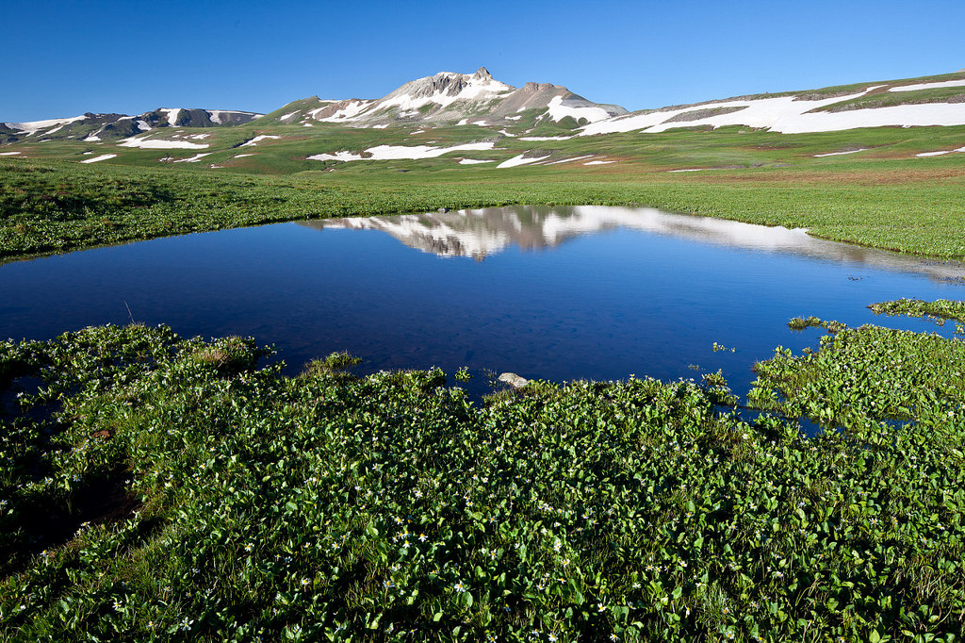
Climate Resiliency Toolkit
Carbon storage
Clean water & air
Biodiversity & Pollination
Land connectivity (adaptation)
Storm & flood protection
Notes:
America’s intact public lands climate defense
Public lands
remove and store carbon,
provide clean air and water,
serve as a buffer to severe storms,
offer large natural areas to serve as habitat,
encourage biodiversity,
and allow for adaptation to changing conditions.
They can solve much of the problem if we “use” them differently.
Studies show nature-based climate solutions can provide over one-third of the cost-effective actions needed between now and 2030 to stabilize warming to below 2 °C.

Slide 21
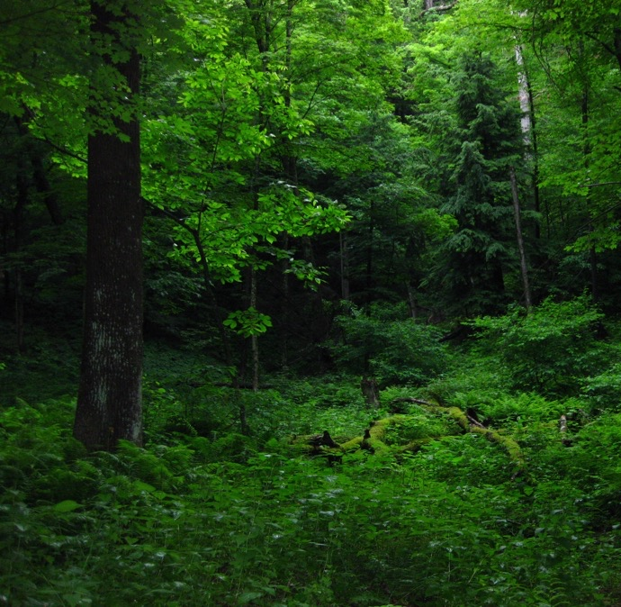
Forests & Carbon Storage
Global forests at full carbon storage potential could provide 37% of the carbon reductions needed to stabilize our climate.
Old-growth trees store more carbon
Never Underestimate Old Broads
Notes:
Forests on public lands in the Northwest:
high carbon storage and low-vulnerability to drought and fire, have the potential to lock up as much carbon by 2100 as burying 72,148 tanker trucks of gasoline, or eliminating ~6 years of current regional fossil fuel emissions
Allowing forests to reach their full carbon sequestration potential on a global scale could provide 37% of the carbon reductions needed to stabilize our climate.

Slide 22
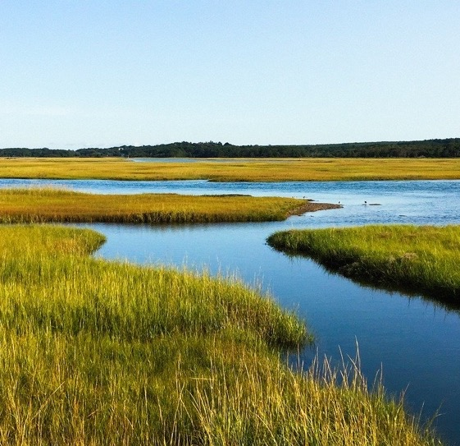
Coastal & Riparian Ecosystems
Water Filtration
Carbon storage
Vegetation reduces flooding
Habitat
Notes:
Coastal ecosystems are even more efficient carbon sinks
absorb 10x more carbon per square foot compared to forests
Oyster beds, kelp forests, and seagrass beds also reduce waves by 60% during extreme weather events.

Slide 23
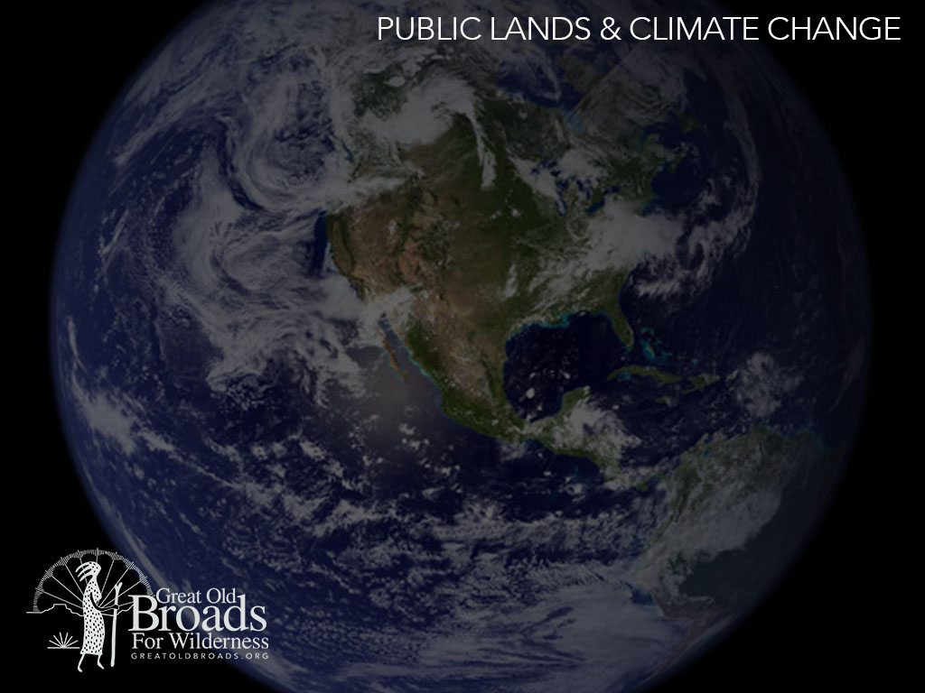
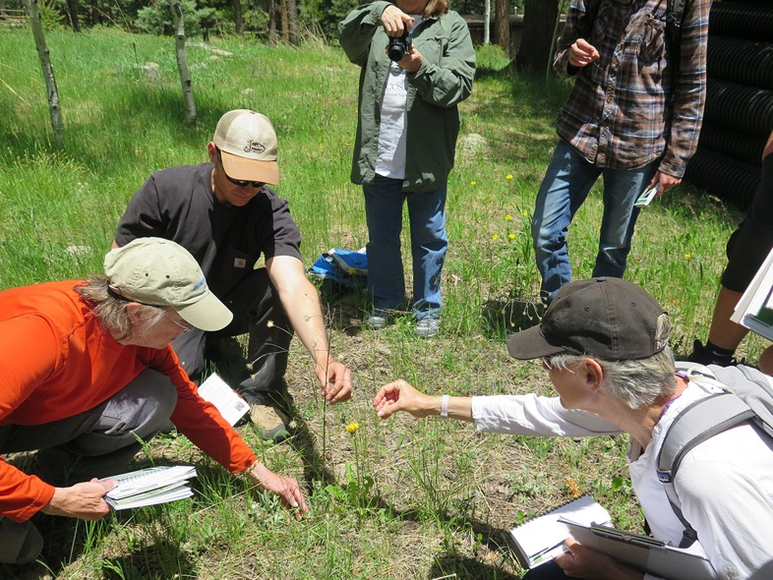
Repairing & Restoring Resilience
Notes:
There are many ways that we can improve the health of public lands and contribute to climate resilience when we actively engage in public land stewardship.

Slide 24
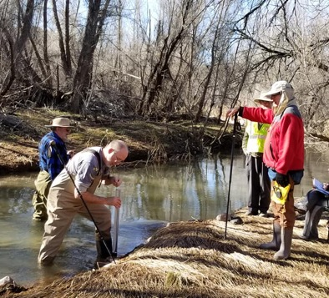
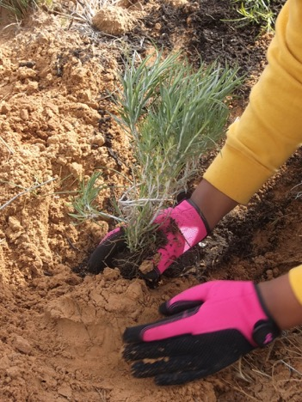
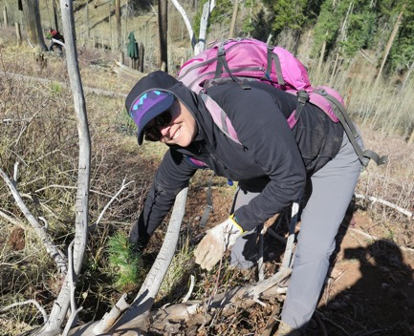
Stewardship takes many forms
Water quality monitoring
Restoring native vegetation
Removing invasive species
Restoration work heals the land and makes it more resilient to climate impacts
Notes:
We can contribute by…
gathering data,
restoring native species, or
repairing entire ecosystems
there are enormous opportunities to enhance our landscapes’ natural climate resilience!
Add your examples: Our broadband (and/or partnering organizations) have… (planted native species, collected water monitoring data, etc. etc.)

Slide 25
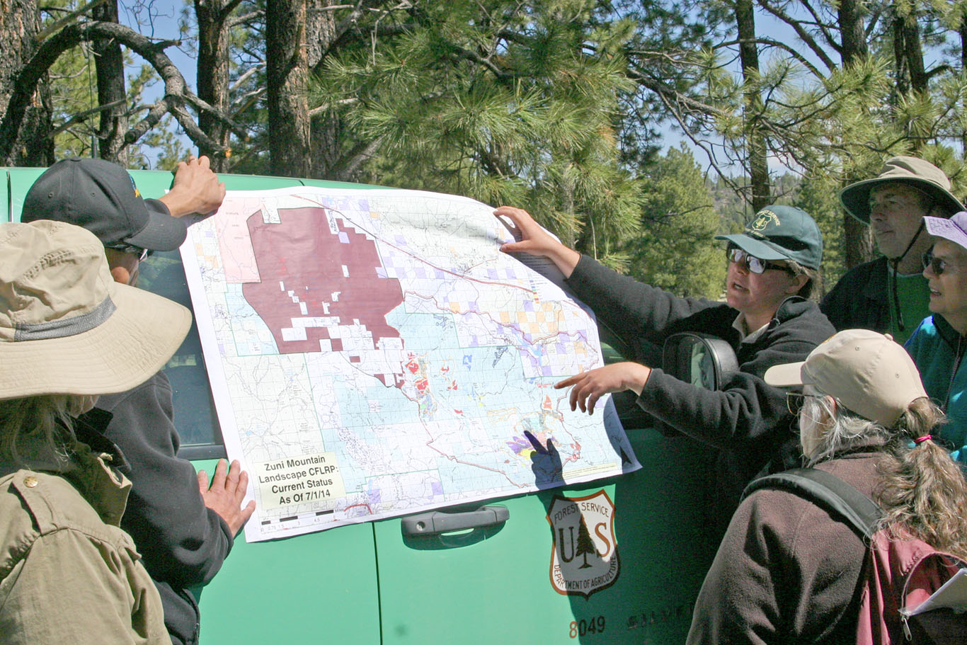
Dive in Deeper
Education – keep the conversation going
Get to know your local public land management agencies
Participate in public land planning processes.
Learn more about the policies in place for local public lands.
Join your local Broadband
Notes:
Plug in your own examples of past accomplishments and ongoing partnerships. Or describe where your Broadband is growing and taking on new roles. This is a great opportunity to talk about the work your Broadband is doing.

Slide 26
Please consider making a tax-deductible donation to Great Old Broads for Wilderness, a 501(c)3 organization, to help continue and expand this program.
We thank you for your support!
www.greatoldbroads.org

