Slide 1
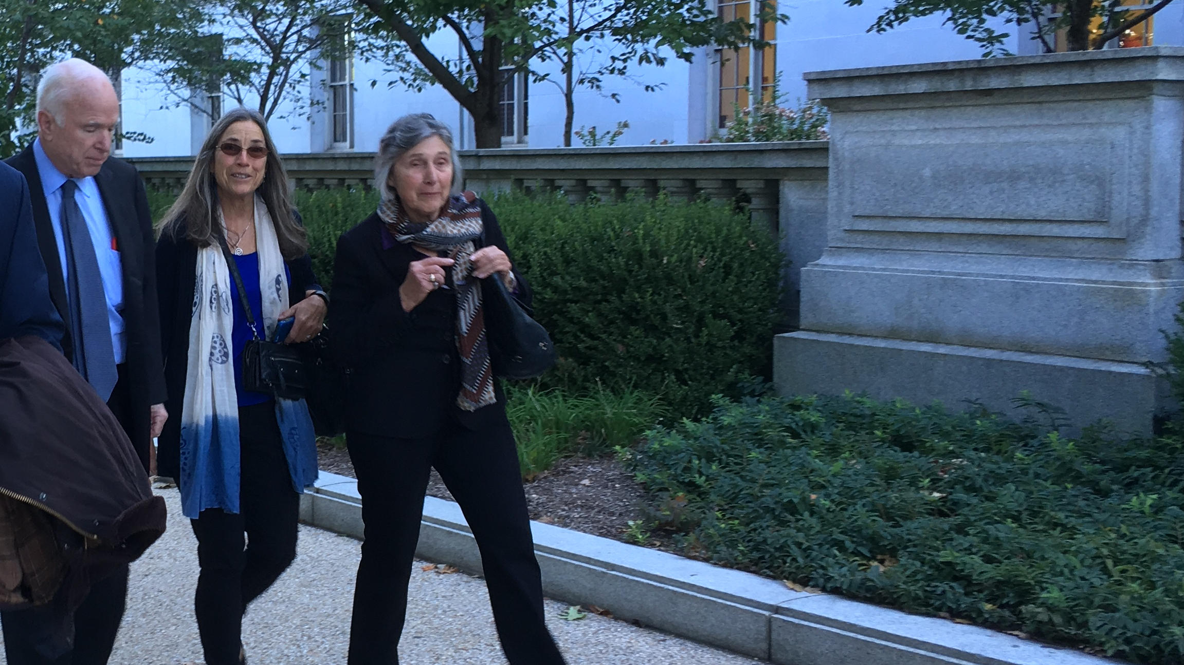
Bills, Elections, & Effective Lobbying
Broadly Navigating the second session of the 115th Congress
Notes:
Picture from Broads DC Broadwalk

Slide 2
Agenda
A Word on Effectiveness
Tracking Congress
Survey of Bills to Know About
Effective Lobbying
Get out the vote: Elections and Great Old Broads
Discussion Throughout

Slide 3
A word on effectiveness
Petitions: Lowest impact.
Calling and writing senators: Low impact.
Personal Meetings with your legislators: Moderate impact.
LTEs/Calling out legislators in the media: Moderate impact.
Packing Town Halls: Moderate-high impact.
Getting out the vote, exposing candidates’ views on public land issues, and inspiring people to vote for public lands. Potentially high impact!

Slide 4
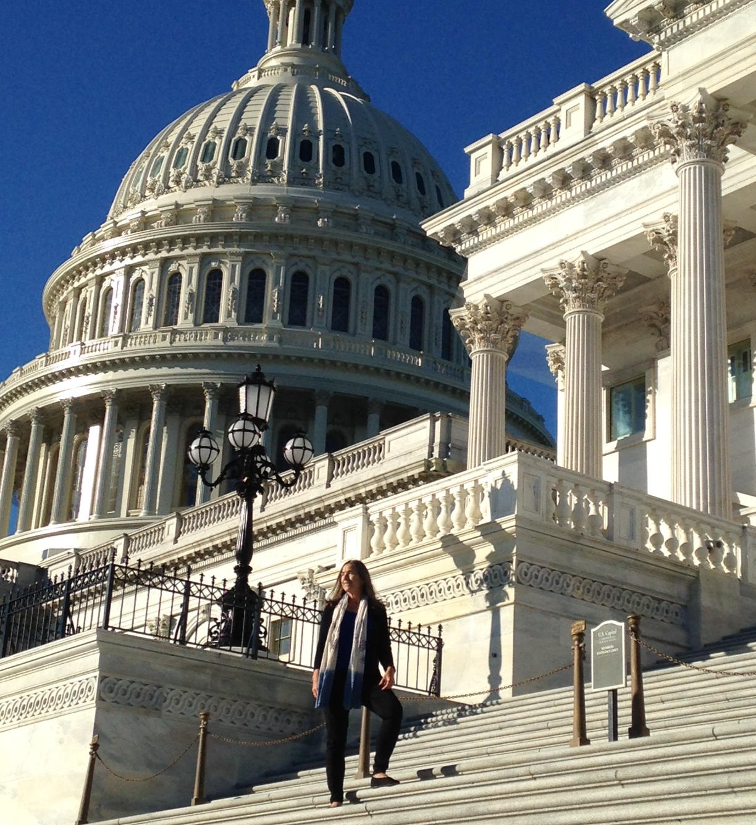
Tracking Congress
Essential Tips for Busy Advocates
Notes:
Picture from Broads DC Broadwalk

Slide 5
Just how busy is Congress?
2,455 Bills in the Senate
5,131 Bills in the House
Thousands of resolutions and amendments
Over 2,000 emails and calls per congressperson per week
Notes:
There’s simply too much to keep track of for any single person. You need tools and a strategy!

Slide 6
Tips for Tracking Congress
Limit your focus and distill important info for chapter members
Spend more effort on bills involving your own state and district’s politicians
When sharing, keep it simple: send just the basics along with clear calls to action
Consider looking at State and local legislative issues closer to you, your impact is often greater the closer you are geographically to the issue.
Get help from environmental groups who keep track
Broads, CBD, TWS, Wilderness Workshop, and Sierra Club are just a few.
Learn simple web skills to research bills quickly
Google for the bill, filter by date and by ‘news’
Look for press releases by environmental groups
Use Govtrack.us
Check sponsors and cosponsors, latest action, and chance to pass
Utilize tracking features & email alerts
Notes:
Wilderness Watch has a great list of bills in the current congress: https://wildernesswatch.org/congress
Wilderness Workshop has a blog you can watch for updates: http://www.wildernessworkshop.org/action/capital-watch/

Slide 7
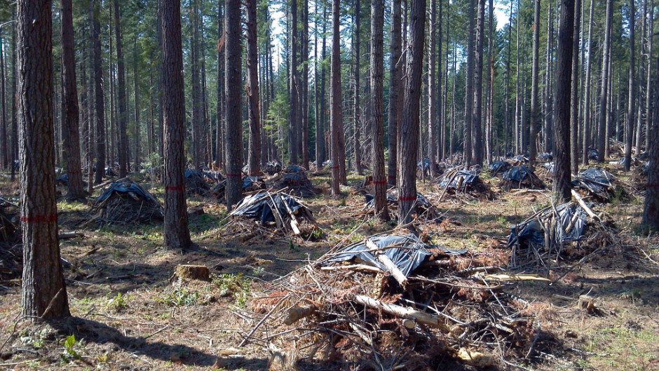
Resilient Federal Forests Act
… aka the Logging Industry Giveaway Act
Notes:
Would exempt up to 30,000 acres of clear-cutting in national forests from any environmental review whatsoever. That’s a 50 square-mile cut, or an area nearly 429 times larger than the current 70-acre exemption for national forest logging projects.
https://docs.google.com/document/d/1CEVqXkZeqEMB6V22BxdWcgwAH0loIcam7iy92TCrazw/edit
Forest thinning, such as this work done in the Umpqua National Forest in Oregon, may be of value for some purposes but will also increase carbon emissions to atmosphere, researchers say. Oregon State University
https://www.opb.org/news/article/researchers-find-more-carbon-from-forest-thinning-/

Slide 8
Resilient Federal Forests Act
Prioritizes timber industry profits and increases the risk of forest fires by gutting environmental safeguards.
Exempts up to 30,000 acre clearcuts from NEPA, 429 times the current 70-acre exemption on national frests.
Fails to fix wildfire funding.
Blocks citizen oversight and government accountability
… aka the Logging Industry Giveaway Act
Notes:
Would exempt up to 30,000 acres of clear-cutting in national forests from any environmental review whatsoever. That’s a 50 square-mile cut, or an area nearly 429 times larger than the current 70-acre exemption for national forest logging projects.
https://docs.google.com/document/d/1CEVqXkZeqEMB6V22BxdWcgwAH0loIcam7iy92TCrazw/edit
Forest thinning, such as this work done in the Umpqua National Forest in Oregon, may be of value for some purposes but will also increase carbon emissions to atmosphere, researchers say. Oregon State University
https://www.opb.org/news/article/researchers-find-more-carbon-from-forest-thinning-/

Slide 9
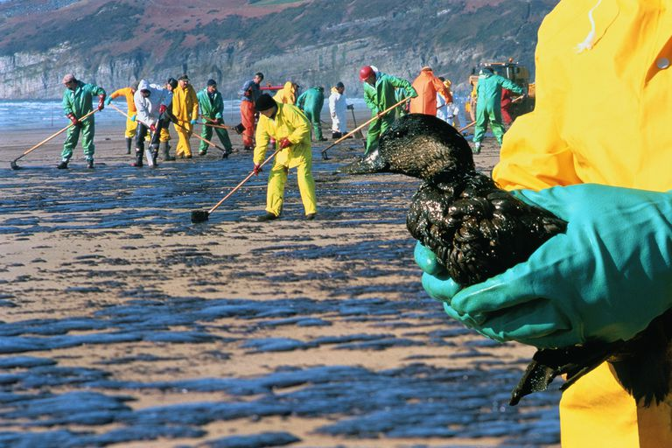
SECURE American Energy Act
… aka the Drill and Spill Forever Act
Notes:
The SECURE Energy Act is a combination of the ONSHORE and ASTRO bills (which are now titles I & II in this new bill) which essentially hand federal land oil and gas management authority to states and significantly roll back marine protections to encourage offshore drilling.
Media Toolkit (Includes many social media samples and links): https://docs.google.com/document/d/1MTqnk-aqVBbT4t0LxMDmROBvL_U0vxOp5Y5yQPyPtRY/edit
The 2010 BP Deepwater Horizon offshore oil spill in the Gulf of Mexico … occurred during prime mating and nesting season for many bird and marine species, and the long-term environmental consequences of that spill won't be known for many years. Oil spills can even disrupt migratory patterns by contaminating areas where migrating birds normally stop.
https://www.thoughtco.com/environmental-consequences-of-oil-spills-1204088

Slide 10
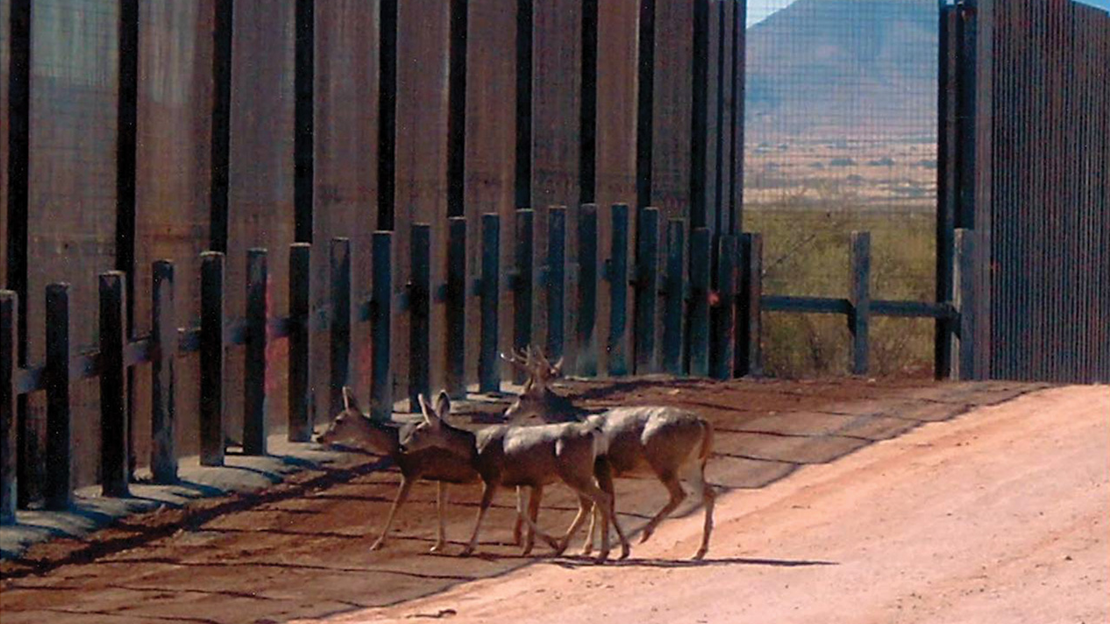
Border Security for America Act
… aka the Wildlife are Illegal Aliens Act
Notes:
CBD Press Release about this issue: http://www.biologicaldiversity.org/news/press_releases/2018/border-wall-02-14-2018.php
Great opinion blog piece on it: http://www.thewildlifenews.com/2018/02/19/border-security-threatens-wildlands/

Slide 11
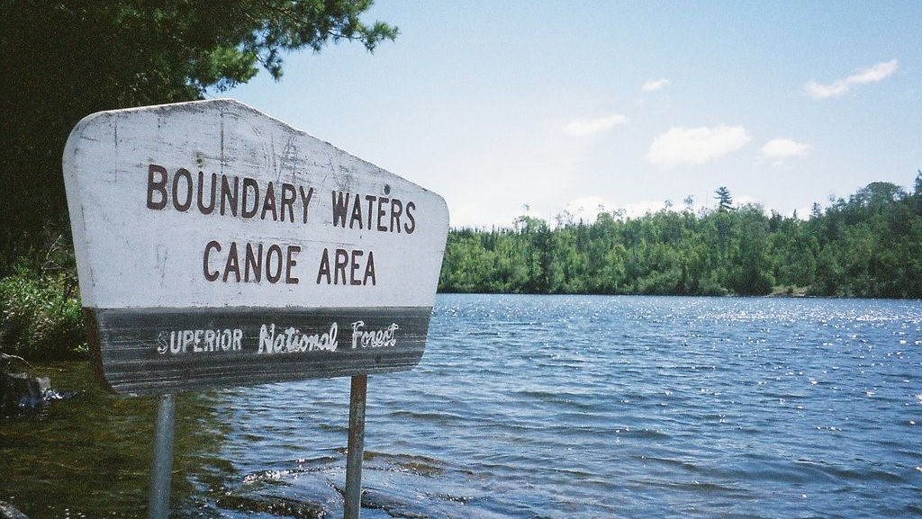
Superior National Forest Land Exchange
… aka the Let’s do toxic mining near the Boundary Waters Act
Notes:
Would thwart current legal proceedings regarding the exchange of 6,650 acres of protected Superior National Forest that PolyMet would like to obtain for its open pit copper-nickel sulfide mine in Minnesota’s Arrowhead Region.
https://www.npca.org/articles/1591-position-on-h-r-3115-superior-national-forest-land-exchange-act

Slide 12
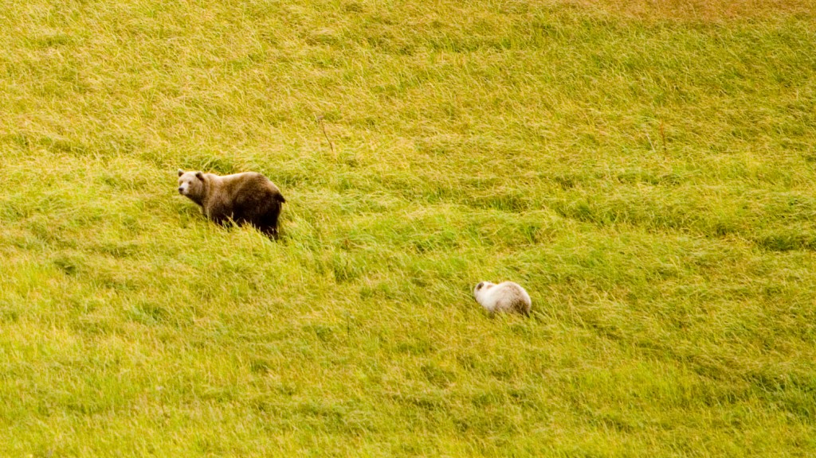
King Cove Road Land Exchange
… aka the Road to Nowhere:
Take Two
Notes:
Sets a dangerous precedent, approving construction of a destructive, unnecessary road through protected wilderness in the vital Izembek National Wildlife Refuge in the Alaska Peninsula.
More info: https://wilderness.org/press-release/us-house-passes-bill-threatening-wilderness-across-America
More about the Road to Nowhere: http://refugeassociation.org/advocacy/refuge-issues/izembek/

Slide 13
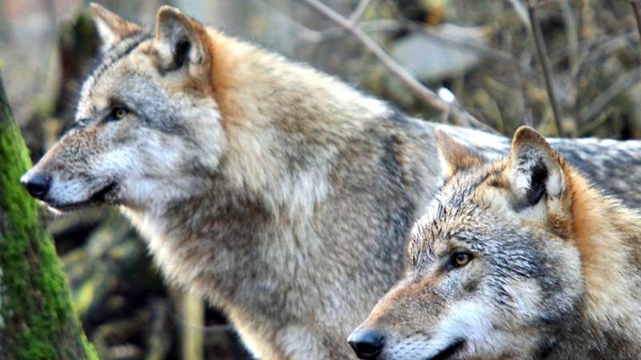
Gray Wolf State Management Act
… aka the War On Wolves Act
Notes:
H.R. 424, a damaging bill that would be more aptly named the “War On Wolves Act,” would override a unanimous D.C. Circuit Court of Appeals decision issued on August 1, 2017 and remove existing Endangered Species Act protections for gray wolves in Michigan, Minnesota, and Wisconsin. This bill would also codify a March 3, 2017 decision by that same appellate federal court that stripped Endangered Species Act protections for wolves in Wyoming. Further, this bill would preclude judicial review of the two agency wolf delistings at issue and thus sets a damaging trend for undermining all laws that allow citizens from across the political spectrum to go to court to hold the government accountable for its actions.
https://newsroom.defenders.org/house-committee-moves-to-gut-the-endangered-species-act/

Slide 14
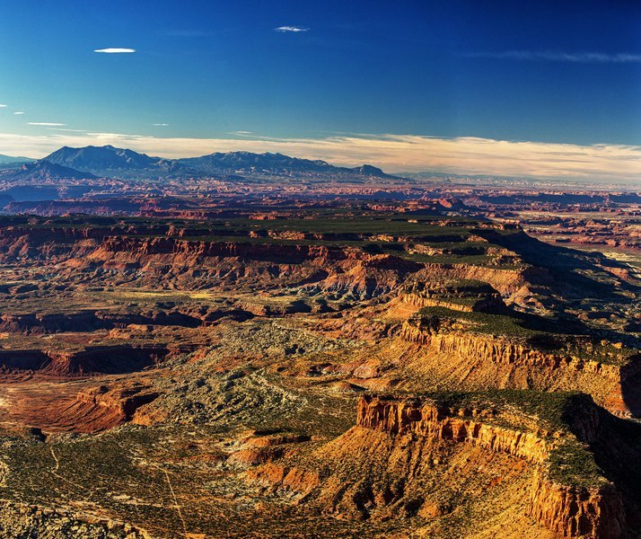
Attacks on Monuments & the Antiquities Act
Notes:
Check out the Broads action alert on Shash Jaa and GSENM Enhancement: http://conta.cc/2GkcmNW

Slide 15
Attacks on Monuments & the Antiquities Act
Bills Enshrining Trump’s Monumental Mistake
Shash Jaa National Monument and Indian Creek National Monument Act
Grand Staircase-Escalante Enhancement Act
Gutting Presidential Power to set Antiquities
National Monument Creation and Protection Act
Attempt to Save Monuments and the Antiquities Act
ANTIQUITIES Act
Bear's Ears National Monument Expansion Act
Notes:
Check out the Broads action alert on Shash Jaa and GSENM Enhancement: http://conta.cc/2GkcmNW

Slide 16
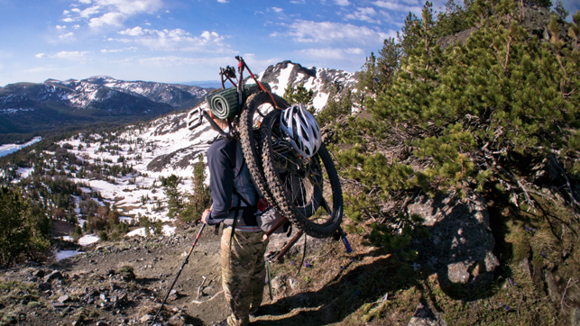
Bikes in Wilderness
… aka the Bikes are Primitive Recreation Act
Notes:
Terrible bill that opens up Wilderness to bikes and other wheeled contraptions at the discretion of land managers.
Check out the Broads action alert on this bill: http://conta.cc/2GkcmNW

Slide 17
Effective Lobbying
Work mainly with your politicians. Politicians often don’t pay much attention unless you are their constituent.
Handwritten letters beat emails in effectiveness.
Calls and letters are fine, but mentioning a politician by name in LTEs and other widespread media (such as media coverage of a direct action like a rally or speech) may better grab their attention.
When meeting politicians, visit in a group and have a clear & concise written version of your position with relevant research to provide to them and their staff.
Packing town halls has been a very effective strategy to pressure politicians and affect change and give stacks of letters in a public way.

Slide 18
Get out the vote!
Elections and Great Old Broads

Slide 19
Elections and Broads
If Broads is found electioneering, it places our 501(c)(3) status in serious jeopardy.
As a representative of Broads you can fully and passionately endorse positions on issues relating to Broads and our mission.
You cannot represent Broads on any occasions where you endorse voting for or against specific candidates for government office.
Non-governmental offices such as local energy cooperatives are fair game!

Slide 20
Election Do’s and Don’ts
DO expose and question politician’s positions on public land issues
DO register all people regardless of their positions to vote
DO NOT endorse voting for or against a specific candidate for government office as a representative of Broads.
DO organize candidate forums and questionnaires, giving candidates totally equal opportunities to attend and respond
DO attend town halls and hold politicians accountable for their actions
DO NOT invite an individual candidate to speak to your group alone.
PLEASE DO participate in endorsing candidates you care about as a citizen and as a member of other groups you align with, just never as representative of Broads

Slide 21
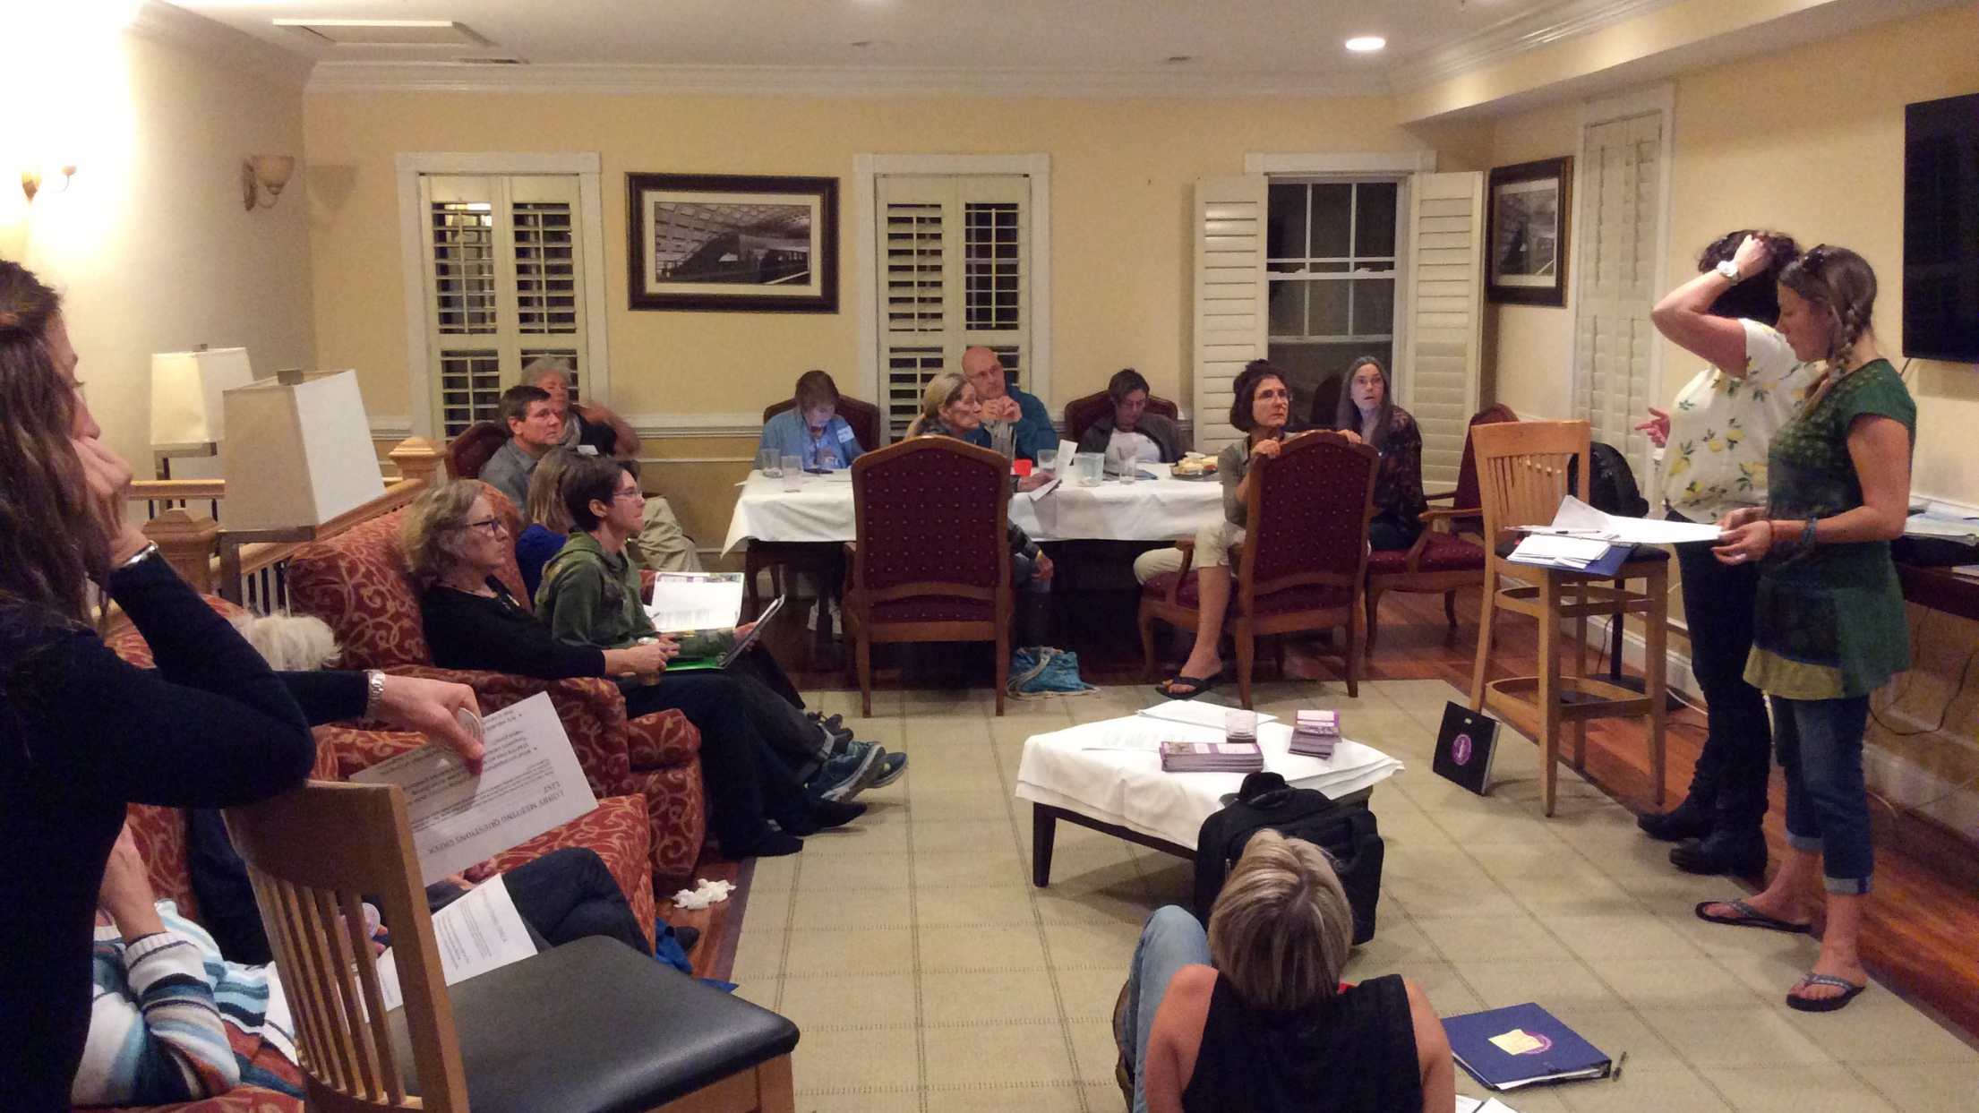
Thank You!
Lionel Di Giacomo, lionel@greatoldbroads.org Research and Advocacy Associate
Carrie King, carrie@greatoldbroads.org Associate Director
Notes:
Picture from Broads DC Broadwalk 2017

