Slide 1
White Mesa Cultural and Conservation Area
2015 & 2016 Research
Prepared by Sue Smith (suejs01@yahoo.com)
Masters in Natural Resource Management Candidate, Utah State 10/15/16

Slide 2
Participants
Project Lead: Sue Smith, Utah State University
Masters in Natural Resource Management candidate
Advisors
Dr. Mary O’Brien, Grand Canyon Trust
Dr. Fee Busby, Utah State University
Dr. Doug Tolleson, University of Arizona, V-Bar-V Ranch
Field Work Performed in 2 Seasons by
3 Grand Canyon Trust Employees
7 Summer Interns
20 Volunteers

Slide 3
Study Area
Southeastern Utah
Manti-La Sal National Forest
White Mesa Cultural and Conservation Area
Gooseberry cattle allotment
Grazing withheld since 2000 except for trespass cattle
Three vegetation cover types
Rocky Mountain Aspen Forest and Woodland (Aspen Woodland)
Rocky Mountain Subalpine Mesic Meadow (Mesic Meadow)
Rocky Mountain Ponderosa Pine Woodland (Ponderosa Pine)

Slide 4
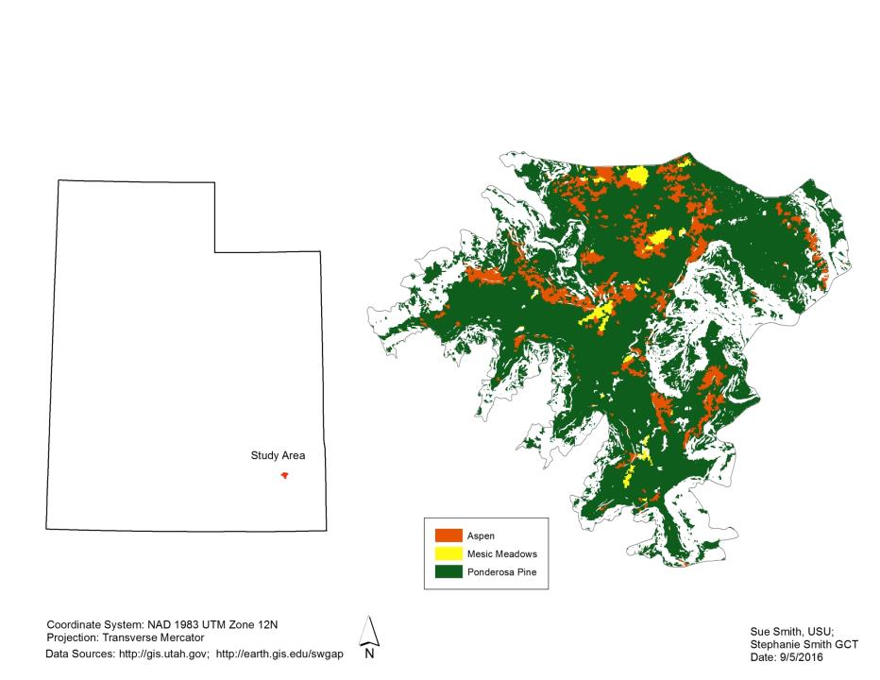
Study Area – White Mesa and Cultural Conservation Area

Slide 5
Research Questions
What is the current composition and cover of native/exotic grass species?
Are there differences in native/exotic grass species and their composition within similar plant communities and soil types?
What is the current composition and cover of rhizomatous smooth brome (Bromus inermis) and Kentucky bluegrass (Poa pratensis) and other exotic grass species?

Slide 6
Survey Plots
Upslope band
Survey plots defined as
Random centroid
Three 50-meter transects
25 meter distance between transects
1-meter x 50-meter upslope band on each transect
Used for exotic grass frequency and species richness
15 plots surveyed per land cover
25 m
Centroid
slope
25 m
25 m
25 m

Slide 7
Plot Centroid Selection
Landcover maps from Southwest Regional Gap
Restricted to mesa tops as defined for the White Mesa Cultural and Conservation Area (Gooseberry allotment)
Generated by Geospatial Modeling Environment random point generator
Buffered 100 meters from
Roads
Riparian areas
Previous studies by Matt Van Scoyoc

Slide 8
Protocols
Study Objective | Protocols
Vegetation composition (%) | Line-point intercept
Bare ground (%) | Line-point intercept
Plant basal cover (%) | Line-point intercept
Foliar cover (%) | Line-point intercept
Species richness | Line-point intercept plus 1-meter band upslope of each transect, number of unique species
Frequency of exotic grass | Scanned 1-meter square every 5 meters in upslope band of each transect ( added 10cm, 40cmto determine size for sensitivity to changes in frequency)
Plot Characterization | Signs of human or wildlife usage; soil characteristics and slope characteristics
Photos | Record of transects, plot centroid and other plot characteristics

Slide 9
Aspen Woodlands Key Observations
Existing aspen stands are reaching the end of their life cycle without young aspen trees to replace them
Snowberry (Symphoricarpus oreophilus)
Exceeds 20% of the understory composition in 7/15 plots
Increaser, displaced native grasses under cattle grazing?
Native grasses
0 to 52% of understory composition
Exotic grasses
1% to 78% of understory composition

Slide 10
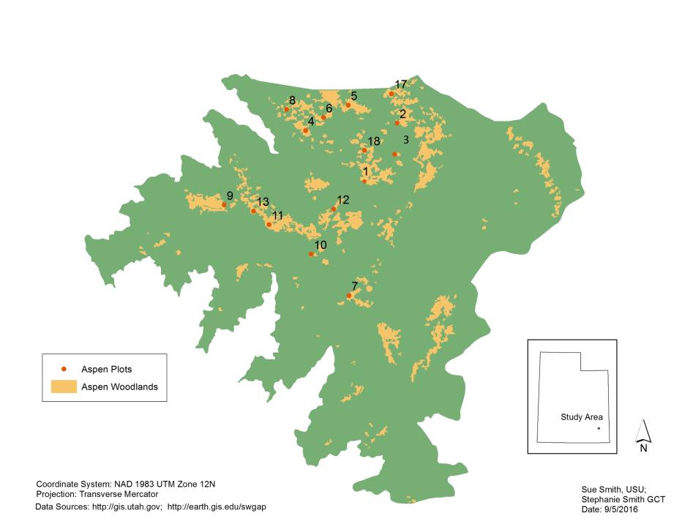
Aspen Woodland Plots

Slide 11
Aspen Woodlands Vegetation Composition Summary
Plot ID | Native Grasses | Exotic Grasses | Forbs | Sedges & Rushes | Shrubs & Trees | Collected for ID | Unknowns not Collected
AW01 | 20% | 27% | 16% | 2% | 35% | 0% | 0% | 100%
AW02 | 10% | 44% | 19% | 0% | 27% | 0% | 0% | 100%
AW03 | 0% | 75% | 20% | 0% | 5% | 0% | 0% | 100%
AW04 | 20% | 29% | 17% | 1% | 33% | 0% | 0% | 100%
AW05 | 14% | 33% | 23% | 1% | 28% | 0% | 0% | 100%
AW06 | 32% | 21% | 25% | 1% | 21% | 0% | 0% | 100%
AW07 | 2% | 78% | 16% | 0% | 2% | 2% | 0% | 100%
AW08 | 20% | 41% | 22% | 0% | 18% | 0% | 0% | 100%
AW09 | 28% | 36% | 24% | 0% | 12% | 0% | 0% | 100%
AW10 | 52% | 1% | 31% | 0% | 15% | 0% | 0% | 100%
AW11 | 23% | 15% | 31% | 0% | 31% | 0% | 0% | 100%
AW12 | 36% | 8% | 25% | 0% | 30% | 0% | 0% | 100%
AW13 | 37% | 19% | 16% | 1% | 26% | 1% | 0% | 100%
AW17 | 19% | 45% | 14% | 0% | 22% | 0% | 0% | 100%
AW18 | 36% | 25% | 36% | 0% | 3% | 0% | 0% | 100%

Slide 12
Aspen Woodlands Exotic Grass Frequencies Occurrence in 1M squares
Plot ID | Bromus inermis | Dactylis glomerata | Phleum pratense | Poa pratensis
AW01 | 90% | 53% | 3% | 100%
AW02 | 0% | 0% | 0% | 97%
AW03 | 0% | 0% | 0% | 93%
AW04 | 10% | 3% | 0% | 70%
AW05 | 13% | 10% | 3% | 100%
AW06 | 10% | 53% | 0% | 60%
AW07 | 60% | 53% | 13% | 97%
AW08 | 50% | 3% | 0% | 100%
AW09 | 0% | 0% | 0% | 100%
AW10 | 0% | 0% | 0% | 87%
AW11 | 0% | 0% | 0% | 63%
AW12 | 0% | 0% | 0% | 67%
AW13 | 3% | 0% | 0% | 97%
AW17 | 90% | 90% | 13% | 47%
AW18 | 0% | 0% | 0% | 90%

Slide 13
Aspen Woodlands Foliar Cover, Basal Cover, Bare Ground and Species Richness
Plot ID | Foliar Cover | Basal Cover | Bare Ground | Soil Type | Species Richness
AW01 | 38% | 1% | 0% | Loam | 35
AW02 | 65% | 0% | 1% | Silty loam | 30
AW03 | 48% | 1% | 0% | Silty loam | 26
AW04 | 91% | 0% | 0% | Loam | 30
AW05 | 21% | 0% | 2% | Clay loam | 33
AW06 | 47% | 0% | 0% | Sandy loam | 27
AW07 | 45% | 0% | 0% | Silty loam | 28
AW08 | 25% | 0% | 1% | Loam | 29
AW09 | 25% | 1% | 5% | Sandy clay loam | 33
AW10 | 53% | 0% | 0% | Sandly loam | 30
AW11 | 61% | 0% | 0% | Sandy loam | 34
AW12 | 66% | 0% | 0% | Sandy loam | 33
AW13 | 96% | 0% | 0% | Loam | 32
AW17 | 99% | 0% | 1% | Silty loam | 33
AW18 | 88.0% | 0.7% | 2.0% | Sandy clay loam | 33

Slide 14
Mesic Meadows Key Observations
Native grasses
0 to 36% of vegetation composition
4 plots had 0% native grasses
2 additional plots had 1% to 5% native grasses
12 of 15 plots under 20% native grasses
Exotic grasses
20% to 75% of vegetation composition
Smooth brome (Bromus inermis)
34% of exotic grasses
Kentucky bluegrass (Poa pratensis)
63% of exotic grasses
Timothy (Phleum pratense)
14% of exotic grasses

Slide 15
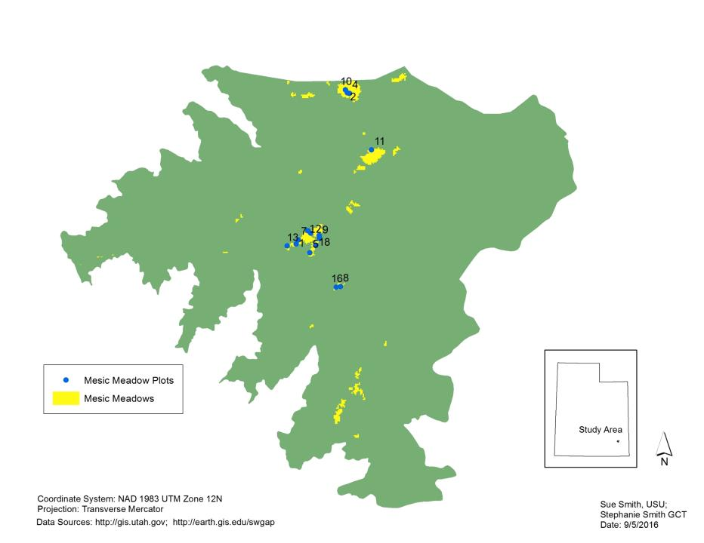
Mesic Meadow Plots

Slide 16
Mesic Meadows Vegetation Composition Summary
Plot ID | Native Grasses | Exotic Grasses | Forbs | Sedges & Rushes | Shrubs & Trees | Collected for ID | Unknowns
Meadow 1 - MM02 | 0% | 55% | 30% | 0% | 14% | 1% | 0% | 100%
Meadow 1 - MM04R | 0% | 54% | 36% | 0% | 9% | 0% | 0% | 100%
Meadow 1 – MM10 | 0% | 55% | 36% | 0% | 8% | 0% | 0% | 100%
Meadow 2 –MM11R | 0% | 73% | 21% | 0% | 6% | 0% | 0% | 100%
Meadow 3 – MM08 | 1% | 75% | 19% | 2% | 1% | 2% | 0% | 100%
Meadow 3 – MM16 | 11% | 63% | 23% | 1% | 0% | 1% | 0% | 100%
Meadow 4 – MM01 | 16% | 34% | 50% | 0% | 0% | 0% | 0% | 100%
Meadow 4 – MM05 | 11% | 35% | 54% | 0% | 0% | 0% | 0% | 100%
Meadow 4 – MM07 | 36% | 26% | 37% | 0% | 0% | 1% | 0% | 100%
Meadow 4 – MM09 | 3% | 45% | 52% | 0% | 0% | 0% | 0% | 100%
Meadow 4 – MM12 | 21% | 32% | 47% | 0% | 0% | 0% | 0% | 100%
Meadow 4 – MM13R | 12% | 36% | 48% | 0% | 0% | 3% | 1% | 100%
Meadow 4 – MM14 | 18% | 20% | 61% | 0% | 0% | 0% | 1% | 100%
Meadow 4 – MM17 | 18% | 29% | 53% | 0% | 0% | 0% | 0% | 100%
Meadow 4 – MM18 | 17% | 23% | 58% | 0% | 0% | 1% | 1% | 100%

Slide 17
Mesic Meadows Exotic Grass Frequencies Occurrence in 1M squares
Plot ID | Bromus inermis | Dactylis glomerata | Phleum pratense | Poa pratensis
Meadow 1 - MM02 | 67% | 60% | 50% | 67%
Meadow 1 - MM04R | 87% | 30% | 97% | 93%
Meadow 1 – MM10 | 97% | 0% | 83% | 87%
Meadow 2 –MM11R | 90% | 0% | 13% | 100%
Meadow 3 – MM08 | 57% | 0% | 100% | 87%
Meadow 3 – MM16 | 73% | 0% | 37% | 93%
Meadow 4 – MM01 | 0% | .0% | 0% | 90%
Meadow 4 – MM05 | 0% | 0% | 0% | 97%
Meadow 4 – MM07 | 0% | 0% | 0% | 93%
Meadow 4 – MM09 | 0% | 0% | 0% | 93%
Meadow 4 – MM12 | 0% | 0% | 0% | 100%
Meadow 4 – MM13R | 0% | 0% | 0% | 100%
Meadow 4 – MM14 | 13% | 0% | 0% | 63%
Meadow 4 – MM17 | 7% | 0% | 0% | 90%
Meadow 4 – MM18 | 3% | 0% | 0% | 90%

Slide 18
Mesic Meadows Foliar Cover, Basal Cover, Bare Ground and Species Richness
Plot ID | Foliar Cover | Basal Cover | Bare Ground | Bare Ground | Species Richness
Meadow 1= MM02 | 86.0% | 22.7% | 3.3% | Silty Loam | 24
Meadow 1= MM04R | 88.7% | 1.3% | 2.7% | Silty Loam | 18
Meadow 1= MM010 | 90.0% | 4.0% | 2.0% | Silty Loam | 18
Meadow 2 - MM11R | 90.7% | 1.3% | 0.7% | Silty Loam | 26
Meadow 3 - MM08 | 96.0% | 0.0% | 0.7% | Silty Loam | 26
Meadow 3 - MM16 | 93.3% | 2.0% | 2.7% | Silty Loam | 24
Meadow 4 -MM01 | 86.7% | 18.7% | 5.3% | Silty Loam | 20
Meadow 4 -MM05 | 82.7% | 7.3% | 12.0% | Clay Loam | 22
Meadow 4 -MM07 | 80.7% | 16.7% | 11.3% | Silty Loam | 21
Meadow 4 -MM09 | 74.7% | 3.3% | 19.3% | Silty Loam | 23
Meadow 4 -MM12 | 94.0% | 9.3% | 2.7% | Clay Loam | 23
Meadow 4 -MM13R | 78.7% | 17.3% | 16.0% | Silty Loam | 27
Meadow 4 -MM14 | 81.3% | 0.0% | 6.7% | Clay Loam | 25
Meadow 4 -MM17 | 81.3% | 2.7% | 11.3% | Silty Clay Loam | 26
Meadow 4 -MM18 | 86.7% | 0.7% | 8.7% | Silty Loam | 32

Slide 19
Ponderosa Pine Forest Key Observations
Exotic grass composition
4% to 45%
Native grass composition
0% to 61%
Kentucky bluegrass (Poa pratensis)
17% of understory composition
89% of exotic grasses
Smooth brome (Bromus inermis)
1% of understory composition

Slide 20
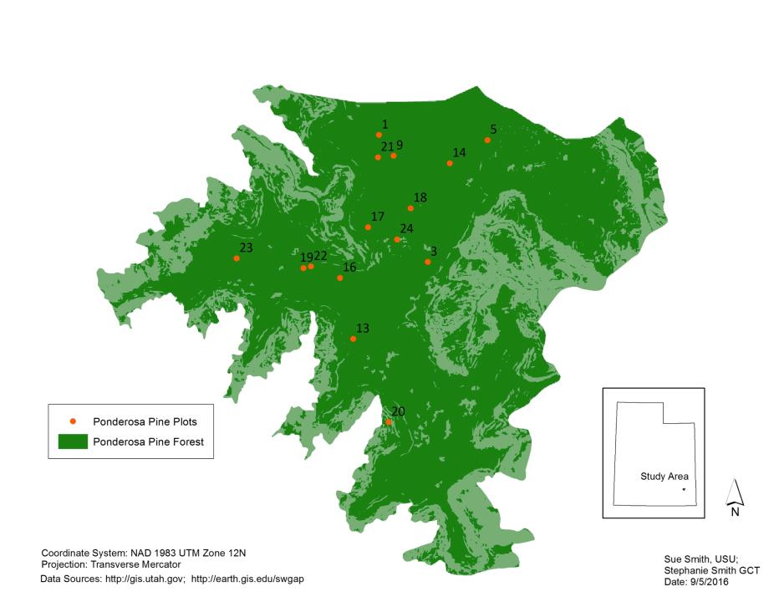
Ponderosa Pine Plots

Slide 21
Ponderosa Pine Vegetation Composition
 | Native Grasses | Exotic Grasses | Forbs | Sedges & Rushes | Shrubs | Collected - for ID | Unknown Forbs
PP01R | 29% | 19% | 21% | 0% | 29% | 1% | 1% | 100%
PP03R | 38% | 8% | 38% | 0% | 9% | 0% | 8% | 100%
PP05 | 0% | 31% | 9% | 1% | 49% | 1% | 9% | 100%
PP09R | 60% | 11% | 16% | 0% | 10% | 0% | 2% | 100%
PP13 | 46% | 8% | 23% | 0% | 22% | 0% | 0% | 100%
PP14 | 47% | 10% | 20% | 1% | 22% | 0% | 1% | 100%
PP16 | 48% | 4% | 26% | 0% | 12% | 0% | 10% | 100%
PP17 | 12% | 14% | 17% | 10% | 47% | 0% | 0% | 100%
PP18 | 15% | 43% | 15% | 0% | 26% | 0% | 0% | 100%
PP19 | 31% | 17% | 23% | 0% | 23% | 0% | 6% | 100%
PP20R | 30% | 23% | 18% | 3% | 26% | 0% | 0% | 100%
PP21R | 36% | 24% | 24% | 0% | 15% | 0% | 2% | 100%
PP22R | 46% | 12% | 17% | 0% | 25% | 0% | 0% | 100%
PP23R | 12% | 45% | 21% | 0% | 3% | 13% | 7% | 100%
PP24R | 27% | 8% | 31% | 1% | 31% | 0% | 1% | 100%

Slide 22
Ponderosa Pine Exotic Grass Frequencies Occurrence in 1M squares
Plot ID | Agropyron cristatum | Bromus inermis | Poa bulbosa | Poa pratensis
PP01R | 0% | 7% | 0% | 30%
PP03R | 0% | 0% | 0% | 40%
PP05 | 0% | 0% | 0% | 90%
PP09R | 0% | 3% | 0% | 17%
PP13 | 0% | 0% | 0% | 27%
PP14 | 0% | 60% | 0% | 40%
PP16 | 0% | 0% | 0% | 20%
PP17 | 0% | 13% | 0% | 50%
PP18 | 0% | 0% | 0% | 33%
PP19 | 0% | 7% | 0% | 33%
PP20R | 0% | 0% | 13% | 37%
PP2!R | 0% | 17% | 0% | 33%
PP22R | 0% | 0% | 0% | 43%
PP23R | 0% | 17% | 0% | 63%
PP24R | 3% | 0% | 0% | 30%

Slide 23
Ponderosa Pine Foliar Cover, Basal Cover, Bare Ground and Species Richness
Plot ID | Foliar Cover | Basal Cover | Bare Ground | Soil Type | Species Richness
PP01R | 83% | 3% | 5% | Clay Loam | 23
PP03R | 61% | 1% | 7% | Clay Loam | 23
PP05 | 69% | 3% | 1% | Clay Loam | 23
PP09R | 81% | 3% | 3% | Clay Loam | 23
PP13 | 97% | 3% | 1% | Sandy Clay Loam | 22
PP14 | 76% | 2% | 1% | Loam | 24
PP16 | 77% | 3% | 2% | Clay Loam | 25
PP17 | 87% | 0% | 4% | Silty Clay Loam | 32
PP18 | 77% | 5% | 7% | Clay Loam | 26
PP19 | 83% | 7% | 3% | Clay Loam | 27
PP20R | 83% | 3% | 1% | Clay Loam | 29
PP2!R | 85% | 4% | 6% | Silty Clay Loam | 25
PP22R | 79% | 0% | 3% | Clay Loam | 31
PP23R | 87% | 3% | 1% | Loam | 25
PP24R | 67% | 3% | 9% | Sandy Clay Loam | 27

Slide 24
Beyond 2016
What management practices will support biodiversity, preserve aspen woodlands, promote native grasses and diminish exotic grasses?
Select and establish survey plots to monitor management practices on the expansion or contraction of native and exotic grasses and aspen woodlands
Active management areas
Fire treatments
Exclosures
Grazing removal
Areas without active management for comparison

