Slide 1
Power Mapping
A Visual Tool to Help Create a Plan of Action

Slide 2
Power mapping ~ A very general definition: A visual tool used by advocates to identify the best individuals to target in order to effect change
Map your community around an issue
Map your target on a campaign

Slide 3
Power Mapping a Target
Important Steps/Questions:
What’s the problem, campaign, or issue?
What is your measurable goal? What is the solution?
Is there a particular person/entity/decision-maker who can give this to you? Who?
Who are the adversaries and can you influence them or prepare for their opposition?
Power Map your target
What’s next? Determine your plan to apply pressure on your target.

Slide 4
Power Mapping a Target
Campaign: Advocate for the inclusion of the Community Conservation Proposal in the draft EIS of the GMUG Forest Plan preferred alternative (and other alternatives)
Problem: We have yet to obtain the support of Ouray Board of County Commissioners (BOCC) for the Community Conservation Proposal and the USFS pays a lot of attention to the opinion of the County elected officials during the planning process.
Goal: Obtain letter of support from Ouray BOCC

Slide 5
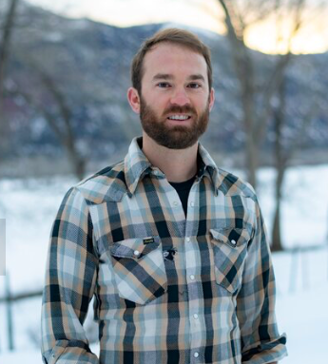
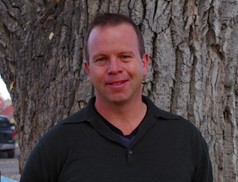
Who are the decision-makers that can help us achieve our goal?
Jake Niece
Lynn Padgett
Ben Tisdel
Ouray County Commissioners

Slide 6
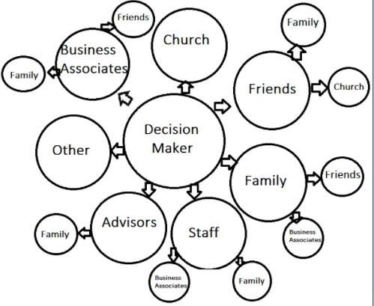
Who can influence our target?

Slide 7
What questions do you have before we power map our targets?
Move to whiteboard

Slide 8
What Next? Networking with a clear request
The messenger matters – Who has most influence and possesses the knowledge?
Communication skills matter – Who can deliver the message and ask respectfully and deliberately?
Timing matters – When are you most likely to achieve your ask? What factors are at play?
Follow up matters – Kind reminders with follow up emails and/or phone calls

Slide 9
Who might be our adversaries?
Motorized community and businesses who offer them services?
Mountain Bikers?
Ranchers/water users?
Others?
Can we influence them? Educate them? Assuage concerns? Just anticipate their opposition?

Slide 10
Questions Discussion

