Slide 1
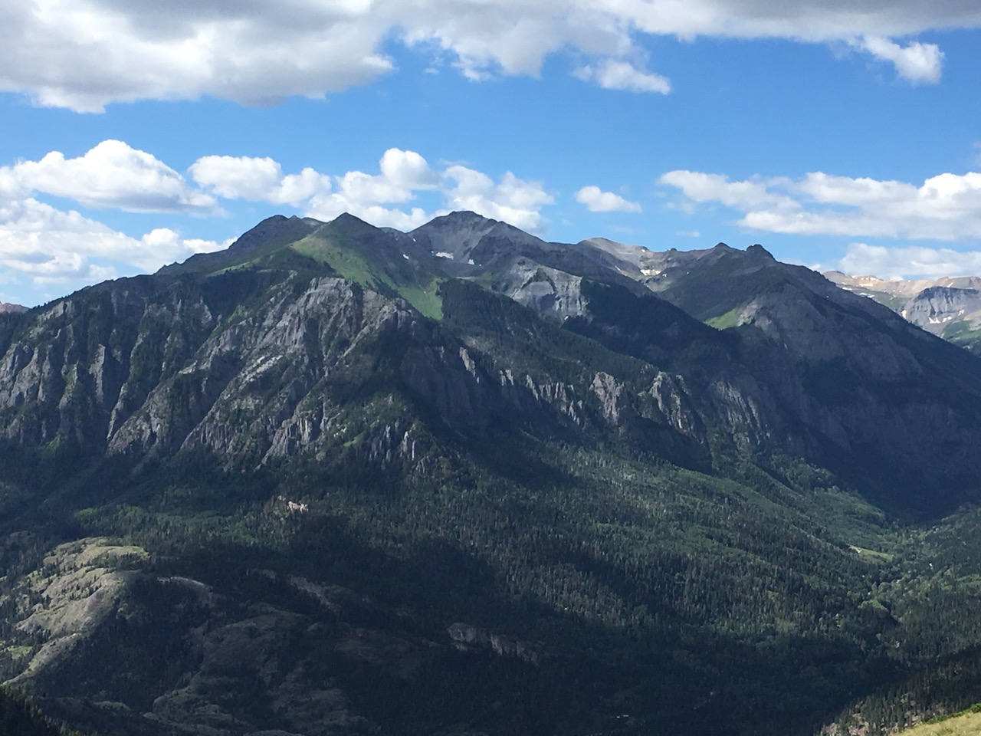
Wilderness Solitude Monitoring
Great Old Broads for Wilderness ~ Robyn Cascade ~ June 1, 2020

Slide 2
Wilderness Solitude Monitoring
What is it?
Why do we do it?
Where do we do it?
When do we do it?
How do we do it?

Slide 3
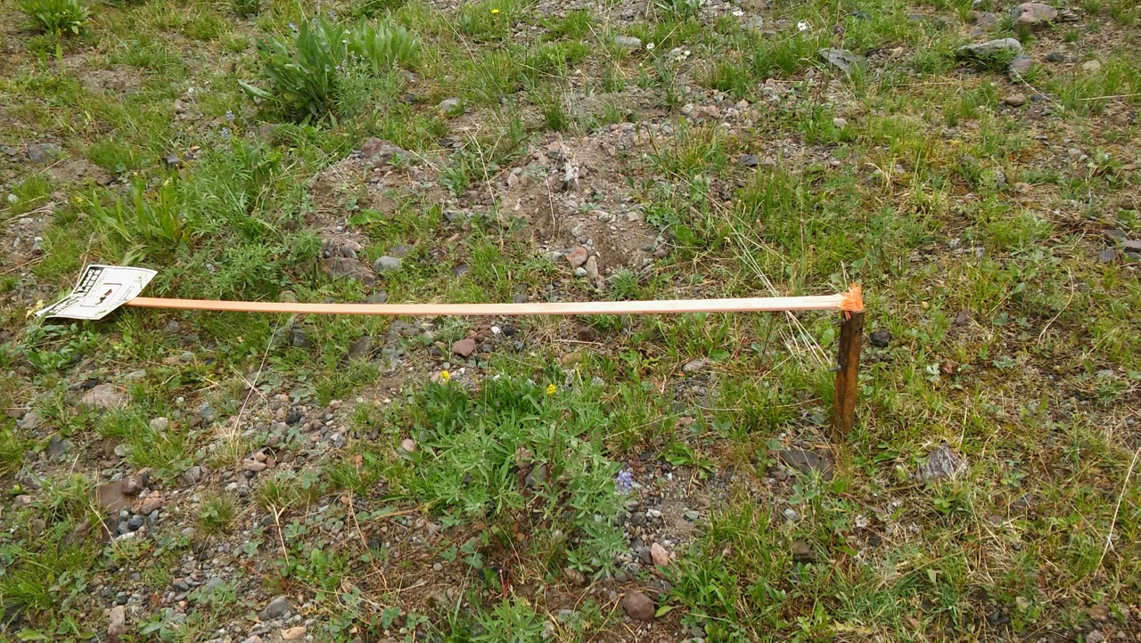
What is it?
Travelling encounter monitoring
Campsite monitoring
Optional: signs, trash, weeds, trail conditions, grazing

Slide 4
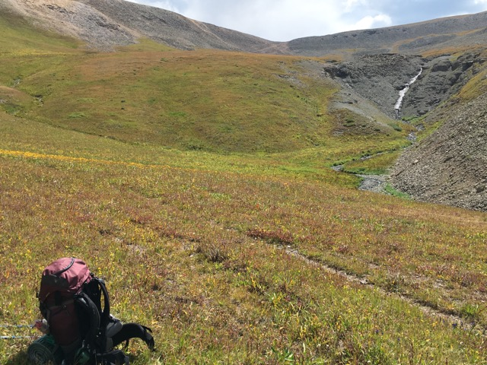
Why do we do it?
USFS
5 year project
Wilderness Stewardship Performance
Inventory of opportunities for solitude

Slide 5
Where do we do it?
INSIDE WILDERNESS BOUNDARY
Mount Sneffels Wilderness
Blue Lakes Trail
Uncompahgre Wilderness
West Fork Cimarron River
Middle Fork Cimarron River
East Fork Cimarron River
Fall Creek

Slide 6
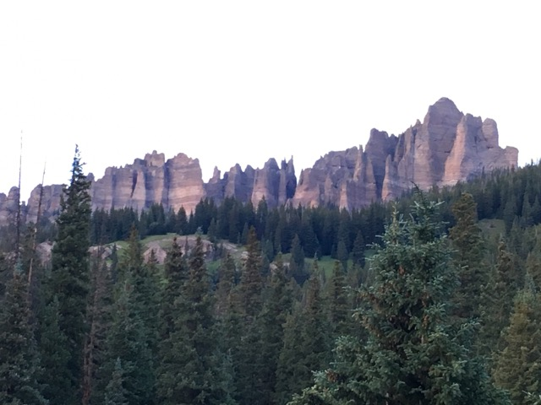
When do we do it?
~Memorial Day to October 15
Weekdays & Weekends/Holidays
Recommended ~ 8:00am -6:00pm

Slide 7
How do we do it? Travelling Encounter
Begin anywhere within wilderness boundary
Encounter = any time at least one person is seen or heard
Minimum 4 hours per survey per trail
Can be two 2-hour session
Can be during an overnight trip with hours on two consecutive days AS LONG AS both days are either weekdays or weekend days.
Let’s look at the data recording sheet.

Slide 8
How do we do it? Campsite Encounter
Stand at the edge of every campsite you see.
Record a description of the campsite location.
Report how many other campsites are seen or heard from this point.
If you neither see nor hear another camper or campsite, record a zero in right column.
Go to the next campsite and repeat the steps above.
Let’s look at Carol’s diagram

Slide 9
Questions?? Experiences to share??
THANK YOU FOR MONITORING!!!

